Slide 1
Increasing Engagement, Decreasing Barriers
Adero C. E. Allison, Ph.D.
Assistant Director – Alternative Media
EOSS – Disability Resource Center

Slide 2
The advent of the microchip has been a boon for people with vision loss…The result has been a virtual explosion of opportunity for independent reading and writing by people who cannot use print.
How Technology Brings Blind People into the Workplace - Julia Anderson
Retrieved 4-16-2019 from https://hbr.org/1989/03/how-technology-brings-blind-people-into-the-workplace
Notes:
Until the advent of GUIs, PCs, minicomputers, and mainframe terminals were operated by command line interfaces (CLIs).
1990, with the introduction of Windows 3.0

Slide 3
What next? Retrieved on 4-16-2019 from A Short History of Computer User Interface Design on April 20, 2016 / by Daniel Rounds https://usabilla.com/blog/short-history-computer-user-interface-design/
Notes:
User Interfaces have moved from textual command inputs to include: keyboards and mouse cursors, touch pads and voice inputs, virtual interfaces and more. Future probabilities include gesture functionality, brain computer interfaces and augmented reality.

Slide 4
UDL
Accessible
WCAG 2.0
Multiple Means of:
Representation
Action and Expression
Engagement
Understandable
Approachable
Attainable
Perceivable
Understandable
Operable
Robust

Slide 5
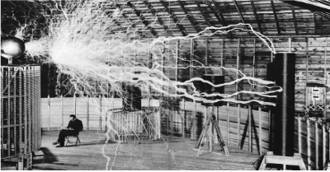
Access to address Visual Limitations
“Man sitting in Lab”
Vs.
"Tesla sitting taking notes near a 10ft cylinder sending electrical charges to a smaller cylinder across the lab.”
Notes:
GB Do I have to alt Text everything? What about design elements in a presentation slide deck?

Slide 6
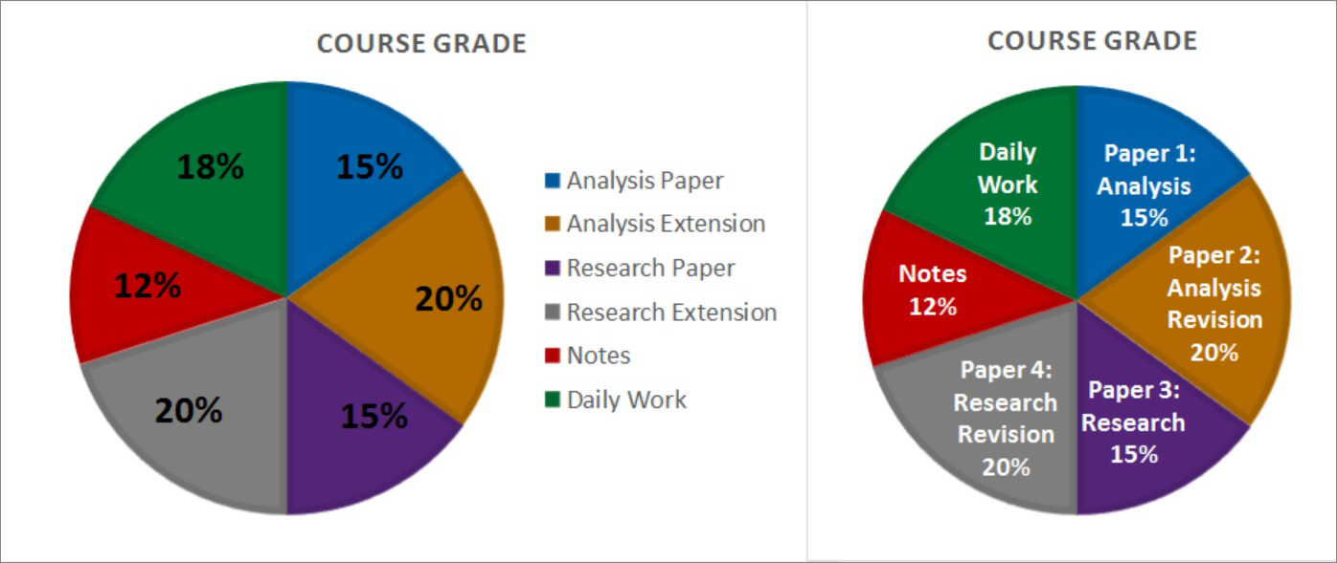
Multimodal Content Creation
Color is often used to convey information but not everyone benefits.

Slide 7
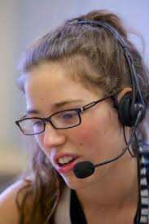
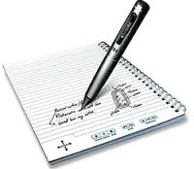
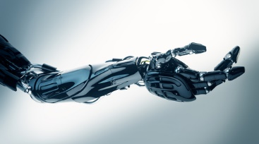
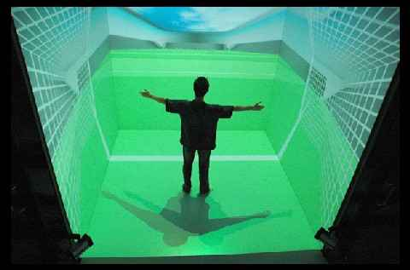
Independent Ability System (I.A.S. ®)
Communication
Image, Sound, Text, Tactile
Cognition
Capture, Process, Store, Recall
Mobility
Walking, running, scooter, chair
Manipulation
Input, Output, Activate
Integration
Notes:
While some mobility impairments are obvious to the observer, others are less apparent. For example, individuals with repetitive stress injuries (RSI) may have no visible impairments yet require assistive technology in order to use a computer without experiencing pain.
it is not essential to be an expert on these conditions: specific disabilities such as muscular dystrophy, cerebral palsy, a spinal cord injury, multiple sclerosis, or RS
People with the same medical condition may require different assistive technology.

Slide 8
“Human factors and all this research with user experience should come in before we design the product.”
Maddie Niichel Human factors grad ready to get comfortable in her new field retrieved December 2018.
Notes:
Let’s think about access first.

Slide 9
How do we design so new applications are created with accessibility in place?
?

Slide 10
Resources
How Technology Brings Blind People into the Workplace - Julia Anderson Retrieved 4-16-2019 from https://hbr.org/1989/03/how-technology-brings-blind-people-into-the-workplace
A Short History of Computer User Interface Design on April 20, 2016 / by Daniel Rounds Retrieved on 4-16-2019 from https://usabilla.com/blog/short-history-computer-user-interface-design/
The Universal Design for Learning Implementation and Research Network Retrieved 5-17-2019 from https://udl-irn.org/
Web Content Accessibility Guidelines (WCAG) 2.0 Retreived 5-17-2019 from https://www.w3.org/TR/WCAG20/
Faculty Canvas Accessibility Course https://asu.instructure.com/courses/20498
IAS® Independent Ability System – enabling Solutions 1997

