Slide 1
The Empowerment of a Diverse and Inclusive Workplace
Notes:
Thank you so much for having me today...I'm very excited to be here at ASU … and to have the opportunity to share my experience on inclusion in the workplace with today...something that I have been on a life journey with… something that can impact to your organization's in so many positive ways if your willing to truly be open to it...
So where do we start…
Well we are on campus so … lets go back to school … hit the books and define or breakdown what we are exploring today into parts…

Slide 2
Work: to perform work or fulfill duties regularly for wages or salary
Inclusion: Inclusion is the act of including : the state of being included, a relation between two classes that exists when all members of the first are also members of the second.
Diversity: the condition of having or being composed of different elements: variety : an instance of being diverse
Notes:
Inclusion in the workplace…
Work...Per Merriam Dictionary: … Work, is: to perform or fulfill duties regularly for wages or salary Inclusion is the act of including : the state of being included, a relation between two classes that exists when all members of the first are also members of the second.
Inclusion, while closely related… is a separate concept from diversity… diversity focuses on differences and inclusion is the deliberate act of including those with differences...

Slide 3
“the achievement of a work environment in which all individuals are treated fairly and respectfully, have equal access to opportunities and resources, and can contribute fully to the organization's success.”
Notes:
The Society for Human Resource Management (SHRM) defines inclusion as…
“the achievement of a work environment in which all individuals are treated fairly and respectfully, have equal access to opportunities and resources, and can contribute fully to the organization's success.”

Slide 4
Innovation Well-rounded Knowledge
Forward Thinking Happier Employees
Creativity Well-versed Work base
Collaborative Influences More Production
Brings new knowledge Broadens Perspectives
Notes:
And these days ...finally … we are starting to understand that inclusivity can bring great things to an organization… it has become quite popular...almost hip in a way... to focus on inclusive initiatives in the workplace…
What can it bring to organizations...
it creates environments that are forward thinking...innovative….creative...collaborative… brings in new knowledge...well rounded knowledge… happier employees...brings a more educated and well versed work base...influences more production...broaden perspectives
and the list go on and on...right … these are all buzzwords and there are ton of buzz words around this idea...buzzing around… and all seems so cool!
And I love it...we have come far from where we were … which I will share a little of that in a bit…

Slide 5
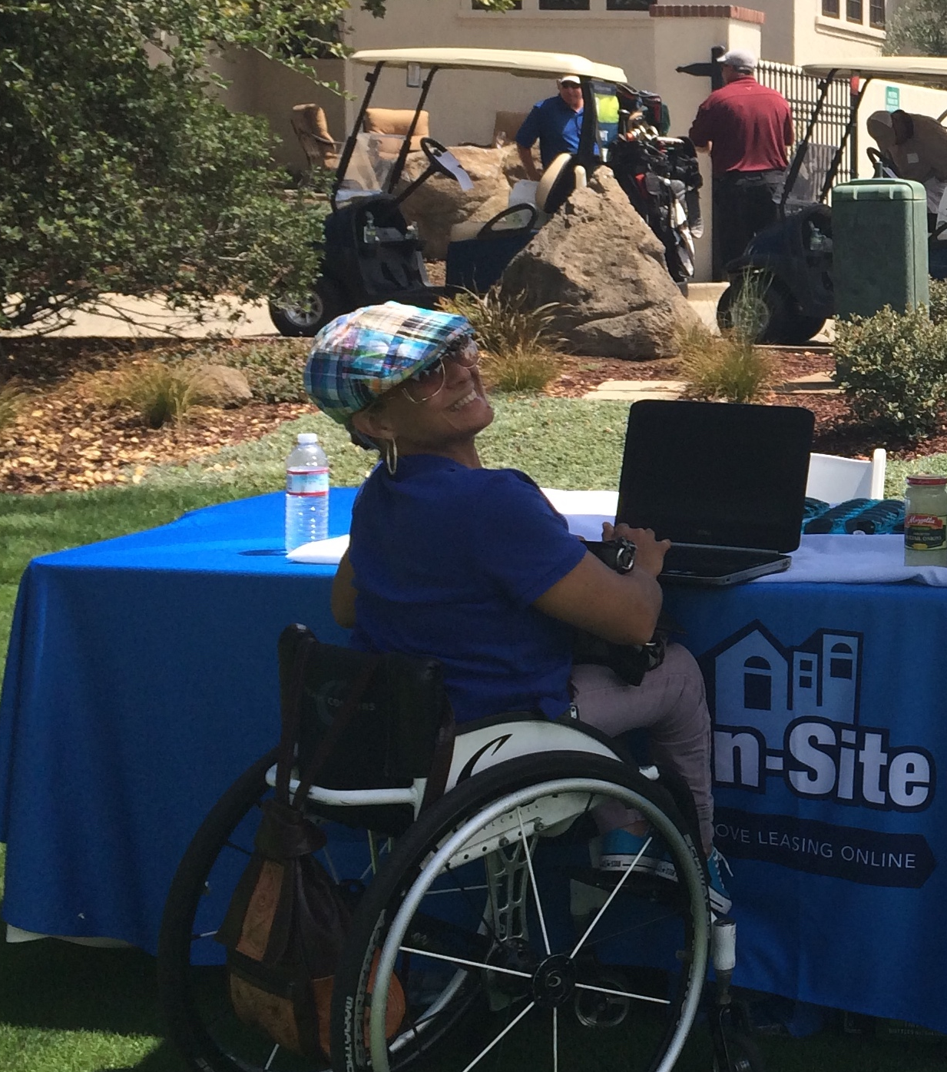
Notes:
What I want to explore a little today… and what I feel I can offer the most …
is what this all mean to me…the end user of inclusion in the workplace…
how does it feel to me...how are we doing...and what can we improve on...how can we do a little better… and master this practice a little bit more…
The one thing I can tell you is … to be successful we must realize... this is collective work...not just for you to figure out or I … but its hard work for all of us...
I thought it be impactful to start with a real life story on inclusion in the workplace …. to give some real world perspective and context to this all....

Slide 6
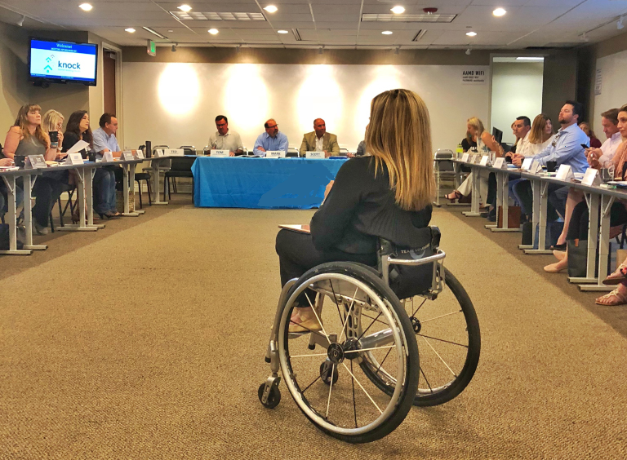
Notes:
Imagine going into a meeting that you have been preparing for weeks...you put together a detailed and thoughtful meeting plan....
your well versed on the client...the structure of their organization...their people...their culture...their need for your services…
you are ready to present on how you can solve a problem...bring value to their organization by implementing your software… your ready to win this deal...
In the room are top executives … (president, VP operations, CTO, VP of marketing, VP of training etc.) whom you have spoken to over phone calls or webinars ...but have never met in person as of yet)...
and honestly you don't show it … but your a little intimidated by the room of attendees …
Questions run through your head…
can I pull this off… do not fail...will I have all the answers…
All you know is I must represent my company and our software in the best light possible...so how innovative and awesome we are.... and win this deal...
You present your product effectively...the group is engaged and interactive… you feel confident the meeting is going off without a hitch…
as you wrap up … the president of the company…who you have noticed has been looking at you sort of deeply…
almost staring at you throughout the meeting....the one who will ultimately make the finally YES or No decision on the partnership…
He approaches with a follow up question…
Your thinking... ok this is good…he has follow ups items for me...awesome…this is it!
and he asks... “did you have any trouble navigating our parking lot/building on your way in” …

Slide 7
Notes:
“WHAT”
Is that what he has been thinking about this entire last hour of my presentation…
did he hear anything I said...did he miss the message....is worried if his building is accessible enough for me...darn it...
This person has not seen or heard one thing I have said in this last hour....could this be true…

Slide 8
Notes:
I'm invisible…
Invisibility vs Inclusion slide -
It is so common … upon first meeting... my reality in life and in business...there is many times a progression to be seen… or heard...or to be considered…or valued for what I can bring to the table professionally …
because many times at first meeting … I am not seen for me… and this is important to understand as we start this talk…
Why is this...many times what you see is at first glance…

Slide 9
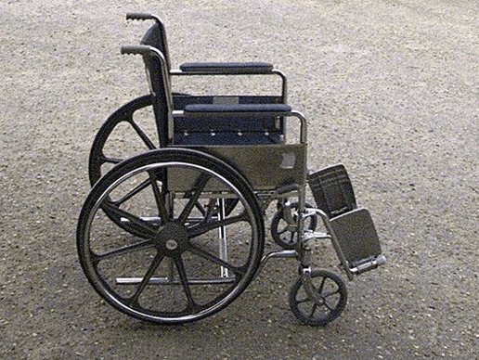
Notes:
and what this story clearly shows is that… most of the time … what you see first is … my wheelchair....an object … its not me …its an unfamiliar object…
Its an object that get me to point a-b...to one meeting...to the next...my independence...my power... its what empowers me to be able to do my job...and do it well...
But its also an object that ...many have no idea how to begin to incorporate in “normal” situations and in the case….business situations
Its an object most fear ....an object that most consider a weakness … or less than…
This object has stigmas that surround it... things like pity, exclusion, stereotyping, discrimination… all things that can drive the decisions we make daily … consciously or subconsciously…

Slide 10
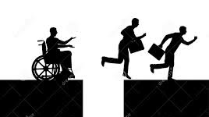
Notes:
And in many professional situations whether admitted or not... its an object that would be perceived as a blockade ... a blocker that aids in the inability to climb life's ladder of success…
its certainly something you would never choose for your life…but for me this “object” offers a pathway to have a shot at being successful … and included in this life with you...
for me this is the biggest challenge in my personal and professional life when nativizing through this world...

Slide 11
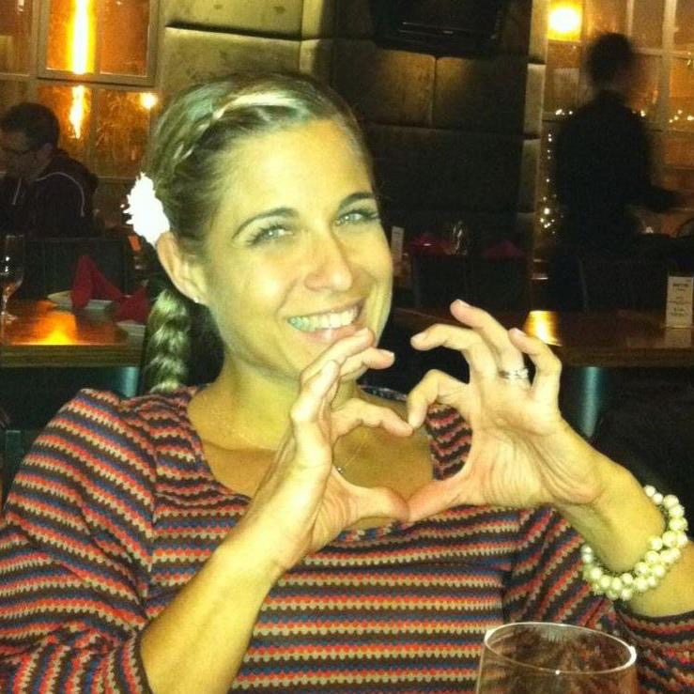
Notes:
is being seen for me...a person…a woman… with talents...experiences… expertise…knowledge...value...
This reality of invisibility may only last a split second in some situations … and into eternity in others...it really depends on the situation…
but for me I'm on a lifelong journey to peel back the many layers of invisibility … to be seen for me…
In my opinion invisibility… is the biggest obstacle that we find in inclusion in the workplace…
why would we ever put forth inclusion efforts in our organizations… or care about inclusion at all... if we are missing the person all together ... in exchange for the acknowledgement of an object …rather than the person… their talents and what they can offer… it just does not work
….invisibility continues…

Slide 12
Notes:
So how we might go about working towards having a more inclusive workplace … starts with finding your way to the person first… finding your way to me...
Eliminating and removing the invisibility factor looming...is the highest priority in my opinion …

Slide 13
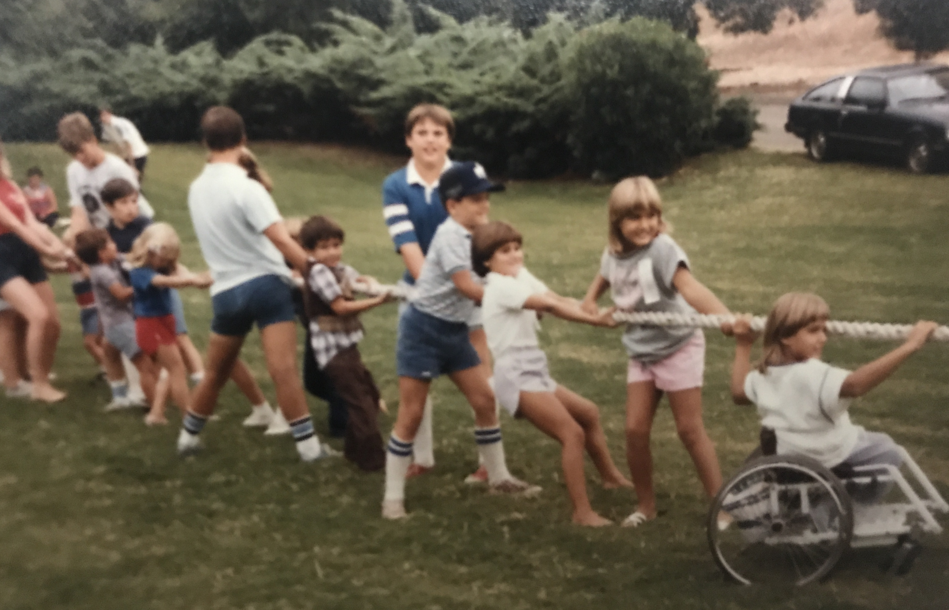
Notes:
which is hard work...its hard for you.. its hard for me…its uncomfortable...super awkward… it takes effort and teamwork…open minds...accepting minds …
it takes asking bold questions...sometimes hard questions... it takes honest answers and being open to sharing...learning...practicing…
.it takes removing fear based assumptions..
.it takes being willing to adapt…its takes creativity...its take being willing to think our side of the box...
it takes being willing to making mistakes along the way...and ultimately changing habits and internal processes...and this is collective hard time consuming work....
And I share disability with 1-5 Americans…

Slide 14
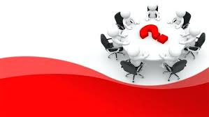
Notes:
-Have anyone ever had a teammate with a disability...
or
-Has anyone in the room ever had to modify their own work environments because of a temporary disability….

Slide 15
Inclusion in the workplace
benefits all!
Notes:
Disability is something that can knock at anyone of our doors… at any time...without any discrimination...for a moment in time … or for a lifetime… and
that is just the hard truth…
With that being said...Inclusivity in the workplace will benefit us all one day... this is important to keep this in the forefront of your mind during this talk… inclusion is not just for me … its for us … for ALL…

Slide 16
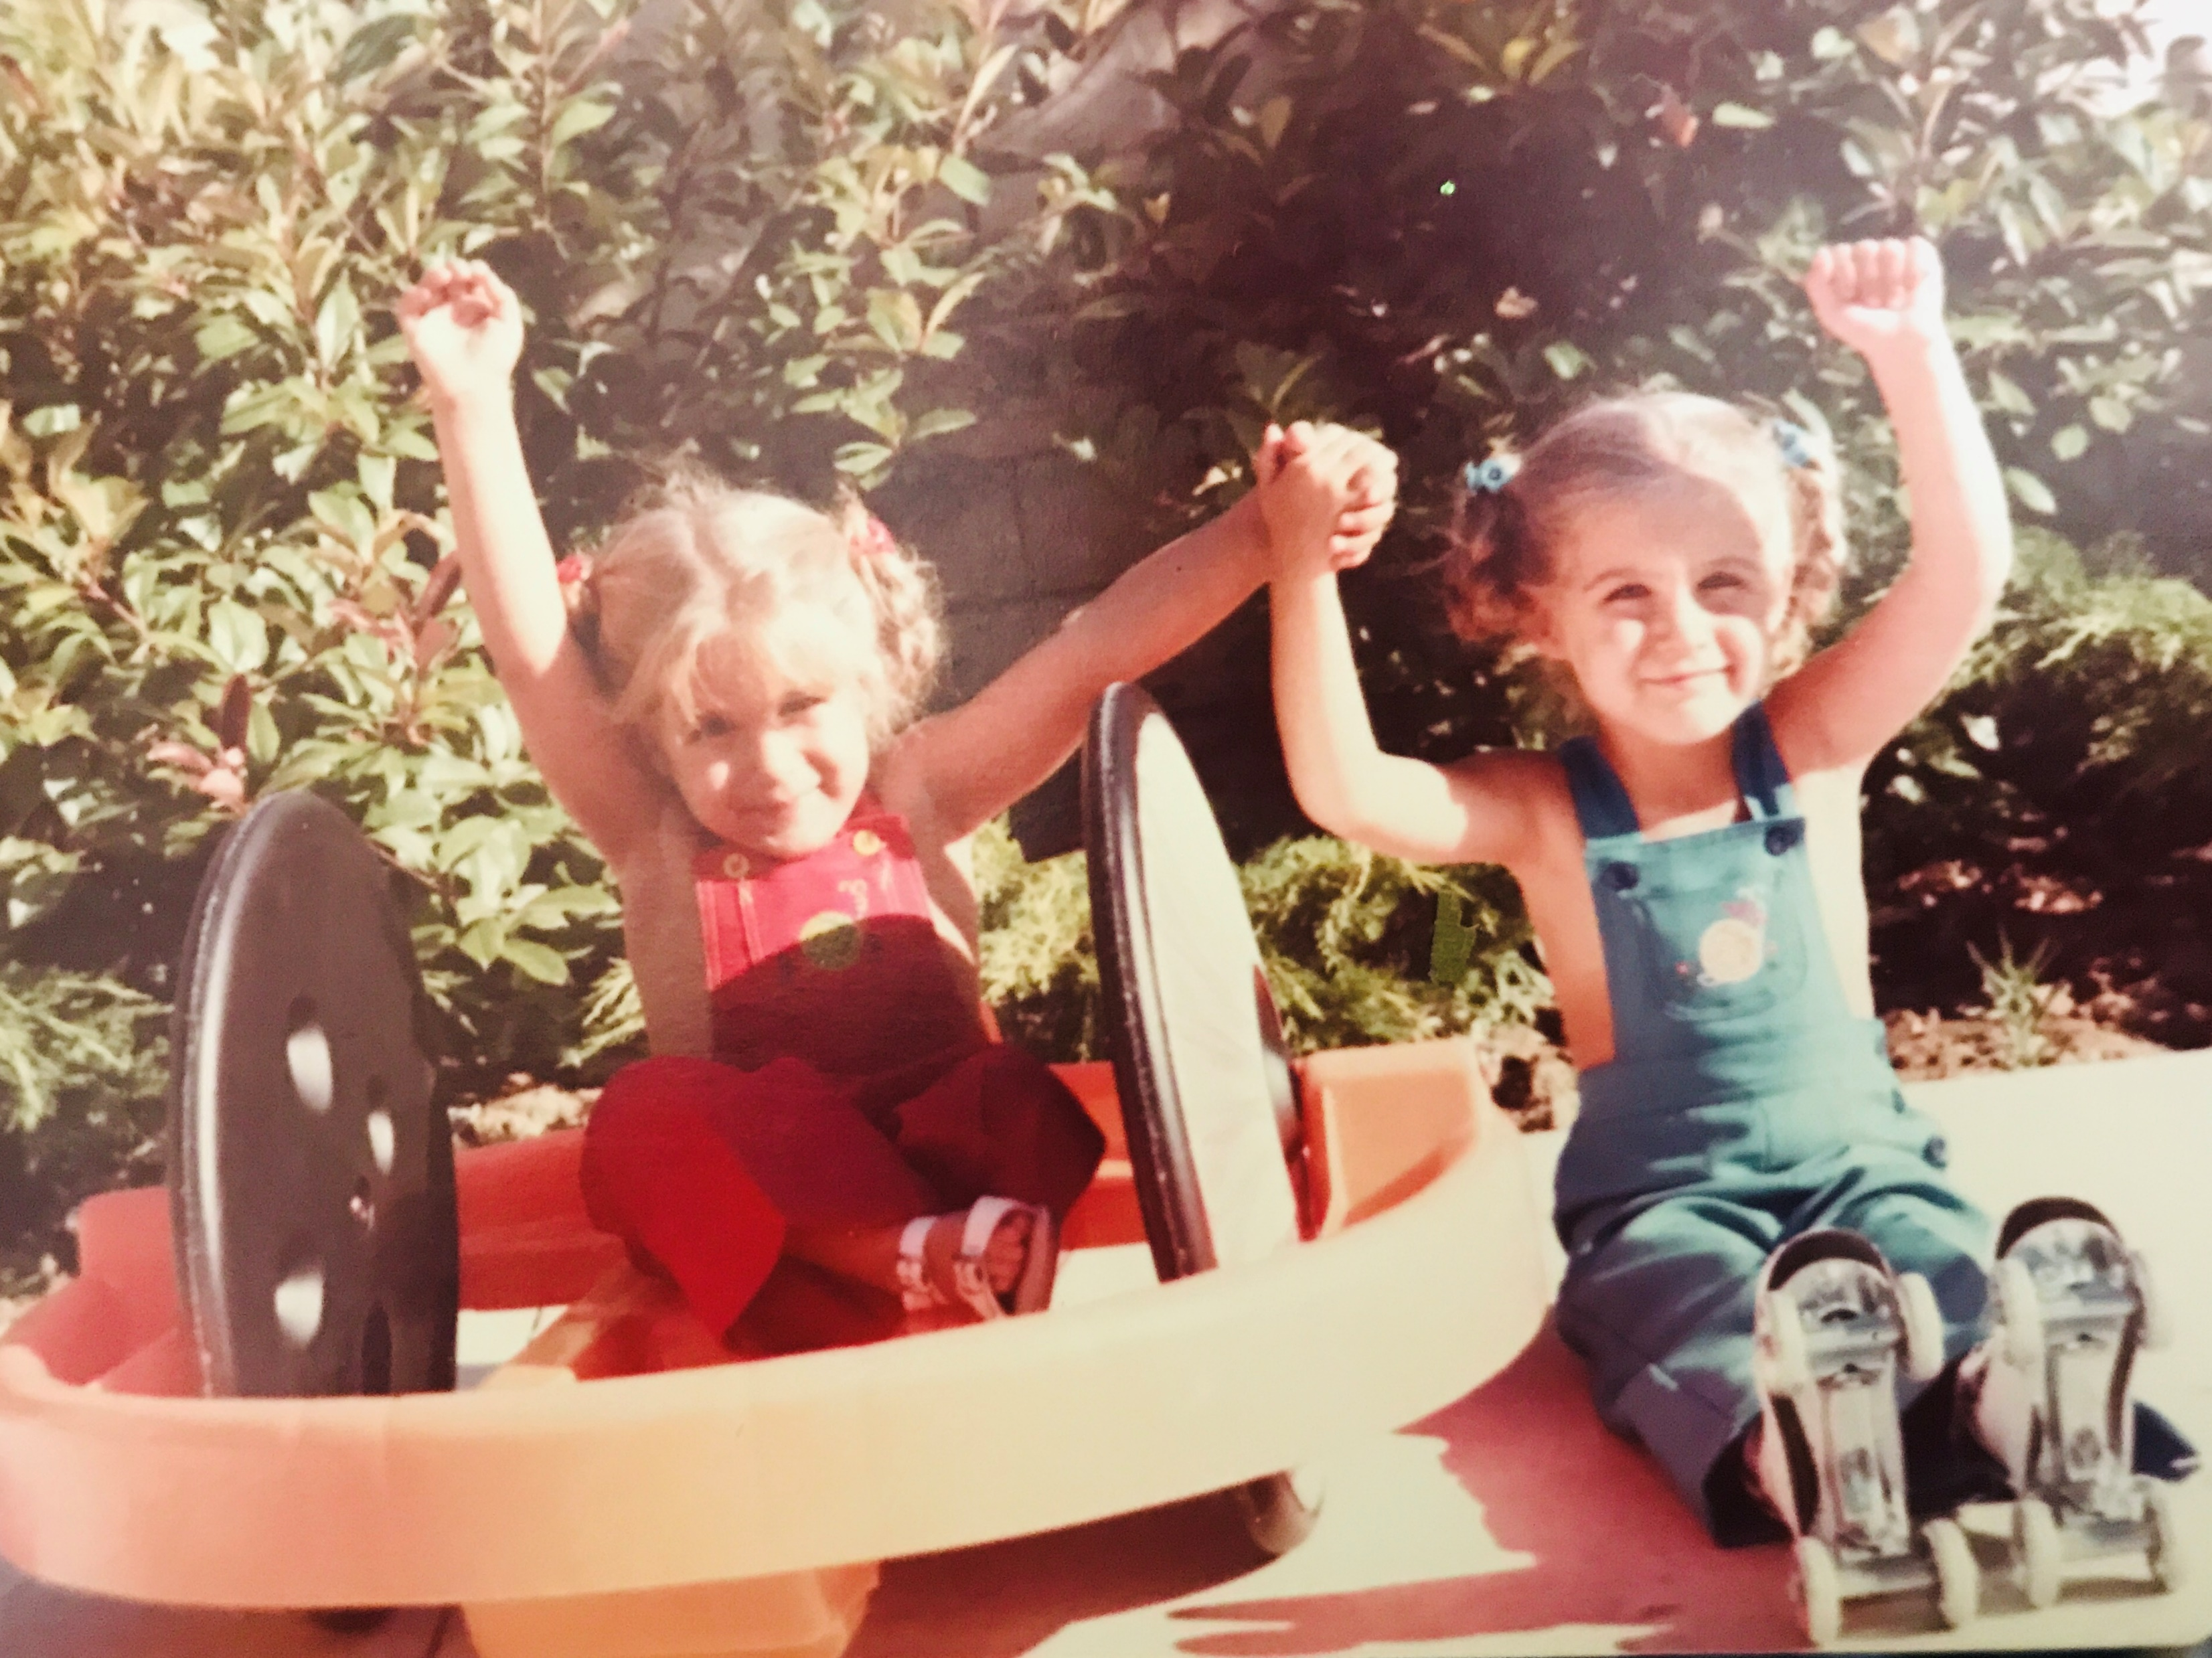
Notes:
My journey on inclusion started really at birth ...
Born an identical twin...yep one egg split in two...the other half of me...the able body other half making walking through the universe...my sister and I have been on a lifelong journey of inclusion
Born with Sacral Agenesis which is basically under development of my spinal cord at the sacrum... sprinkled with lots of internal organ issues…
When I was born drs didn't not expect me to survive the 40 years I have at this point … let alone become a productive independent contributor of our society …
but I did ultimately survive and I am

Slide 17
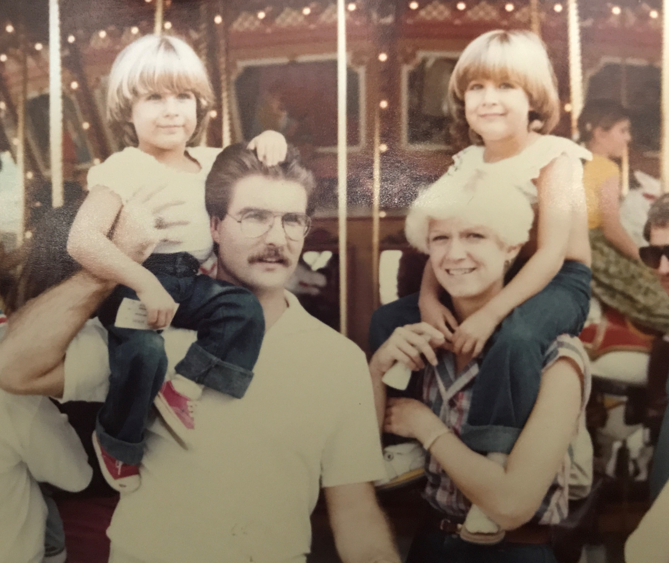
Notes:
My parents very young … and not knowing how to embark on this journey … had one main goal for me which was to have all of the same opportunities my sister would through this life
So for my parents there was sure to be an uphill battle... the fights of fights... to advocate for me…
As a child they fight for me to be integrated into regular classrooms, activities and events. To play sports and to be active in this world just like my sister.
They taught to push aside my own self doubt and to be bold…to be fearless...to embrace each challenge…
to look at it at each moment of discomfort or embarrassment or pain as an opportunity to overcome and grow and become stronger...
that I had the opportunity to teach by example… and to change perspectives along the way…
and this was an honor…. I do this simply holding my head high… do the best I can with what I have been given... and go for it with a smile…
And most of all … they taught me to work hard for what I want...to go for my dreams...that whatever I wanted to achieve … I could obtain with hard work... no limitations…

Slide 18
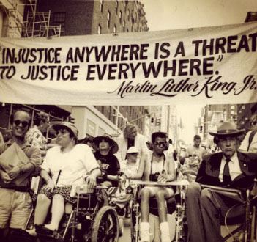
Notes:
*Born in 1975 on the cusp of the exchange of segregation of people with disabilities to inclusion...
A time when discrimination was finally illegal... forcing societal change in the way of law …
Where for the first time in history people with disabilities were to be considered as a class…
a minority group at that...but we were finally considered in the human race…what victory!
All of this all happening as if in preparation for my birth …

Slide 19
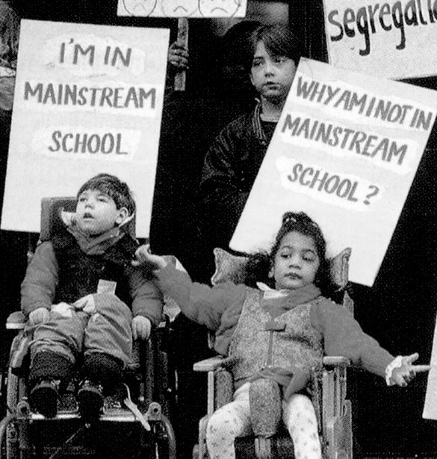
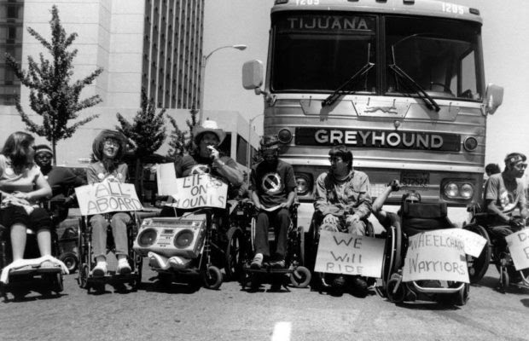
Notes:
activist with disabilities has just lead the charge for the Rehabilitation Act of 1973 to be passed into law...
This legislation prohibits discrimination on basis of disability in federal programs and infrastructure …
laws such as these give me rights … just like you … access to things like medical care... and education...employment in our case today...
and not only gave me the same rights as you… but also give me access to get there…

Slide 20
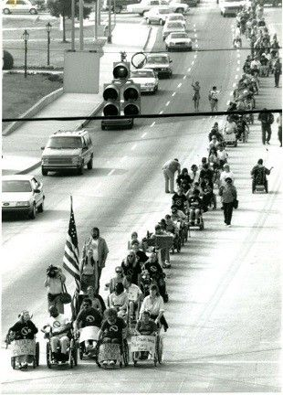
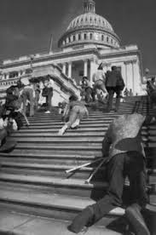
Notes:
and later lead to the Americans with Disability Act (ADA) … passed in 1990
ADA being one of the most comprehensive piece of civil rights legalization... that prohibits discrimination and guarantees that people with disabilities have the same opportunities as everyone else in mainstream America …
ADA was modeled after the Rehabilitation Act of 1973 and the Civil Rights Act of 1964 which prohibits discrimination on the basis of race color religion, sex or origin…

Slide 21
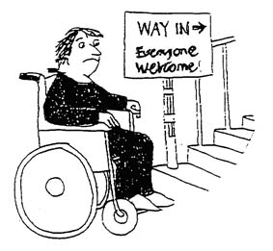
Notes:
Though the laws had successfully passed … and inclusion is born.
exclusion in society for people with disabilities was the still the norm and what most in society were comfortable with...
Why… it would take a lot of time… effort and money … would be required legally to make accessibility accommodations in schools, hospitals, public places, employment… and give access to things like parking, transportation or even
bathroom access...common necessities we all deserve to have as we make our way through the world...
because of these laws … society was being forced to remove the invisibility screen and we were being forced to see people for people...we had to start to collectively find ways to include… no choice…

Slide 22
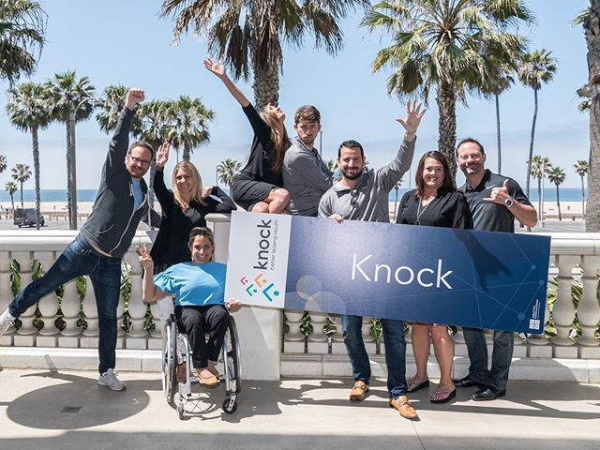
Notes:
And these laws had a direct effect on the successes I would achieve in my professional lifetime…because in theory… they opened the doors of unlimited professional opportunities...among other things...
Empowered by the lessons from my parents… I would masterfully know how to navigate a world that was not quite ready for me…
Lessons of independence, adapting and implementing strategies to always be included in life…
that whatever my heart may desire … I would not be afraid to go for…
This coupled with the legislations that opened doors to employment …

Slide 23
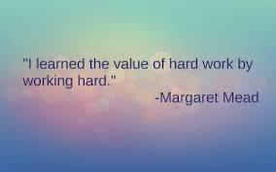
Notes:
I started working at age 14...in my dads law office … shuffling papers and answering phones.
His lesson as a young adult…to embrace the value of work...you must have a reason to get out of bed every day...
Which carried me through my career…
Another tough lesson he taught me was to provide for myself..
And he encouraged my sister and I to move out at age 18… on our own … and when I say encouraged… its was enforced...a hard knocks lesson on “its a tough tough world out there girls… and no one cares but me…. so you have to figure it out girls…

Slide 24
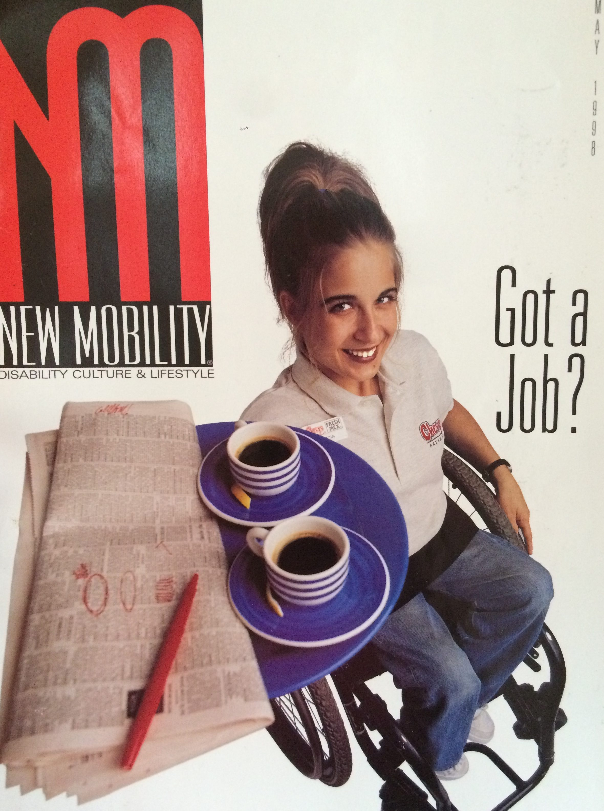
Notes:
So...I would go on to… Start my first job … out from under the wing of my dad
I would become the first waitress in a wheelchair...my first true lesson in inclusion in the workplace…
This took an open minded … forward thinking company … to embark on this journey with me…
And a huge part … was my willingness to try…
Of course it helped me … that my sister started there before I … and she advocated for me that I could do it…
And I did!
I would wait on tables after school… to close of business each night …
and I found that the people that I waited on … were truly inspired and showed them what is possible … and I enjoyed their tips…
I would stun my guest carrying 15 margs at a time on my lap … and weave my way through the tables delivering their meals... many guest returned as my regulars...
and somehow… the word spread about this waitress in a WC...and soon I was asked to share my story in the news and media…the story even made it all the way to China newspapers
So definitely this experiment on inclusion paid off …
for the company I worked for...as they would benefit from a good amount of free advertising and notoriety ...as well as they benefited from being looked at as forward thinking inclusive company…
it also benefited society to see what is possible to think outside of the box... which I had the opportunity to share each every day I showed up to work…
and it also benefited me … to pay my rent and get a car and put myself through school…

Slide 25
Notes:
This story would also prove... that the legislation passed had worked...and that people with disabilities could be included in the workforce… in any type of job...maybe even the jobs no one ever thought a person with a disability could ever do…
But it took willingness and risk… of my employer … who hired me …. along with my never quite attitude...to make it possible …
inclusion in the workplace is collaborative...collective… its creative work … we have to do it together … we got the job DONE. Boom!
This experience would allow me to transfer from the restaurant in SoCal to another branch in Lake Tahoe where … I begin my college career…
A wonderful thing … thinking back on it now…

Slide 26
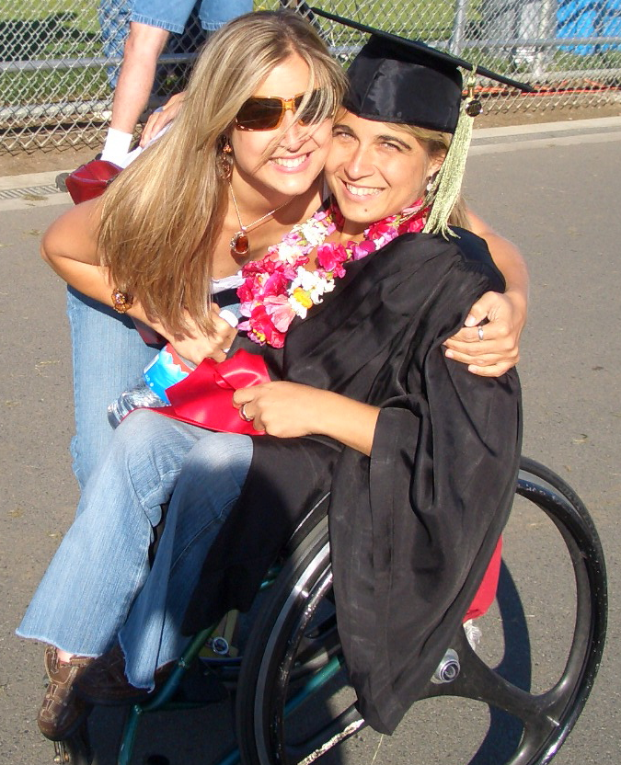
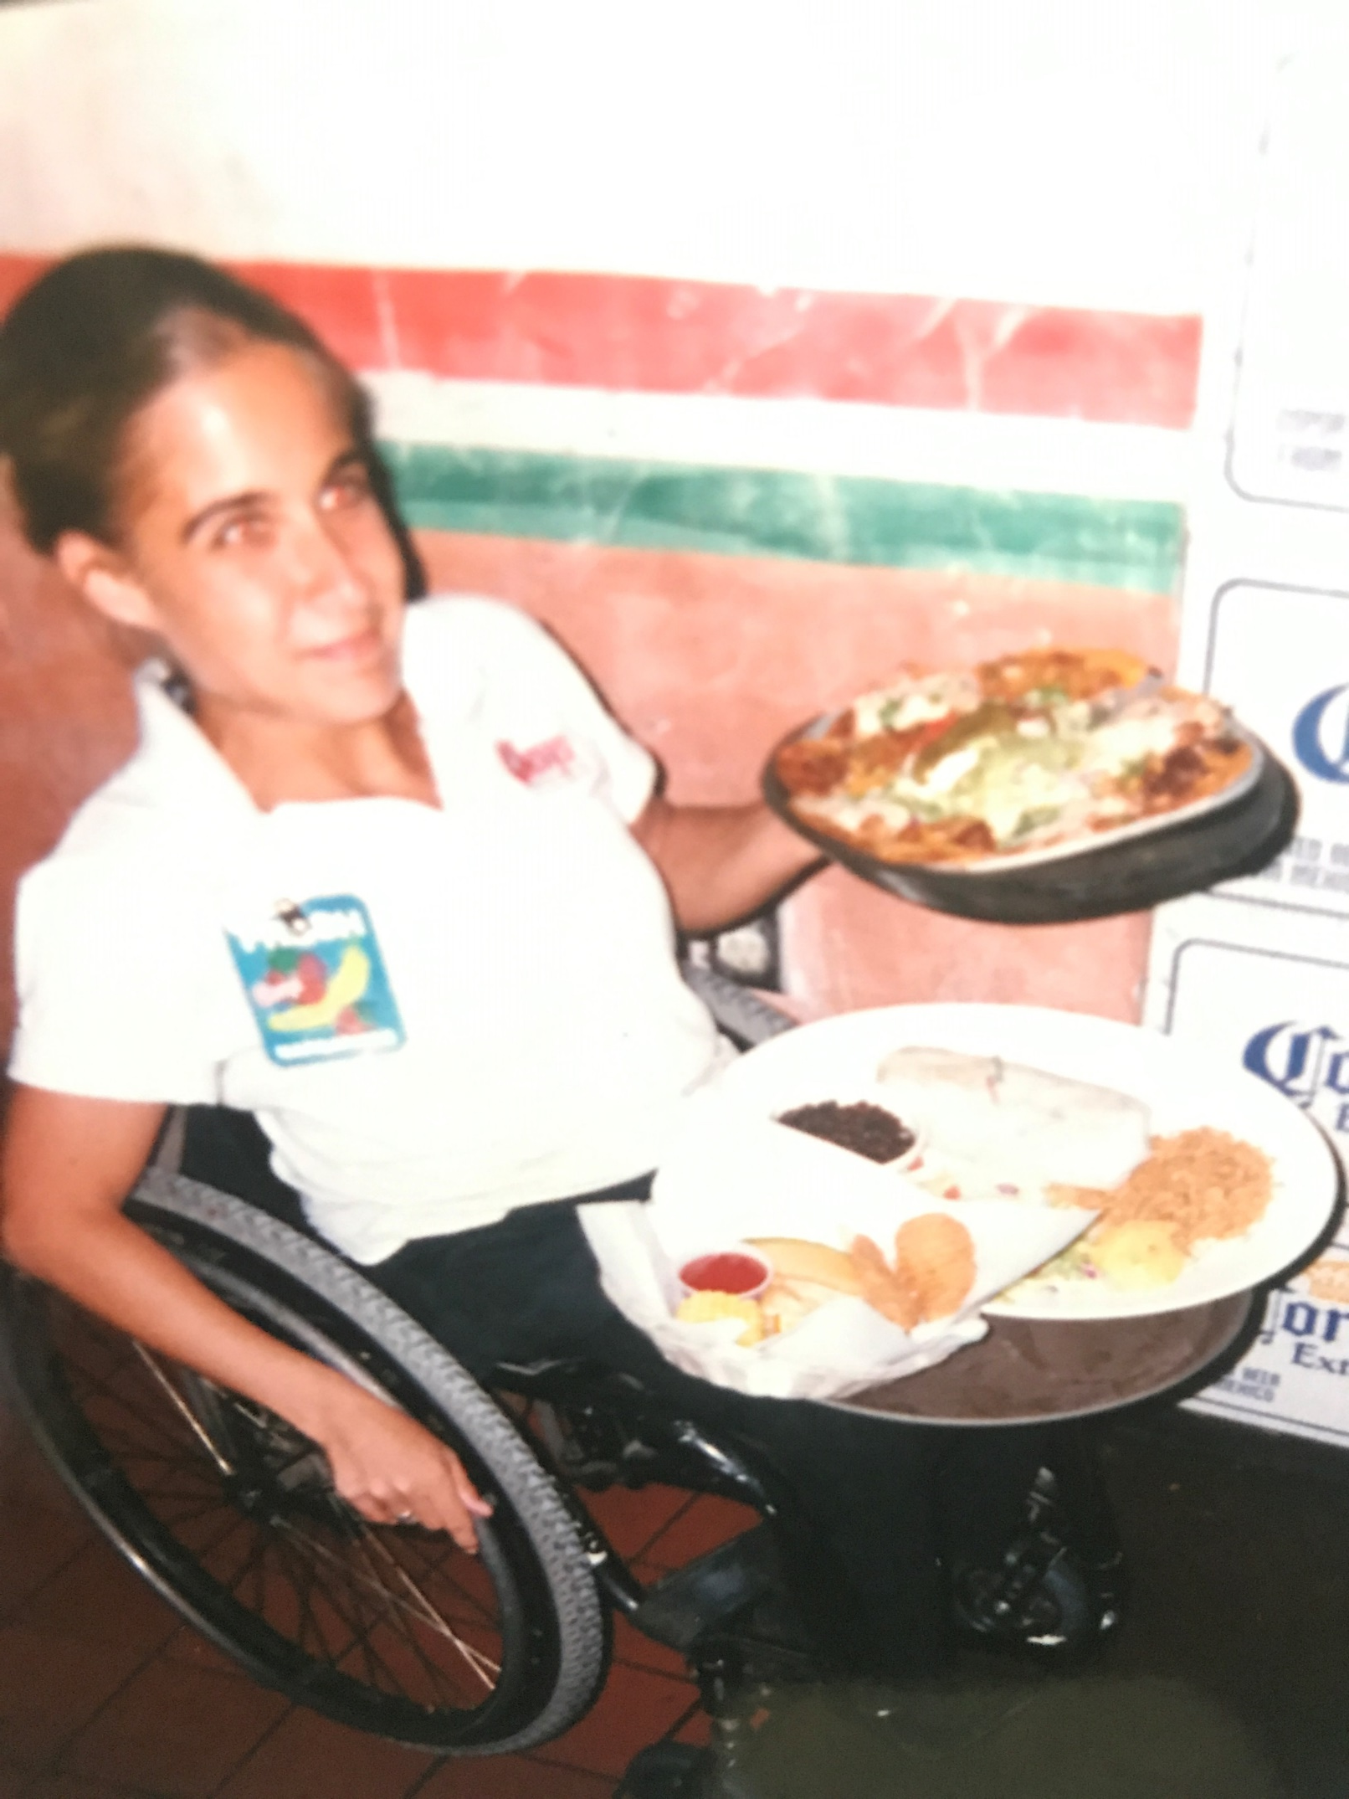
Notes:
I was able to perform so well … that the next branch of the restaurant had no questions that I could do the job … and not only that … they looked forward to sharing the work I was doing… with their customer base as well…
Ultimately excelling in work would empower me to reach for higher goals…and I would...
Move on and attain a BA from Chico State in Adapted Kinesiology …
and a full ride Masters Degree scholarship from Leuven University in Belgium in Adapted Physical Activity…
I chose these fields of study very strategically ... I felt passionate about inclusion… and how through activity and adaptations with my peers and environments … anything is possible...

Slide 27
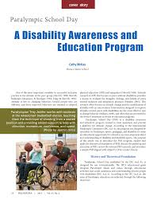
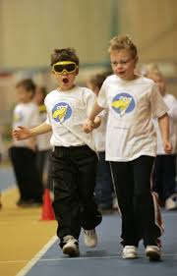
Notes:
In my master degree experiences …. I would get my first taste of true professionality … having the opportunity to intern with the IPC and collaborated on international educational projects that would teach inclusion to youth globally...
These experiences through my education … were naturally inclusive due to the nature of the studies for the most part…
but they also would further grant me the strong foundation … and abilities to articulate these ideas of inclusion… as I would move forward into my corporate career in sales...

Slide 28
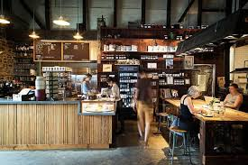
Notes:
I would return to the states armed with my degrees … and my strong desire to further place myself into a professional career path in corporate America...
A sales representative for a specialty coffee company was my first go at it … A national firm that provided premium coffee programs to businesses and universities…
I would harness my talents in dealing with people … and once again I amazed those who saw me work…
showing what is possible as I assembled product promotion materials... in places of business … while managing accounts and servicing their needs… all the while generating revenue for the company…
this yet another very physical job…literally having to jump on counters to set up new programs...customer would walk in … as I am working and say: “well I never seen that before”
This industry very much dominated by men at the time…
by the time I made my exit to move on to other opportunities… I had proven to be a valued part of the team and organization as a woman... and more importantly a woman with a disability who can get the job done...

Slide 29
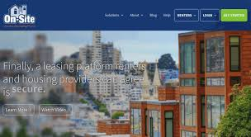
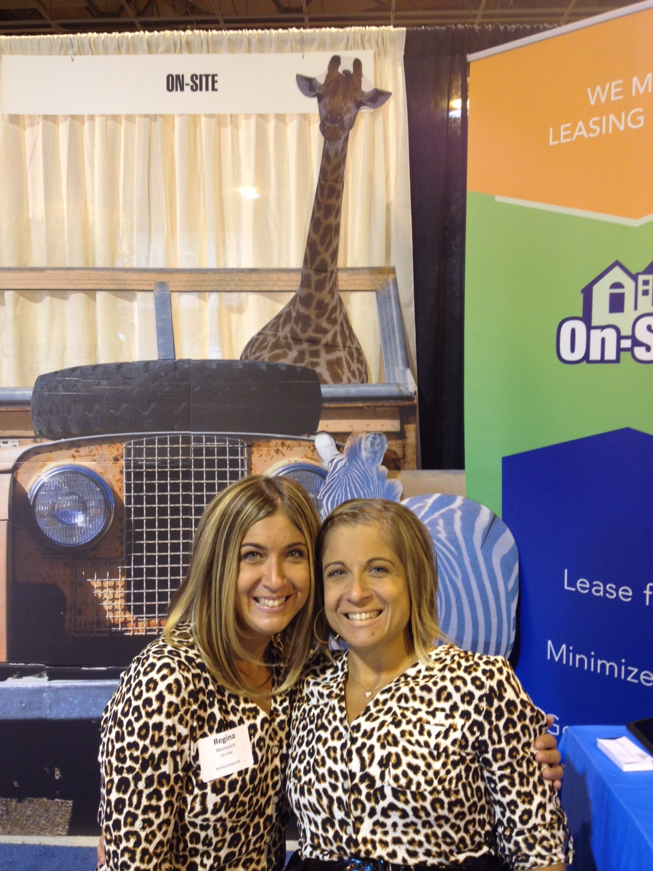
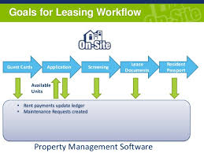
Notes:
I would then move on to the tech world from there…
again following my sister...who once again advocated for me to get my foot in the door … but it was up to me from there to prove my value, worth and abilities … and perform
And what an opportunity… I move to silicon valley and was engulfed in software… and tech and it was super hip
and we all know in this room how fun that is...its exciting to work in an industry and with products that are ever changing through innovation, creativity and development…
I was part of a team that took that company from 15mil to 60 mil and later was acquired for 100s of millions of dollars... this was so exciting to be a part of...

Slide 30
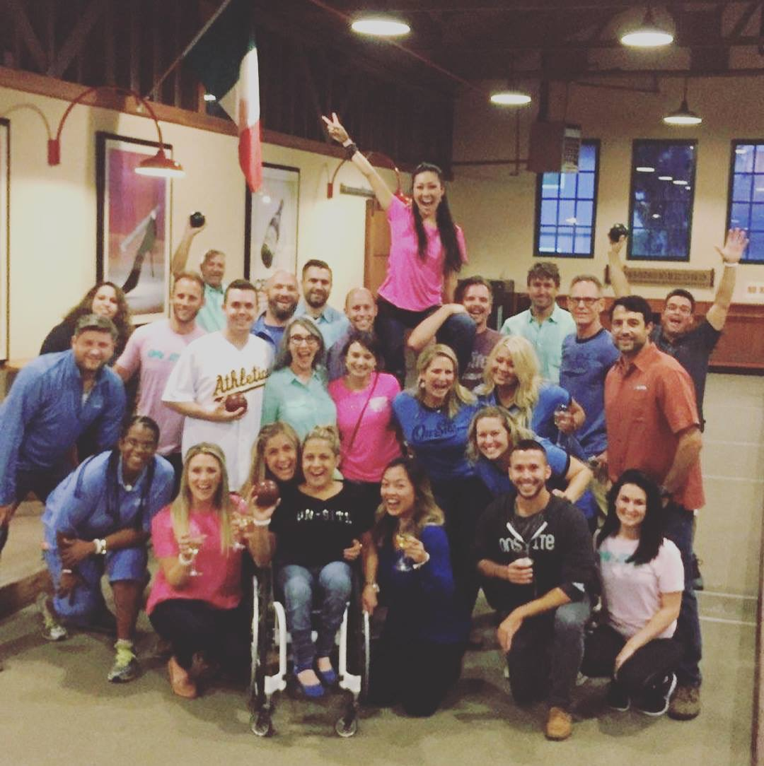
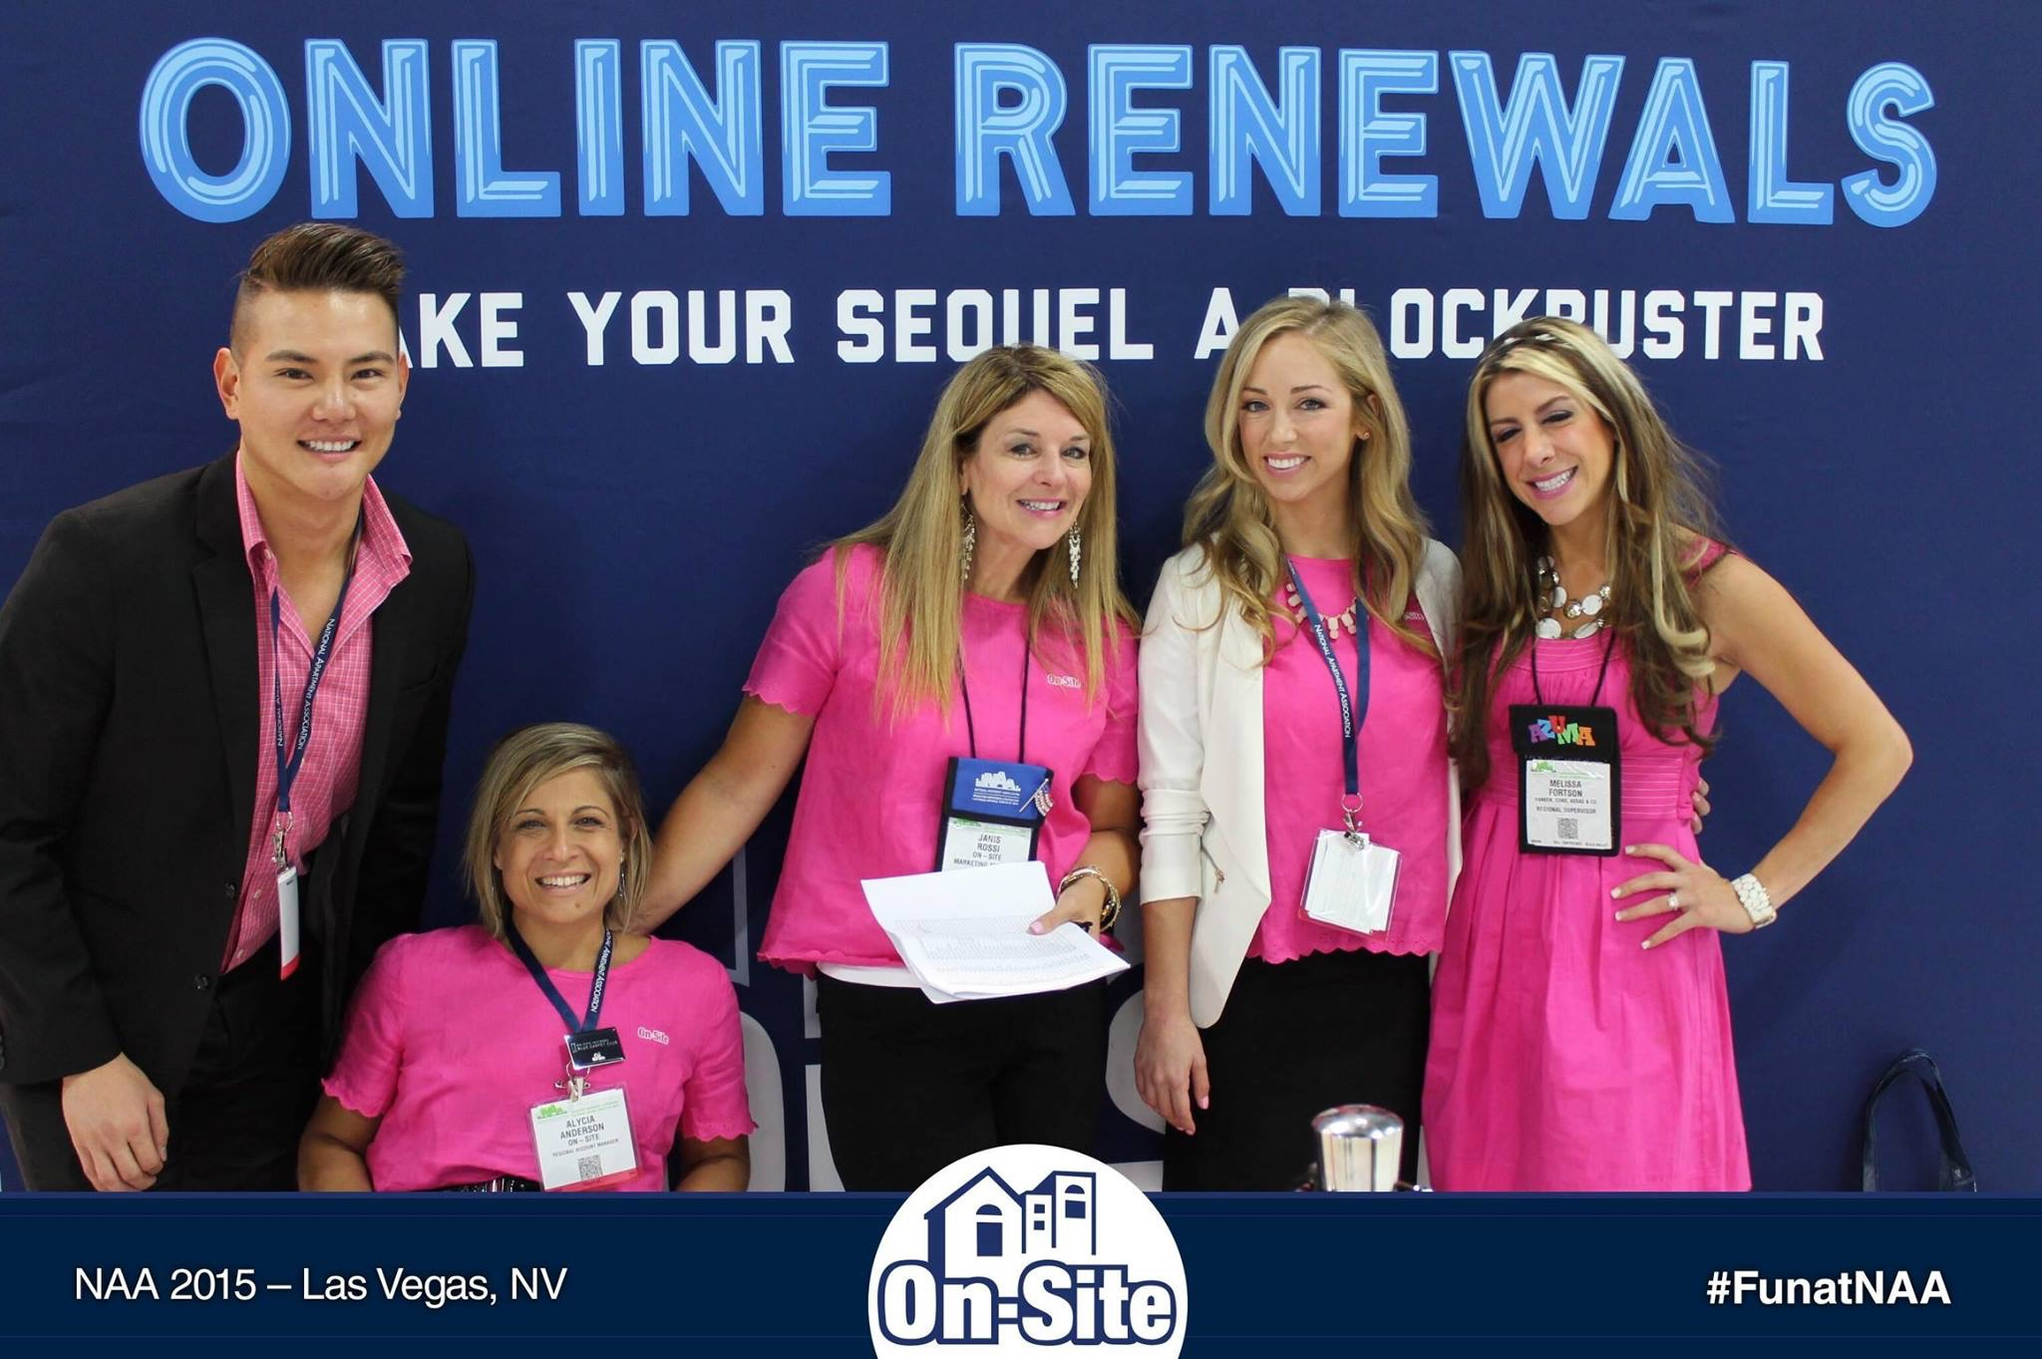
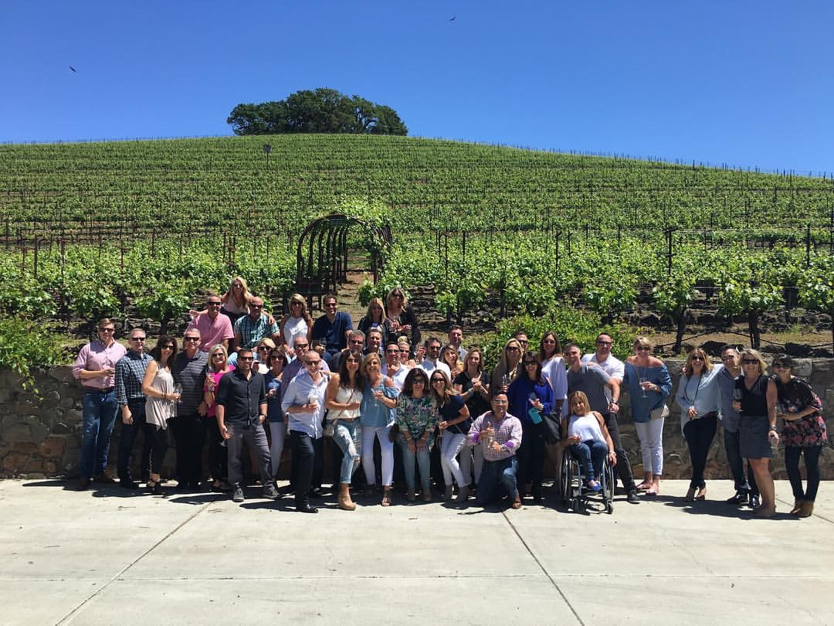
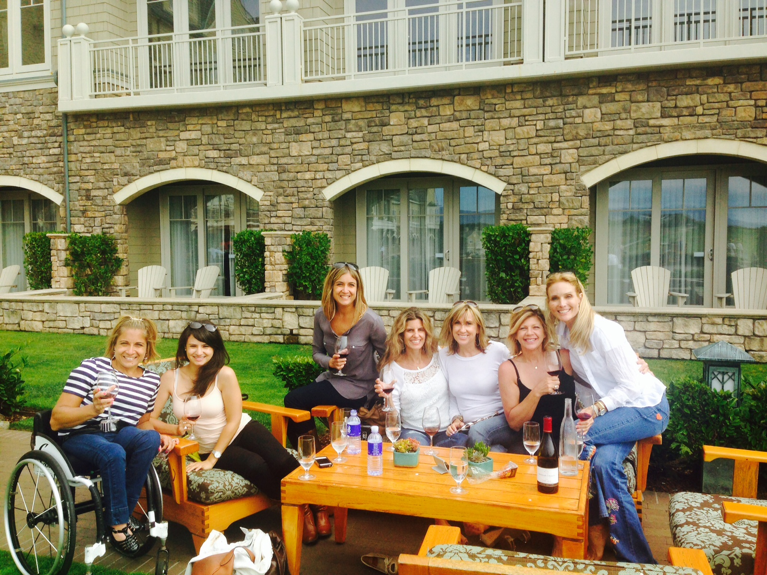
Notes:
And although I had reached a professional career … the challenges of inclusion still existed...
not only on a physical level but also an intellectual level …
Challenges like how to fit in with things like team building exercises … or customer events …
and how I would entertain my clients while trying to close deals…
this would be more challenging … as I would smooch with clients as we stroll through wine tasting events on buses that are not accessible for me to get on…
or navigate the crowds of golf courses ...moving from hole to hole with my clients…
the awkwardness and challenges of inclusion are in every walk of life and in every career….
and again much of the navigation …. and the leading the way of adaptations lies on me…
and I have continued to accept the challenge and find a light in sharing different ways of thinking about situations…
and showing people that anything is possible…
But we all need to be open to finding ways to adapt together...it cant just be my job to figure how to adapt on the fly… I need your help just as much as you need my help to remember to see the person first…

Slide 31
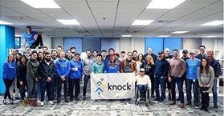
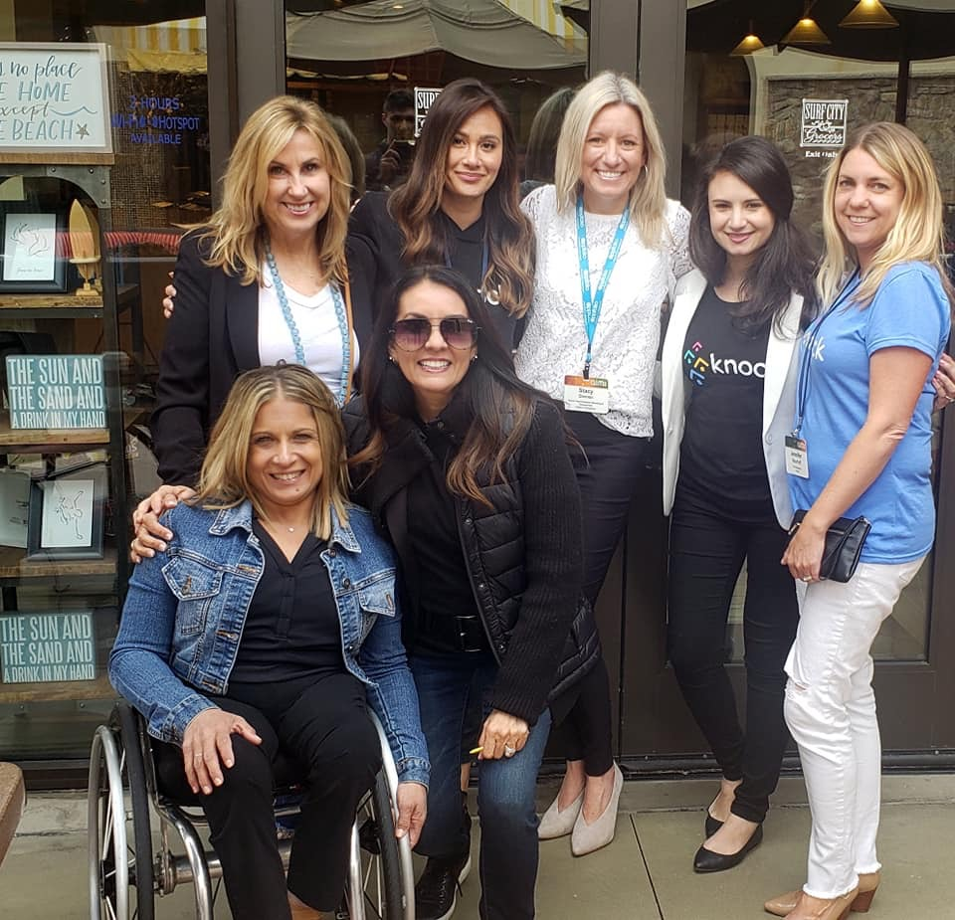
Notes:
Which leads me to where I am today… VP of Sales for KnockCRM a SaaS software for the multifamily industry...
A position I was finally unafraid to go for on my own...and my own journey…
a job that requires a lot of travel… a lot of trains, planes and automobiles...hotels...meeting navigation planning... conference navigation planning… team building navigation planning… presentation in clients offices navigations and
accessible planning…planning on top of planning
and when I took a moment to ask my boss some of the reasonses he hired me he said…
he knew I had to be proficient in planning, organizing, thinking a head…
that he knew… how I knew… how to be proficient… in game planning in all possible scenarios … which comes with the territory of my life path… way more than the average person …
and he knew this would translate into my work…
Here I am again… this time sought after by a forward thinking company… who had heard of my achievements...and wanted that for their team...

Slide 32
Notes:
So now I'm discarding the cloak of invisibility…
and drawing my cape of super womanness…and I need to fly and be seen for me...
I refuse to have any limitations placed on me by others or situations or my environment… I refuse to have limitations on the jobs I'm considered for… or limitations on how much I can succeed in this life by others standards…or beliefs

Slide 33
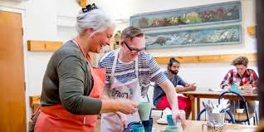
Notes:
70% of ppl with disabilities are not counted in the workforce...think of all of the missed talent and room to grow
The only way you will make change… is to hire... to try … and see...
We need to be open to working side by side…
and once people see this happening in the workforce... society will change its mind and start believing … in the possibilities and capabilities of all..

Slide 34
Notes:
Each moment of my life has been an opportunity for inclusion …
it has been apparent to me due to the physical nature of my disability... because it a glaring thing...and there is no hiding my wheelchair…
no hiding my inability to walk up stairs...or my need to have adaptations to access to enjoy or be successful in the world like just like you…
and sometimes even toughing through it without adaptations and doing the best I can..
That I am many times whether I choose it or not I am a bridge for all to see how to practice and learn how to be inclusive...
here it is again...inclusion is hard work...day in day out...moment to moment...the hard collective work of inclusion never ends...inclusion is an ongoing opportunity.
And maybe now its time for me to pivot once again … and find a new role or an additional role as a speaker where I can impact people at a deeper...and open minds and doors for those that follow me..

Slide 35
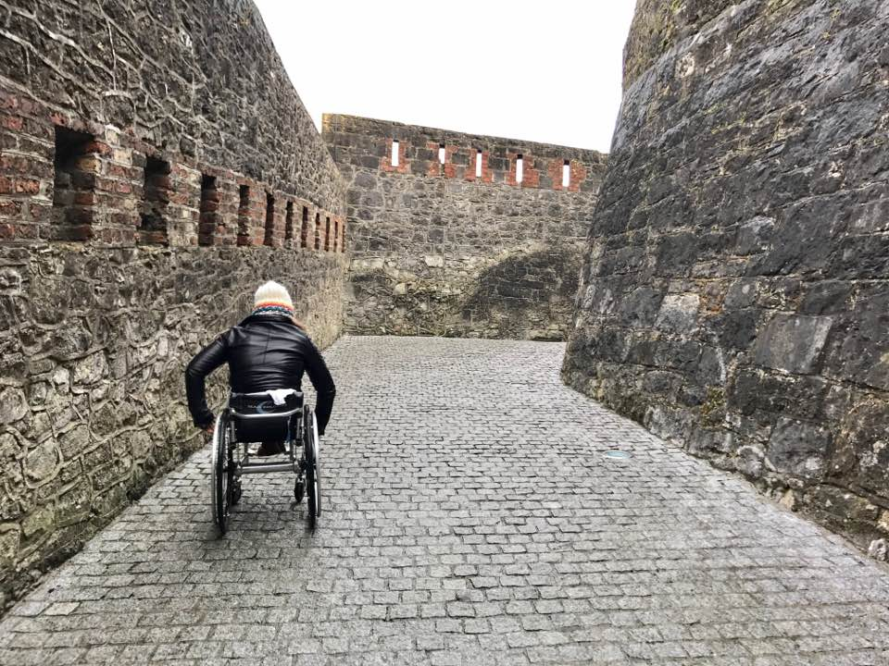
Notes:
Inclusivity is based on love for each other... respect for each other...care for each other… and doing what we can for each other...enabling a path for each other… and the hardest part of all … working with each other.
It allows us to recognize and celebrate our differences as individual gifts… and allows us to adapt to an ever changing world...experience… learn..and accept and see.
See people for people and me for me...
We can’t hold people back from successes … we need to remove invisibility screen… we need to see people for people…
we need to nurture the self worth in each other…
we cant let the stigmas get in our way…
and understand we do not know what is possible for another until we give them a chance to show us….
we cant miss out on talent and expertise, creativing, innovation…
And I'm ready to challenge society...challenge you... to look at diversity and inclusion through the eyes of innocents…
Just like how a child embraces the unknown...without judgement, with open arms, with love, and genuine curiosity to learn and grow....
Inclusion is not just about including people with disabilities in the world… its about how we include each and everyone one of us on the earth… to a better world.
I challenge you when leaving her today to be open to the collective work it takes to remove the screen of invisibility and see people for people and ...
me for me…
and open the doors even just a little more to inclusivity in the workplace…

Slide 36
Thank you for having me!
Connect with me via:
@alyciaspeaking
www.alyciaanderson.com

