Slide 1

New Pipeline of STEM Students: The Online Biochemistry Degree
Dr. Ara C. Austin
Clinical Assistant Professor
School of Molecular Sciences – Arizona State University
EMPOWER: ASU IT Professional Community Day (2019)

Slide 2
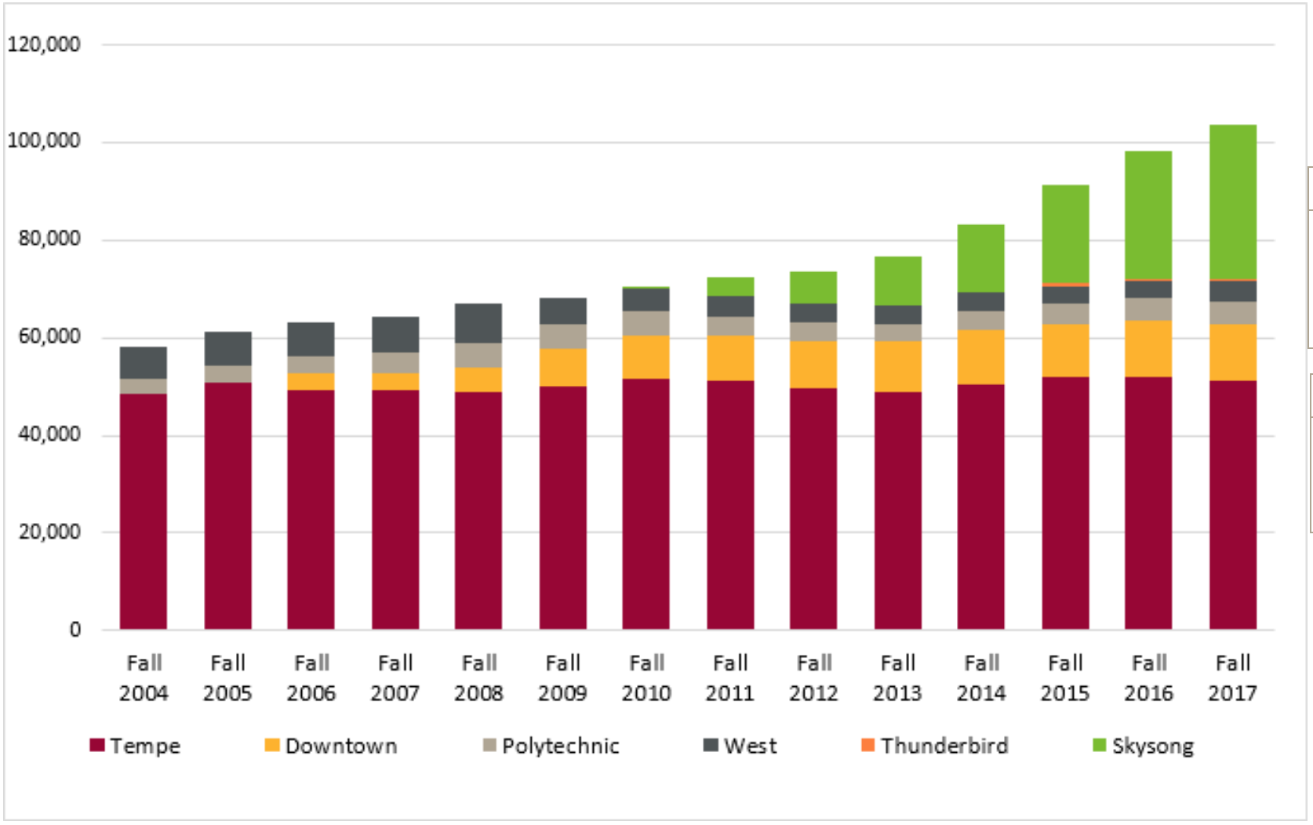


Slide 3
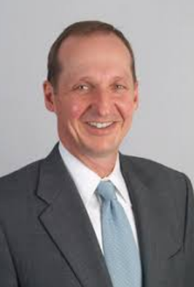
20 programs
Fall 2017
new
> 350 Employees
Instructional Design
Project Management
Academic Advising
Student Services
Quality Control
Student Success Coaches
BS & BAS Health Innovation
MS Business Journalism
MS Psychology & Forensic Psychology
BA and BS Forensic Psychology
BA Business/Corporate Accounting
MA Global Security
BA Global Studies
All Masters of Engineering (7 programs)
MBA
BS in Biochemistry – ONLY DEGREE
Phil Regier
Dean & CEO
Kepler Refugee Project
Kepler Refugee Project
with an on-campus component

Slide 4
Online BS in Biochemistry
In-state Tuition + Fees ~$10,800/year
Eight 14-week Sessions
Online Tuition + Fees
~$11,000 /yr
Nineteen 7-week Sessions

Slide 5
Online BS in Biochemistry
In-state Tuition + Fees ~$10,800/year
Eight 14-week Sessions
Online Tuition + Fees
~$11,000 /yr
Nineteen 7-week Sessions
Year 1:
English & Composition
Calculus I & II
General Chemistry with Labs I & II
Social Science or Humanities Electives
Year 2:
General Physics with Labs I & II
Organic Chemistry I & II
Social Science or Humanities Electives or Science Electives (example: Anatomy & Physiology I & II)
Summer 2:
Organic Chemistry Labs I & II
Year 3:
General Biology with Labs I & II
Physical Chemistry
Biophysical Chemistry
Upper Division Electives
Year 4:
Biochemistry I & II
Upper Division Biology Courses (examples: Cell Biology, Genetics, Animal Physiology)
Upper Division Chemistry or Biochemistry Courses
Summer 4:
Biochemistry Lab

Slide 6
Online BS in Biochemistry
In-state Tuition + Fees ~$10,800/year
Eight 14-week Sessions
Online Tuition + Fees
~$11,000 /yr
Nineteen 7-week Sessions
Year 1:
English & Composition
Calculus I & II
General Chemistry with Labs I & II
Social Science or Humanities Electives
Year 2:
General Physics with Labs I & II
Organic Chemistry I & II
Social Science or Humanities Electives or Science Electives (example: Anatomy & Physiology I & II)
Summer 2:
Organic Chemistry Labs I & II
Year 3:
General Biology with Labs I & II
Physical Chemistry
Biophysical Chemistry
Upper Division Electives
Year 4:
Biochemistry I & II
Upper Division Biology Courses (examples: Cell Biology, Genetics, Animal Physiology)
Upper Division Chemistry or Biochemistry Courses
Summer 4:
Biochemistry Lab
Identical Major Map for both
On-Campus and Online Students

Slide 7
On-Campus Lab Courses for ONLINE STUDENTS
TWO Semesters of Organic Chemistry Lab Courses IN 7 DAYS!

Slide 8
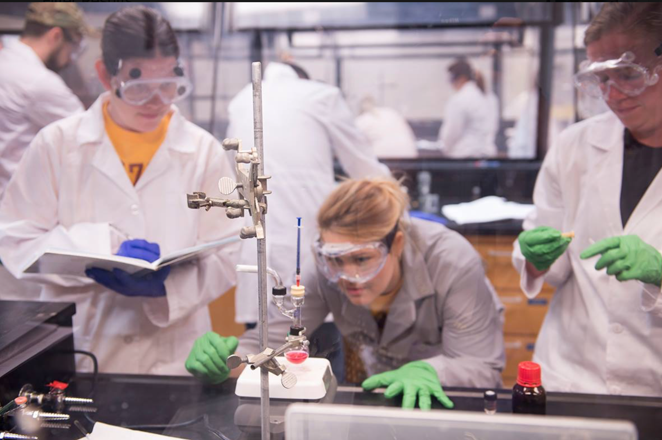
On-Campus Lab Courses for ONLINE STUDENTS
TWO Semesters of Organic Chemistry Lab Courses IN 7 DAYS!
1st Sem
2nd Sem
Sa Su Mo Tu We Th Fr Sa Su
Lab Reports
arrive
leave
Each Day: 8AM – 6PM
Identical assignments as on-campus
lab courses
All experiments in curriculum completed

Slide 9
Is This a Better Way to Run Labs Anyway?
Motivation, Identity and Knowledge Study

Slide 10
Is This a Better Way to Run Labs Anyway?
Motivation, Identity and Knowledge Study

Slide 11
Is This a Better Way to Run Labs Anyway?
Motivation, Identity and Knowledge Study

Slide 12
~50 majors

Slide 13
550 majors!
450 enrolled

Slide 14
Reality!
550 majors!
450 enrolled
650 majors!

Slide 15
Reality!
550 majors!
450 enrolled
550 majors!
450 enrolled
650 majors!

Slide 16
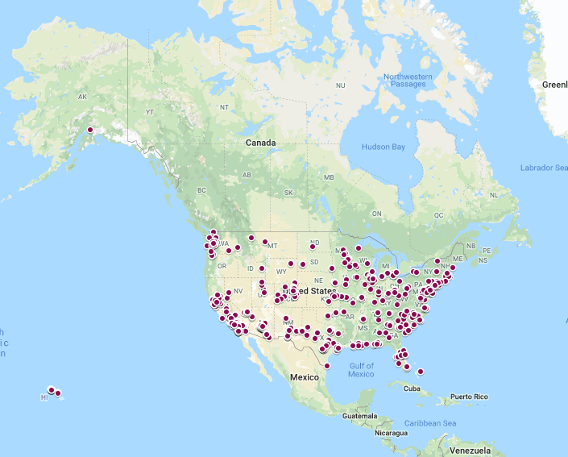
Online BS in Biochemistry
Spring 2019 – 660 students
Arizona | 14.4%
Non-Arizona | 82.3%
Outside of US | 3.3%
47 states represented!

Slide 17
Online BS in Biochemistry
Spring 2019 Enrollment
On
Campus
776
Female
51%
Female
51%
Female
66%
Male
37%
Online 660
Male
51%
Female
49%
Female
63%

Slide 18
Online BS in Biochemistry
Spring 2019 Enrollment
On
Campus
776
Female
51%
Female
51%
Female
66%
Male
37%
Online 660
Male
51%
Female
49%
Female
63%
Age = 21
Age = 26

Slide 19
Online BS in Biochemistry
Spring 2019 Enrollment
On
Campus
776
Female
51%
Female
51%
Female
66%
Male
37%
Online 660
Male
51%
Female
49%
Female
63%
Age = 21
Age = 26
Latinx/Hispanic
22%
Latinx/Hispanic
19%
White/Caucasian
47%
White/Caucasian
57%
Black/African
American
9%
Black/African
American
3%
Asian
21%
Asian 7%

Slide 20
Online BS in Biochemistry
Financial Need (FAFSA)
LOW Need
25%
LOW Need
13%
Female
51%
Female
51%
Female
66%
Male
51%
Female
63%
On
Campus
Online
Female
51%

Slide 21
Online BS in Biochemistry
Financial Need (FAFSA)
LOW Need
25%
LOW Need
13%
Female
51%
Female
51%
Female
66%
Male
51%
Female
63%
On
Campus
Online
HIGH Need
7%
HIGH Need
14%
Female
51%
Female
51%
Female
66%
Male
51%
Female
63%
VERY HIGH Need
36%
VERY HIGH Need
50%

Slide 22
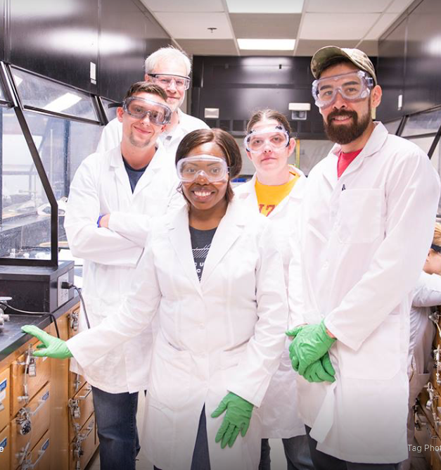
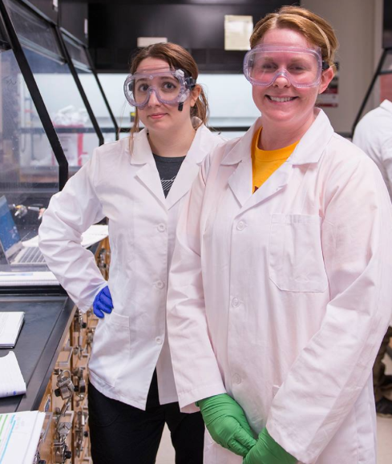
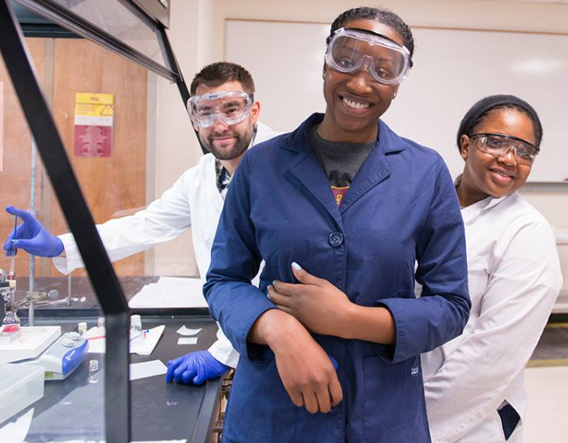
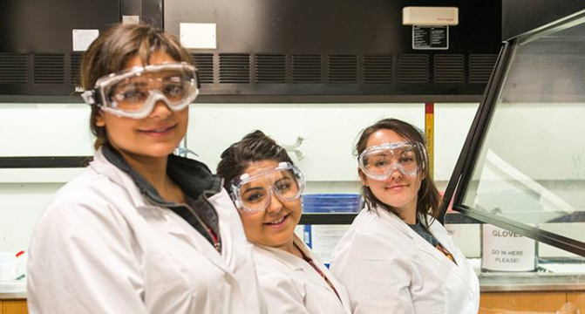
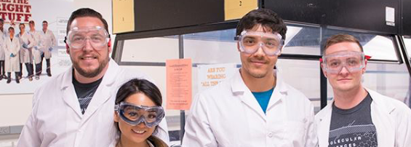
Student Narratives – Why are they pursuing an online degree?

Slide 23
So, where does IT (UTO) fit into all of this?
I don’t know what I clicked on Canvas, but everything seems to be broken!
Call the Help Desk!

Slide 24
So, where does IT (UTO) fit into all of this?
I don’t know what I clicked on Canvas, but everything seems to be broken!
Call the Help Desk!
I tried to access my exam for the 5th time on RPNow, but it isn’t working!
Call the Help Desk!

Slide 25
So, where does IT (UTO) fit into all of this?
I don’t know what I clicked on Canvas, but everything seems to be broken!
Call the Help Desk!
I tried to access my exam for the 5th time on RPNow, but it isn’t working!
Call the Help Desk!
I have 7 Zoom accounts and want to merge all of them into one!
Call the Help Desk!

Slide 26
So, where does IT (UTO) fit into all of this?
I don’t know what I clicked on Canvas, but everything seems to be broken!
Call the Help Desk!
I tried to access my exam for the 5th time on RPNow, but it isn’t working!
Call the Help Desk!
I have 7 Zoom accounts and want to merge all of them into one!
Call the Help Desk!
ALL Online Degrees

Slide 27
So, where does IT (UTO) fit into all of this?
I don’t know what I clicked on Canvas, but everything seems to be broken!
Call the Help Desk!
I tried to access my exam for the 5th time on RPNow, but it isn’t working!
Call the Help Desk!
I have 7 Zoom accounts and want to merge all of them into one!
Call the Help Desk!
ALL Online Degrees
NEED
TECHNOLOGY

Slide 28
So, where does IT (UTO) fit into all of this?
I don’t know what I clicked on Canvas, but everything seems to be broken!
Call the Help Desk!
I tried to access my exam for the 5th time on RPNow, but it isn’t working!
Call the Help Desk!
I have 7 Zoom accounts and want to merge all of them into one!
Call the Help Desk!
ALL Online Degrees
NEED
@ASU
UTO (IT)
TECHNOLOGY

Slide 29
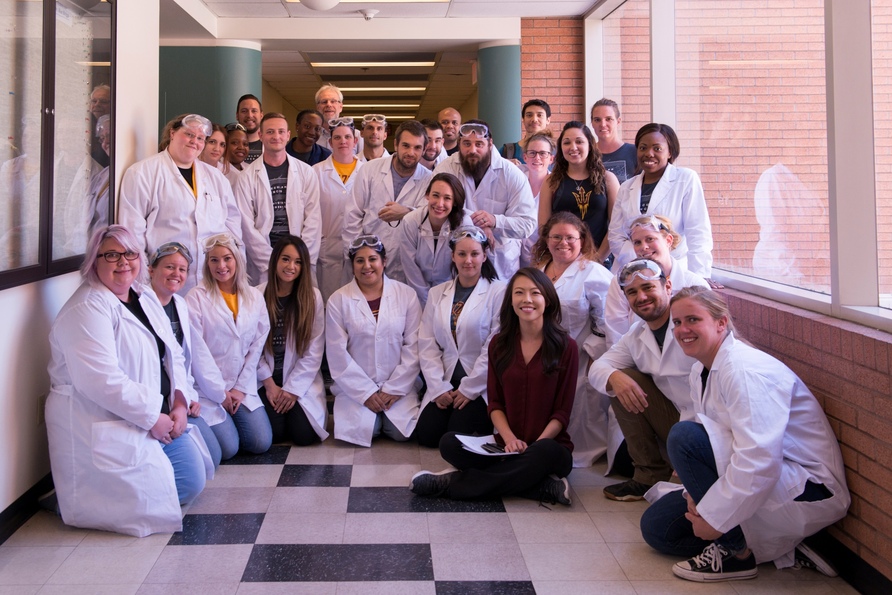

Thank you for your HARD WORK – we appreciate you!

