Slide 1
CGEST@ASU
Empower: An ASU IT Professional Community Day
Presentation by
Dr. Kimberly A. Scott
Professor & Founding Executive Director
May 22, 2019
The Center for Gender Equity in Science and Technology
2019 | Arizona State University

Slide 2
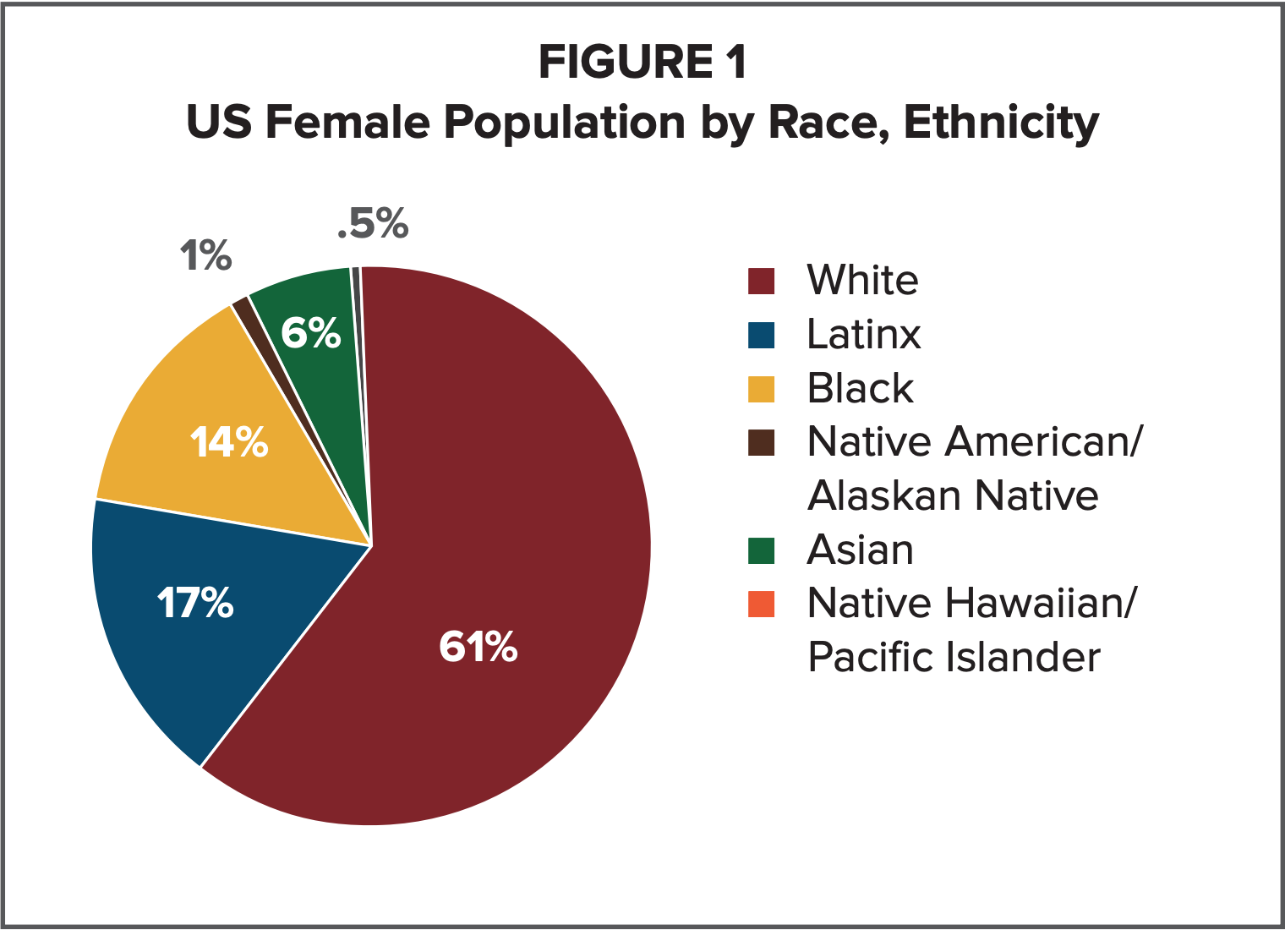
Statistics
Source: U.S. Bureau of Census (2014)
Notes:
https://www.wocincomputing.org/wp-content/uploads/2018/08/WOCinComputingDataBrief.pdf

Slide 3
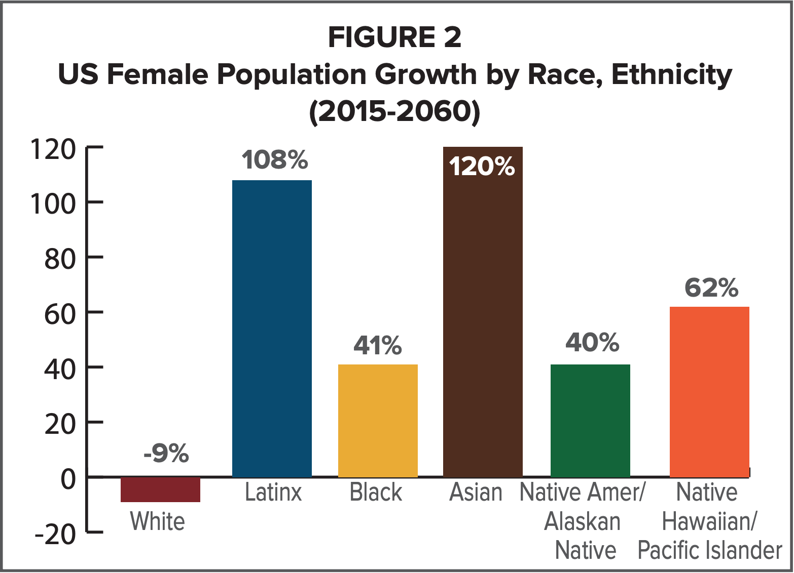
Statistics
Source: U.S. Bureau of Census (2014)
Notes:
https://www.wocincomputing.org/wp-content/uploads/2018/08/WOCinComputingDataBrief.pdf

Slide 4
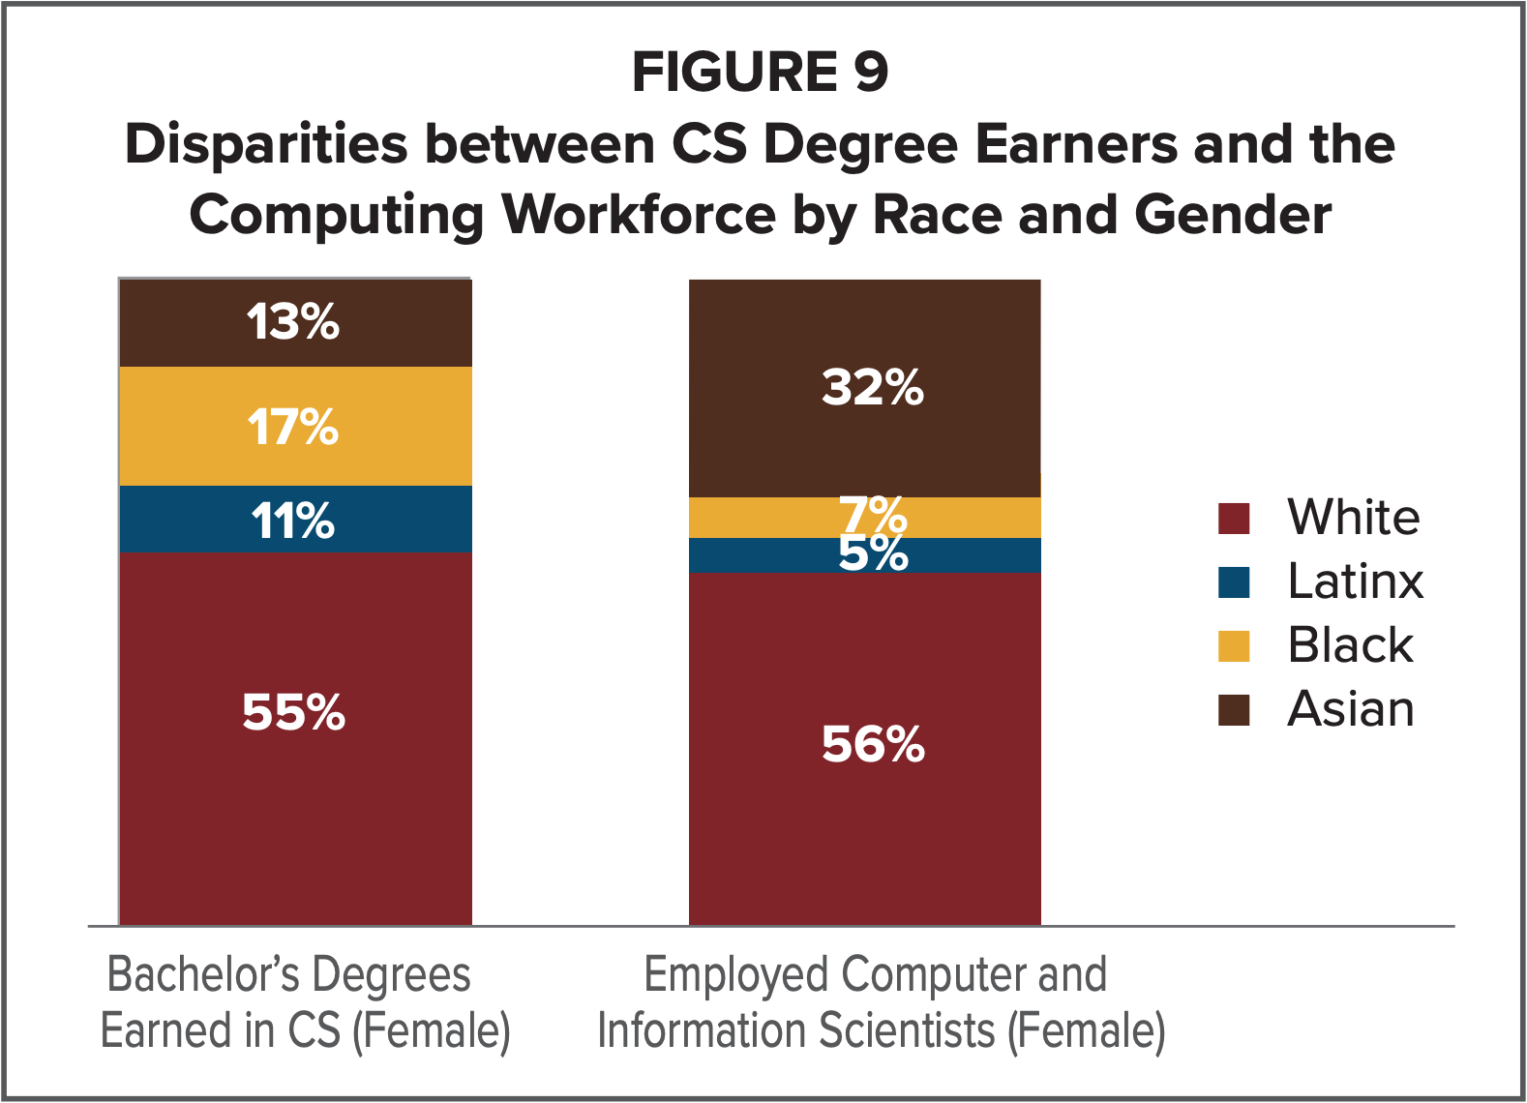
Statistics
Source: NSF (2015a). Table 9-7; NSF (2016a). Table 5-4. Native American/ Alaskan Native and Native Hawaiian populations were too small to report. The percentages for Other/Multiple Races not reported.
Notes:
https://www.wocincomputing.org/wp-content/uploads/2018/08/WOCinComputingDataBrief.pdf

Slide 5
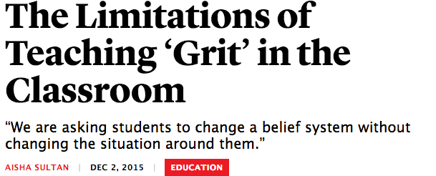
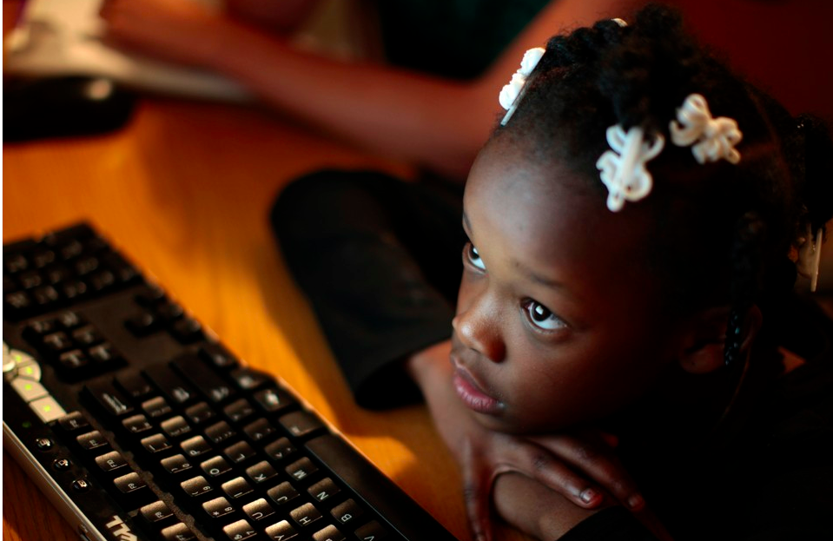
Alleged Cause #1: Motivation
Grit=Perseverance + Passion
(Duckworth, Peterson, Matthews & Kelly, 2007;
Dweck’s Growth Mindset
Notes:
Rhetoric: Black girls and women are not motivated to engage in Computer Science
Evidence to refute:

Slide 6
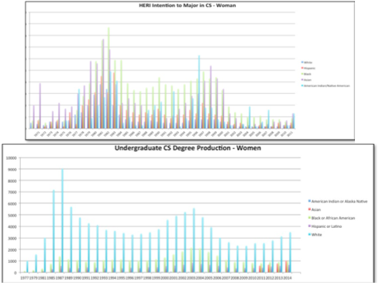
Counternarrative #1
“...the myth of the level playing field...is the myth of equal opportunity to compete.”
- Hill Collins & Bilge (2016)
Notes:
When looking specifically at
Black women in CS, they comprise only 3% of all of the
Bachelor’s degrees awarded in CS in the United States [25],
despite 2016 resulting in the highest number of Bachelor’s
degrees awarded in CS in the U.S. to women overall since
2002-2003 [25].

Slide 7
Alleged Cause #2: Skill / Capability/Experiences
“...they hadn’t been ‘Googley’ enough”
Rhetoric:
Evidence to refute:
“I think that our [black women’s] experiences are unique…appropriate to be the most broadly thinking, systematic thinkers, innovative thinkers in computing. And so to not get into computing would be to rob the world of ground-breaking solutions that will truly impact lives.”
- Thomas, et. al, in press
Notes:
Black girls and women have deficiencies or deficits in their Computing skills & capabilities that cannot be addressed or overcome because they enter and move through Computing differently than other groups
Evidence to refute - 1) we are present in the field (see below immediately for making that stronger)
Look for evidence that when we do go into the field, we stay and/or we do well in the field
According to a study by the Center for Talent Innovation: • Eighty percent of women in SET report “loving their work” (Hewlett, Sherbin, with Dieudonné, Fargnoli, & Fredman, 2014). •
2) the contextual factors (see next slide)
Yet 56 percent leave their organizations at the mid-level points (10-20 years) in their careers (Hewlett et al., 2008). As Figure 1.5 illustrates, female attrition is higher in technology than in science and in engineering. In all cases, the quit rate for women is higher than it is for men. In the high tech industry, the quit rate is more than twice as high for women (41 percent) than it is for men (17 percent) (Hewlett et al., 2008).
Tech Leavers Report - “unfairness-related turnover” costing the high-tech
industry over $16 billion [16]. This trend is perpetuated, in
part, by a false narrative of Computing being color blind and
meritocratic, where the success of individuals is almost
exclusively based on ability and talent. This notion of
Computing being color blind and meritocratic suggests a level
playing field as well as the notion of who is and is not “CS
material” [14]. These false notions of a level playing field
coupled with notions around who is or is not “CS material”
often result in interventions where the emphasis is on “fixing”
the perceived deficiencies or characteristics that exist among
groups who are under-represented in the field or helping them
adapt to the “chilly” and often uninviting climates of
Computing in the absence of also fixing the institutional and
organizational structures, behaviors, and culture that create and
support those barriers and from which those challenges for
women of color manifest. The lack of diversity in the high-tech
workforce is also perpetuated, in part, by a lack of transparency
around issues of diversity acquisition and retention [16] as well
as by the history of racial and gender discrimination in the US,
implicit biases and assumptions that a different look, path into
or path through CS equates to deficiencies in CS that cannot be
supported or addressed [17].

Slide 8
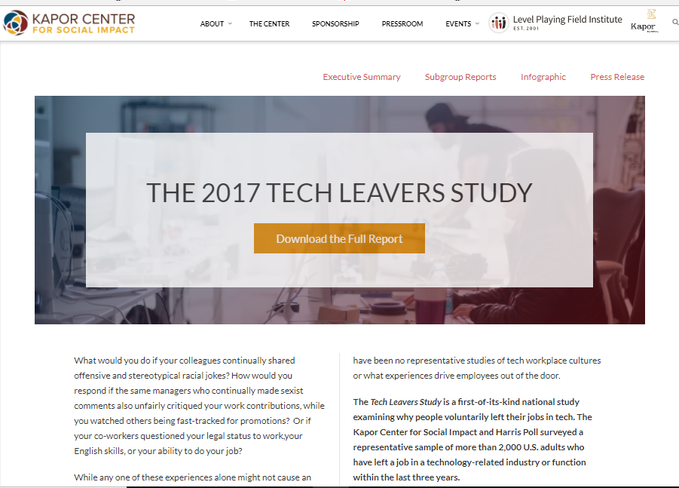
Counterstory #2
“‘Unfairness-
related turnover’ [is] costing the high-tech industry over $16 billion...”
-Tech Leavers Report (2017)

Slide 9
Counterstory #2

Slide 10
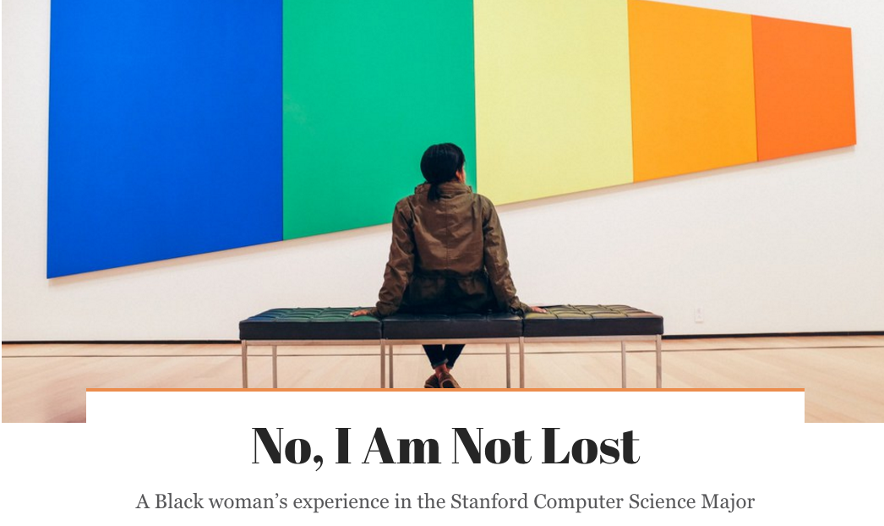
Alleged Cause #3: Access
“They expect me to either be able to do it all because I have had a wealth of experience, or they pretty much expect me to be there and just cosign to whatever it is they want to do. So, it's one extreme or the other, not much in the middle.
Thomas, et. al., in press
Notes:
Rhetoric: If Black girls and women had more access to Computing hardware and/or outreach programs, representation in Computer Science education would improve
Evidence to refute:

Slide 11
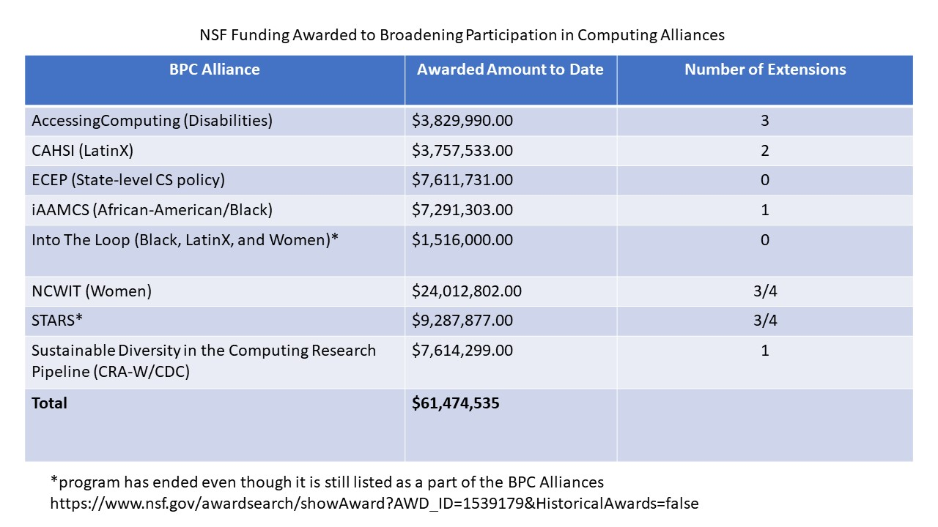
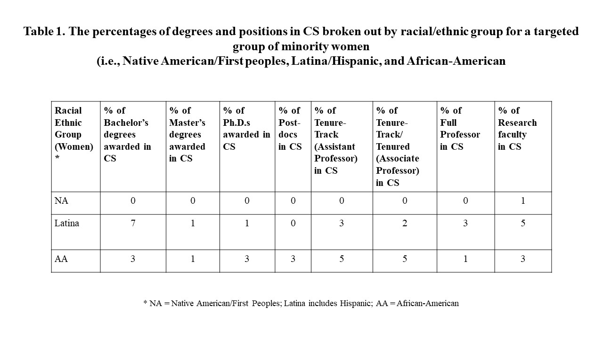
Counterstory #3
“...cultures have to change, too” - L. Burge
Notes:
The BPC Alliances were established between 2006 and 2009 to increase the number and diversity of college graduates in the computing and computationally-intensive disciplines. The Alliances are national and regional collaborations of academic institutions, educators, professional societies, community organizations, and industrial partners. They create the best practices, educational resources, advocacy networks, and forums needed to transform computing education. In aggregate, the BPC Alliances broadly address issues of engagement and education across the K-20 academic pipeline. They are specifically charged with addressing the long standing underrepresentation of many groups within the computing community but, many, if not most, BPC-A activities increase awareness, access, engagement, and inclusion for all students.
What is surprising is that it is failing to attract many of our students: since 2000, the number of students who arrive at college intending to major in computing is down by 70%, 80% for women.[1] College enrollments and degree production in computing majors has also decreased dramatically over this time period, and although there are some recent improvements in enrollments, we are still significantly under producing students with the 21st Century skills that will be needed in a competitive, global economy. Recent ACT data, for example, shows projected job growth out-pacing student interest in computing majors by a factor of 5.5.

Slide 12
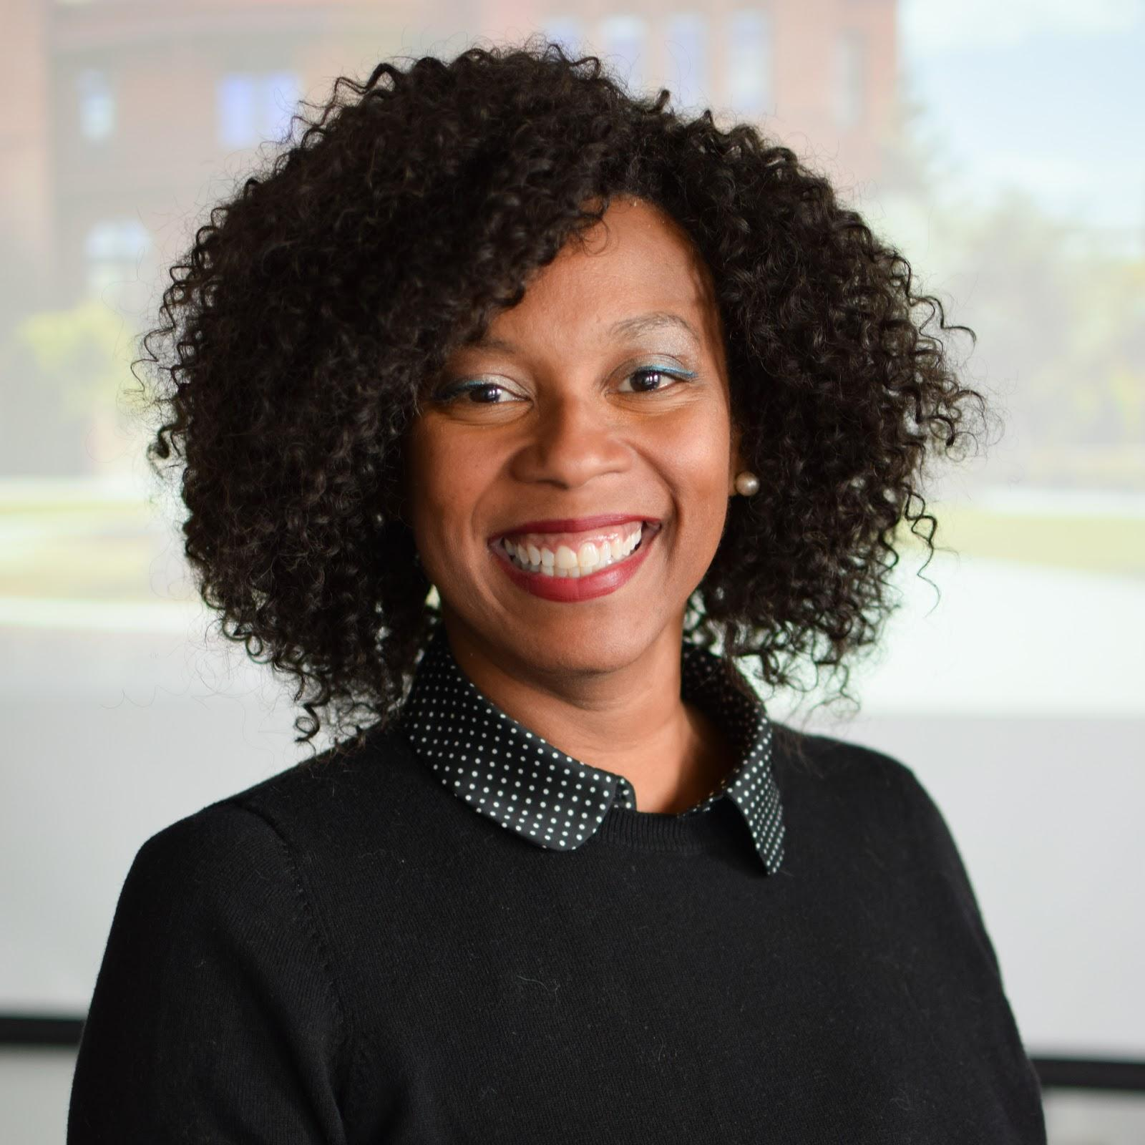
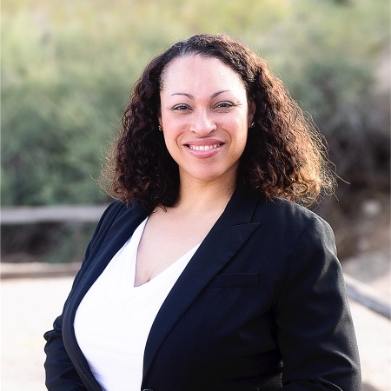
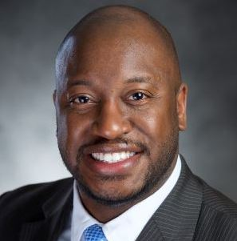
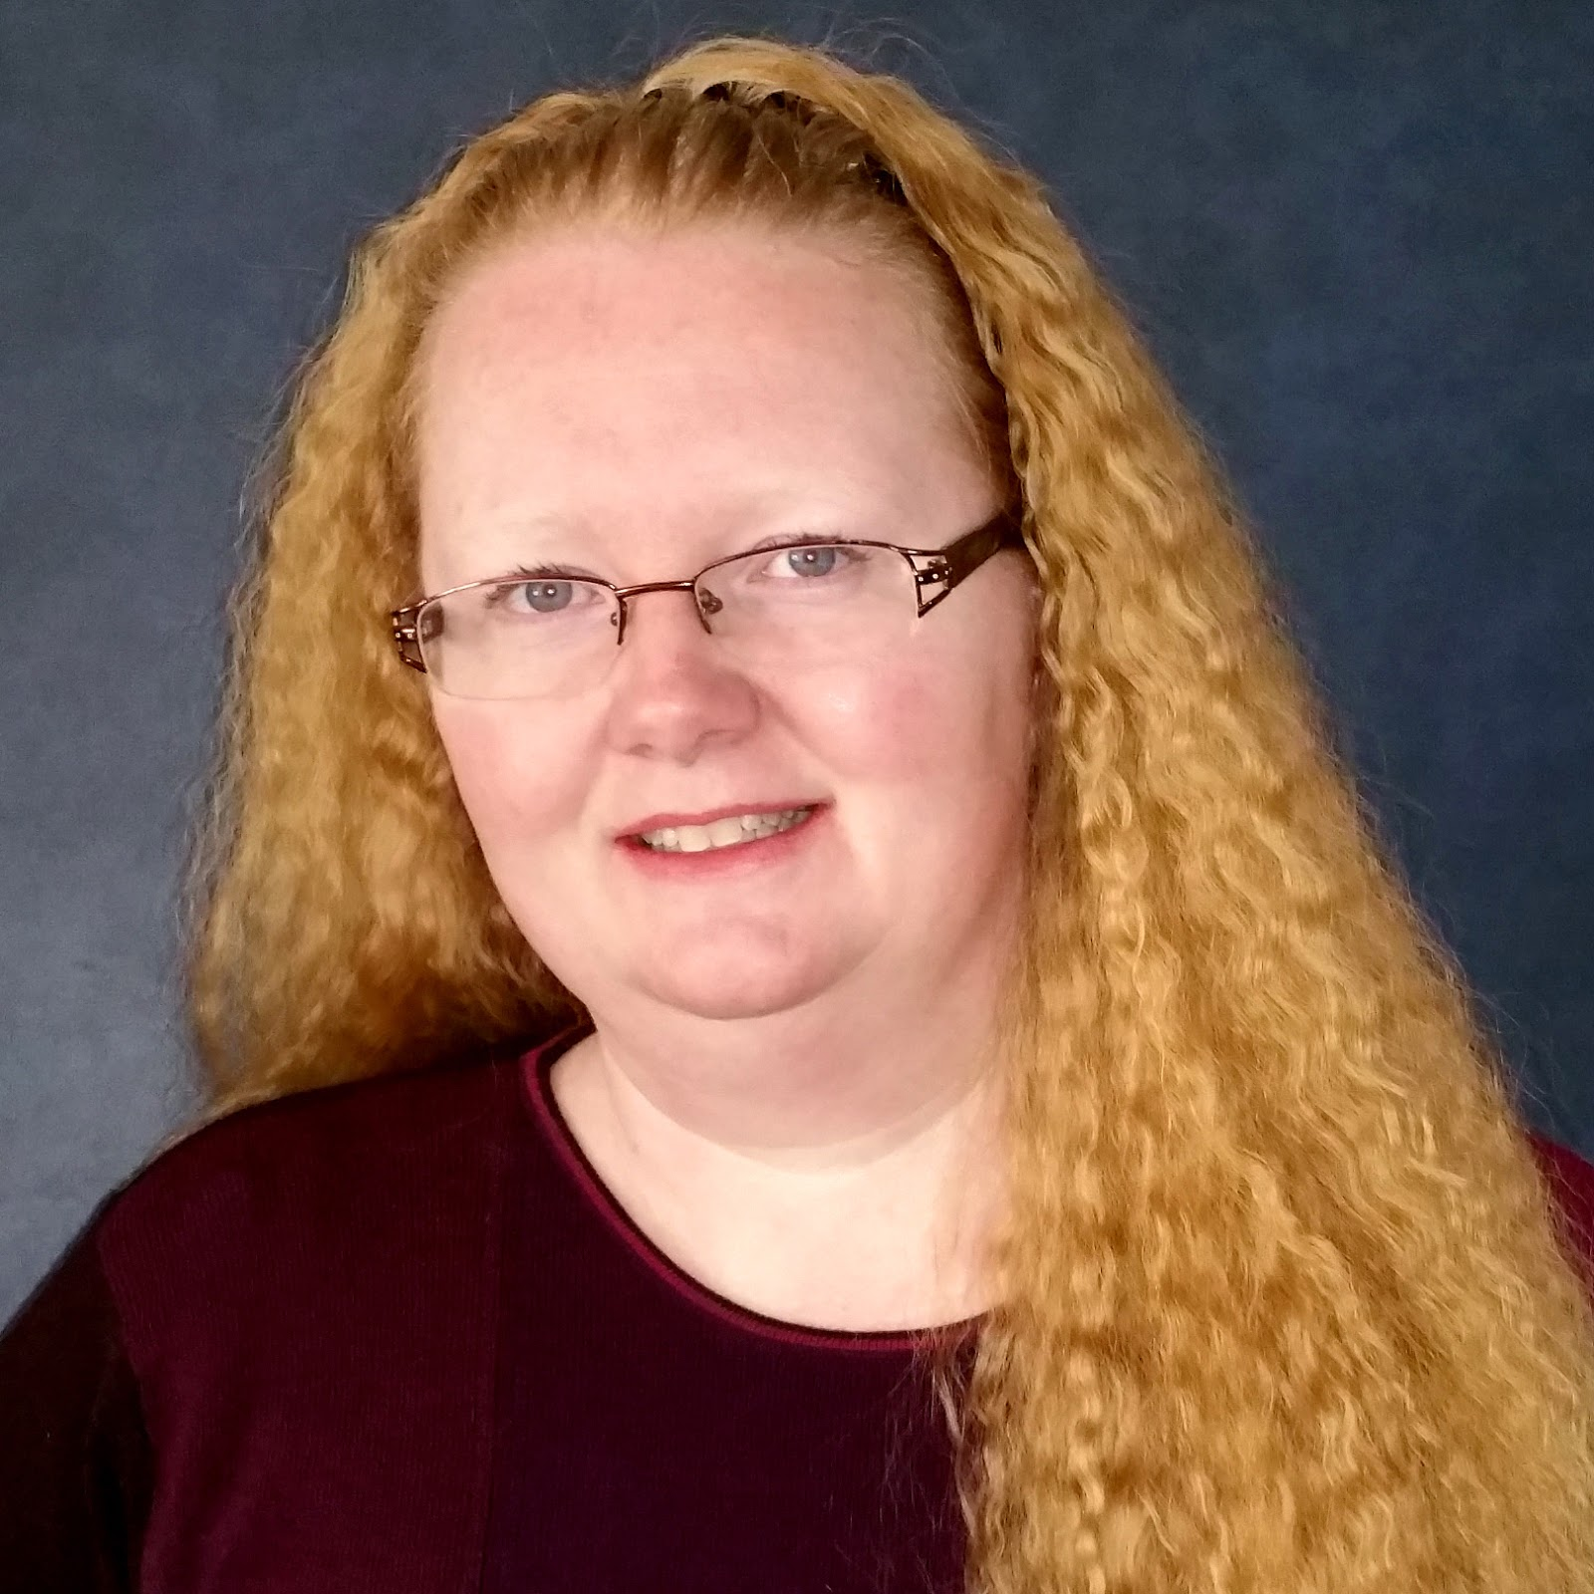
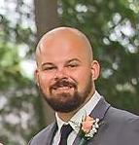
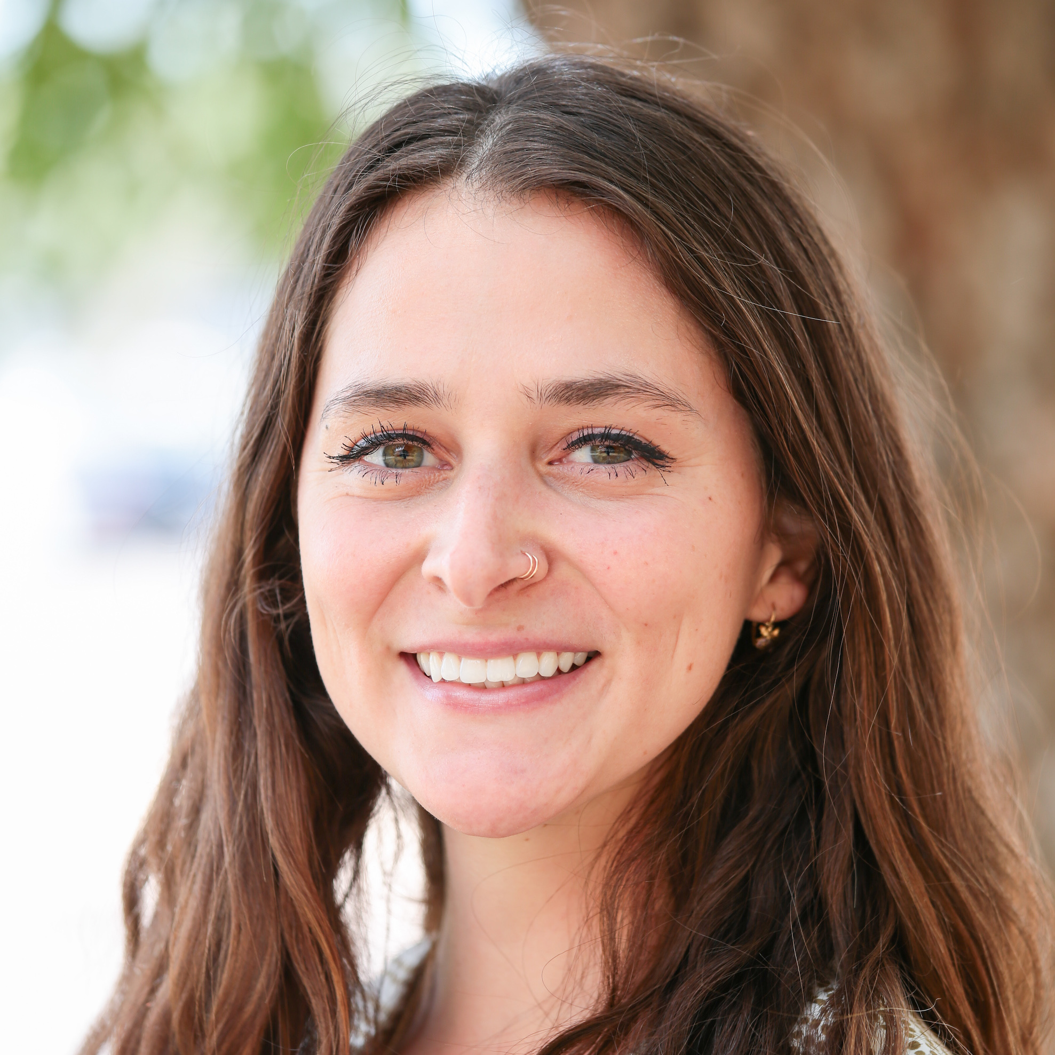
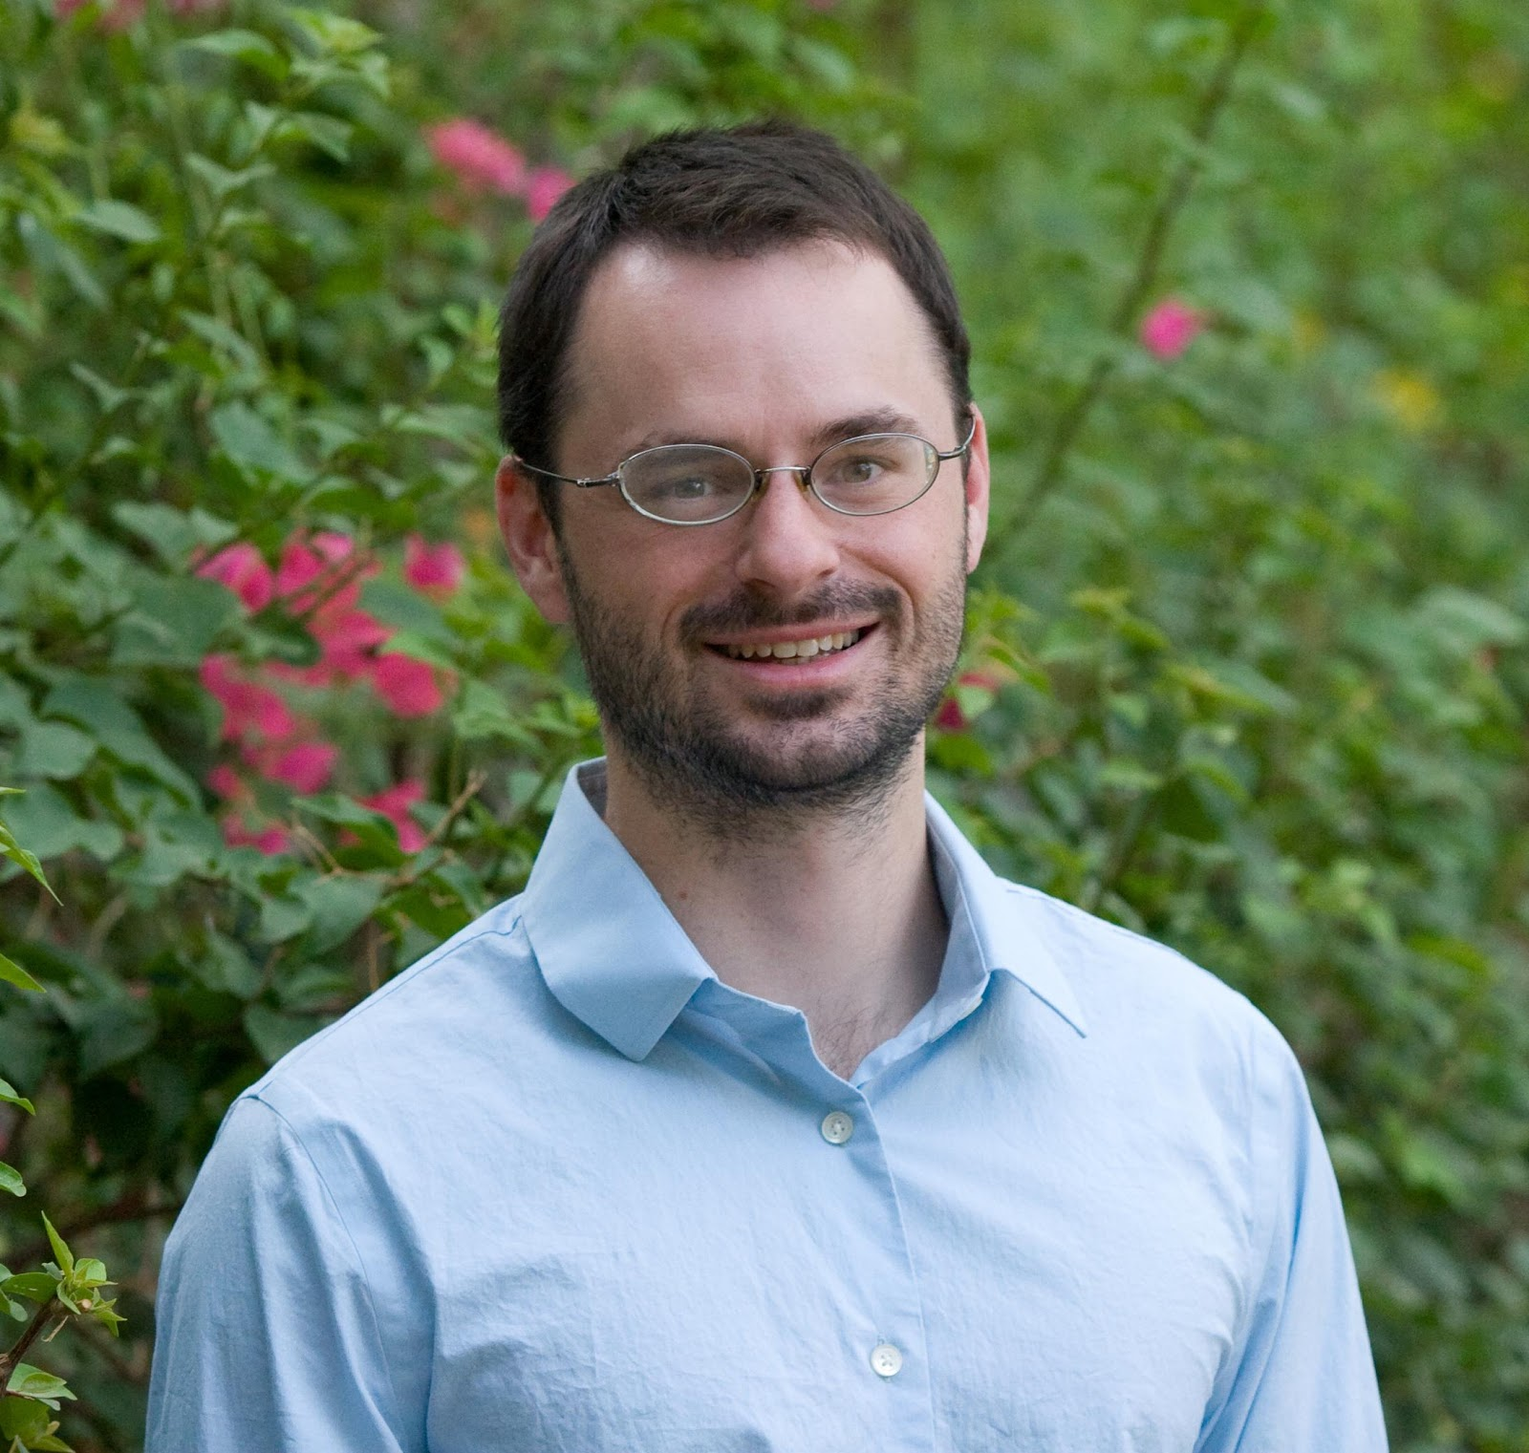
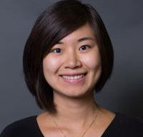
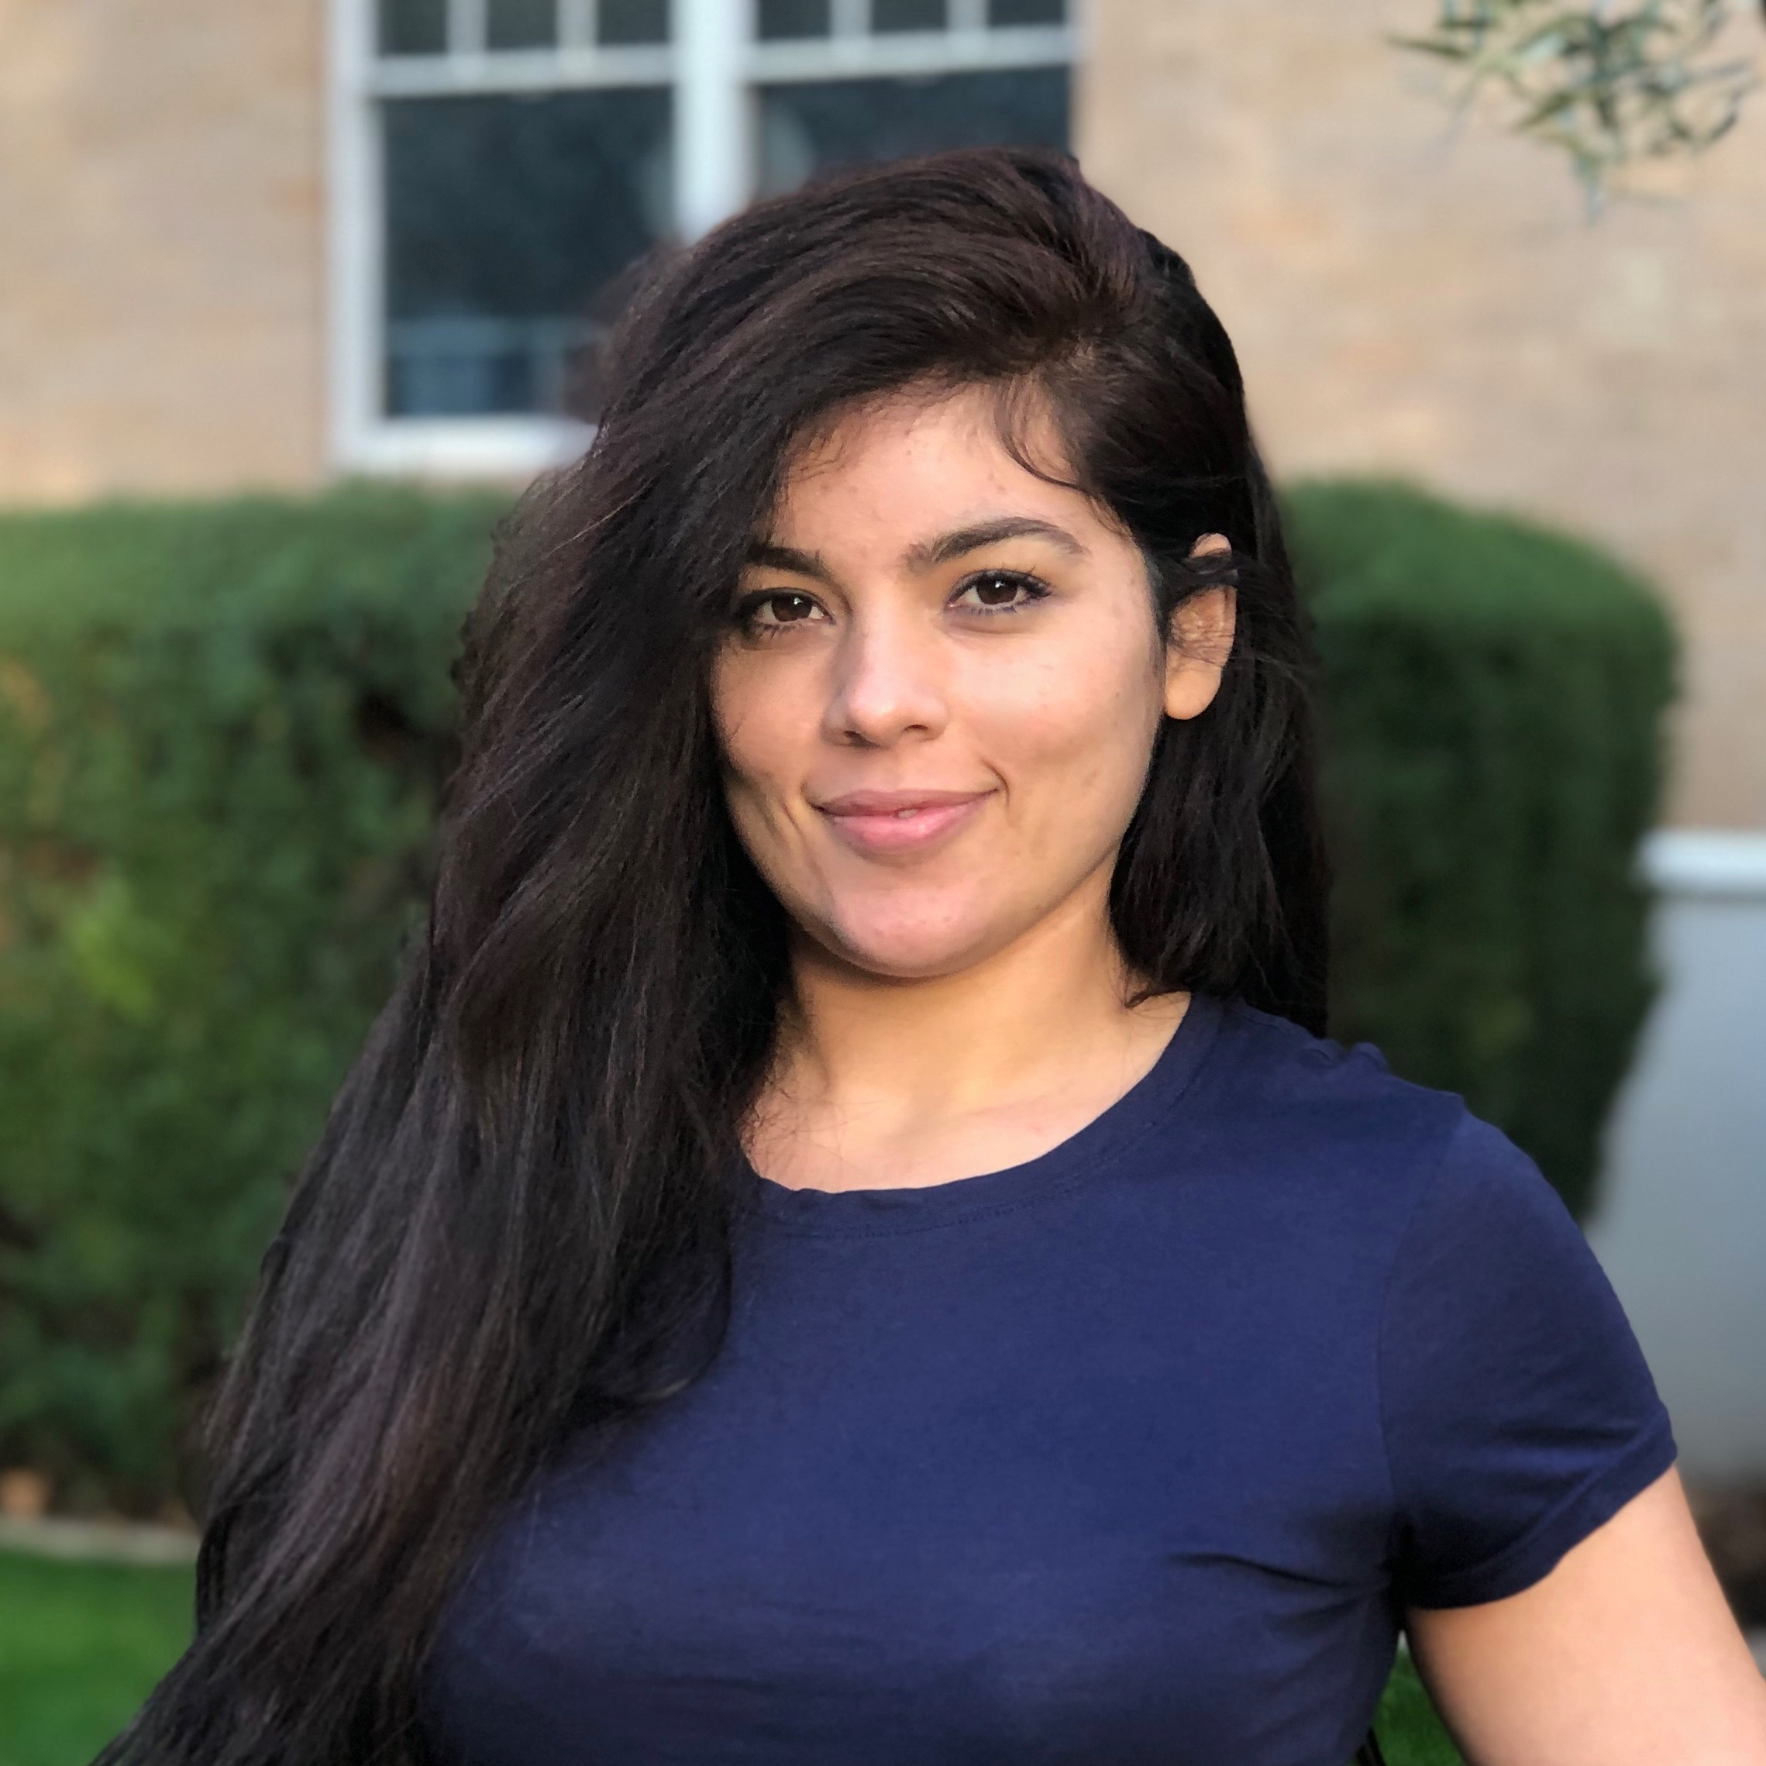
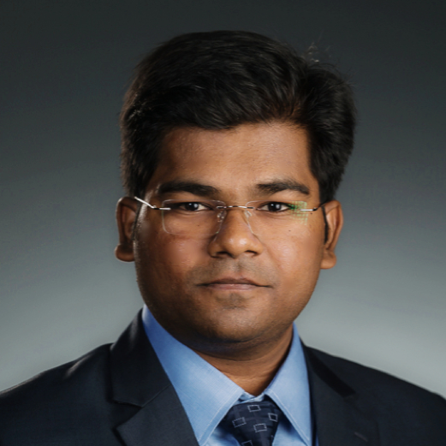
Advocacy
Kimberly A. Scott, EdD
Professor and Founding Executive Director
Kalani Rice
Program Manager
Oliver Dean
Communications & Media Relations Program Coordinator
Capacity Building
Sheldon Joseph
Project Manager
Kristin Elwood, Ph.D
Curriculum Designer
Matt Ruf
Executive Coordinator
Gabrielle Swindle
Education Outreach Specialist
Knowledge
CGEST@ASU
Steve Elliot, Ph.D
Postdoctoral Scholar
Chun Tao
Graduate Research
Assistant
Jessica Borders
Graduate Research
Assistant
Mounic Kumar
Ravikumar
Graduate Research
Aide
Notes:
Notes from Kalani: Add grants under name.

Slide 13
How do WE help?
CGEST@ASU
We establish and create culturally responsive programs through Advocacy, Capacity Building and Knowledge

Slide 14
The Mission
CGEST@ASU
The Center aims to create an interdisciplinary, racially-ethnically diverse Community of scholars, students, policy makers, and practitioners who explore, identify, and ultimately create innovative scholarship about and best practices for under-represented girls and women in STEM.

Slide 15
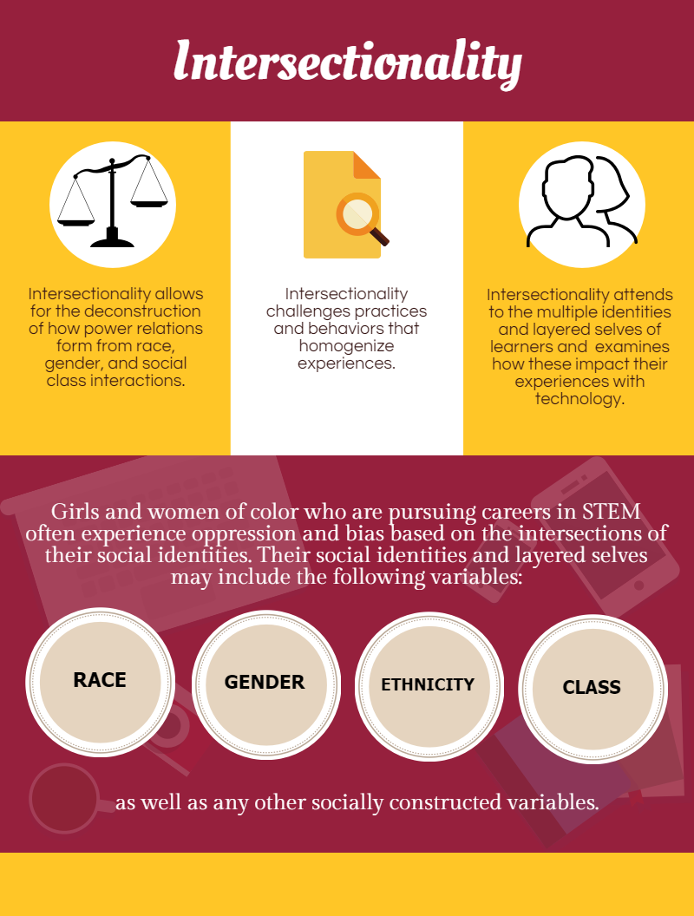

Slide 17
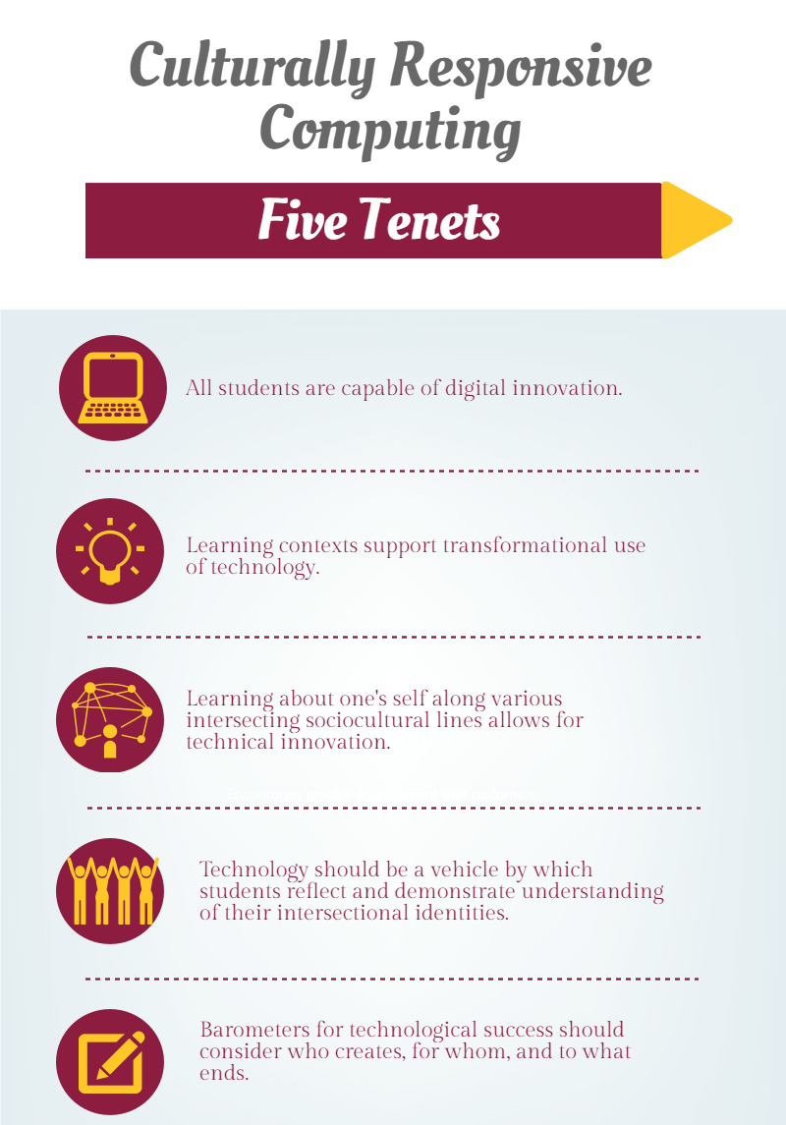

Slide 18
CompuGirls Ecosystem
CGEST@ASU
Techno-social Change Agent
Teachers
Peers
Self Concept
Leadership
Technical
Abilities
Parents
Industry
SOURCE: Scott, K. A., Sheridan, K. M., & Clark, K. (2014). Culturally responsive computing: A theory revisited. Learning, Media and Technology, 40(4), 412-436.

Slide 19
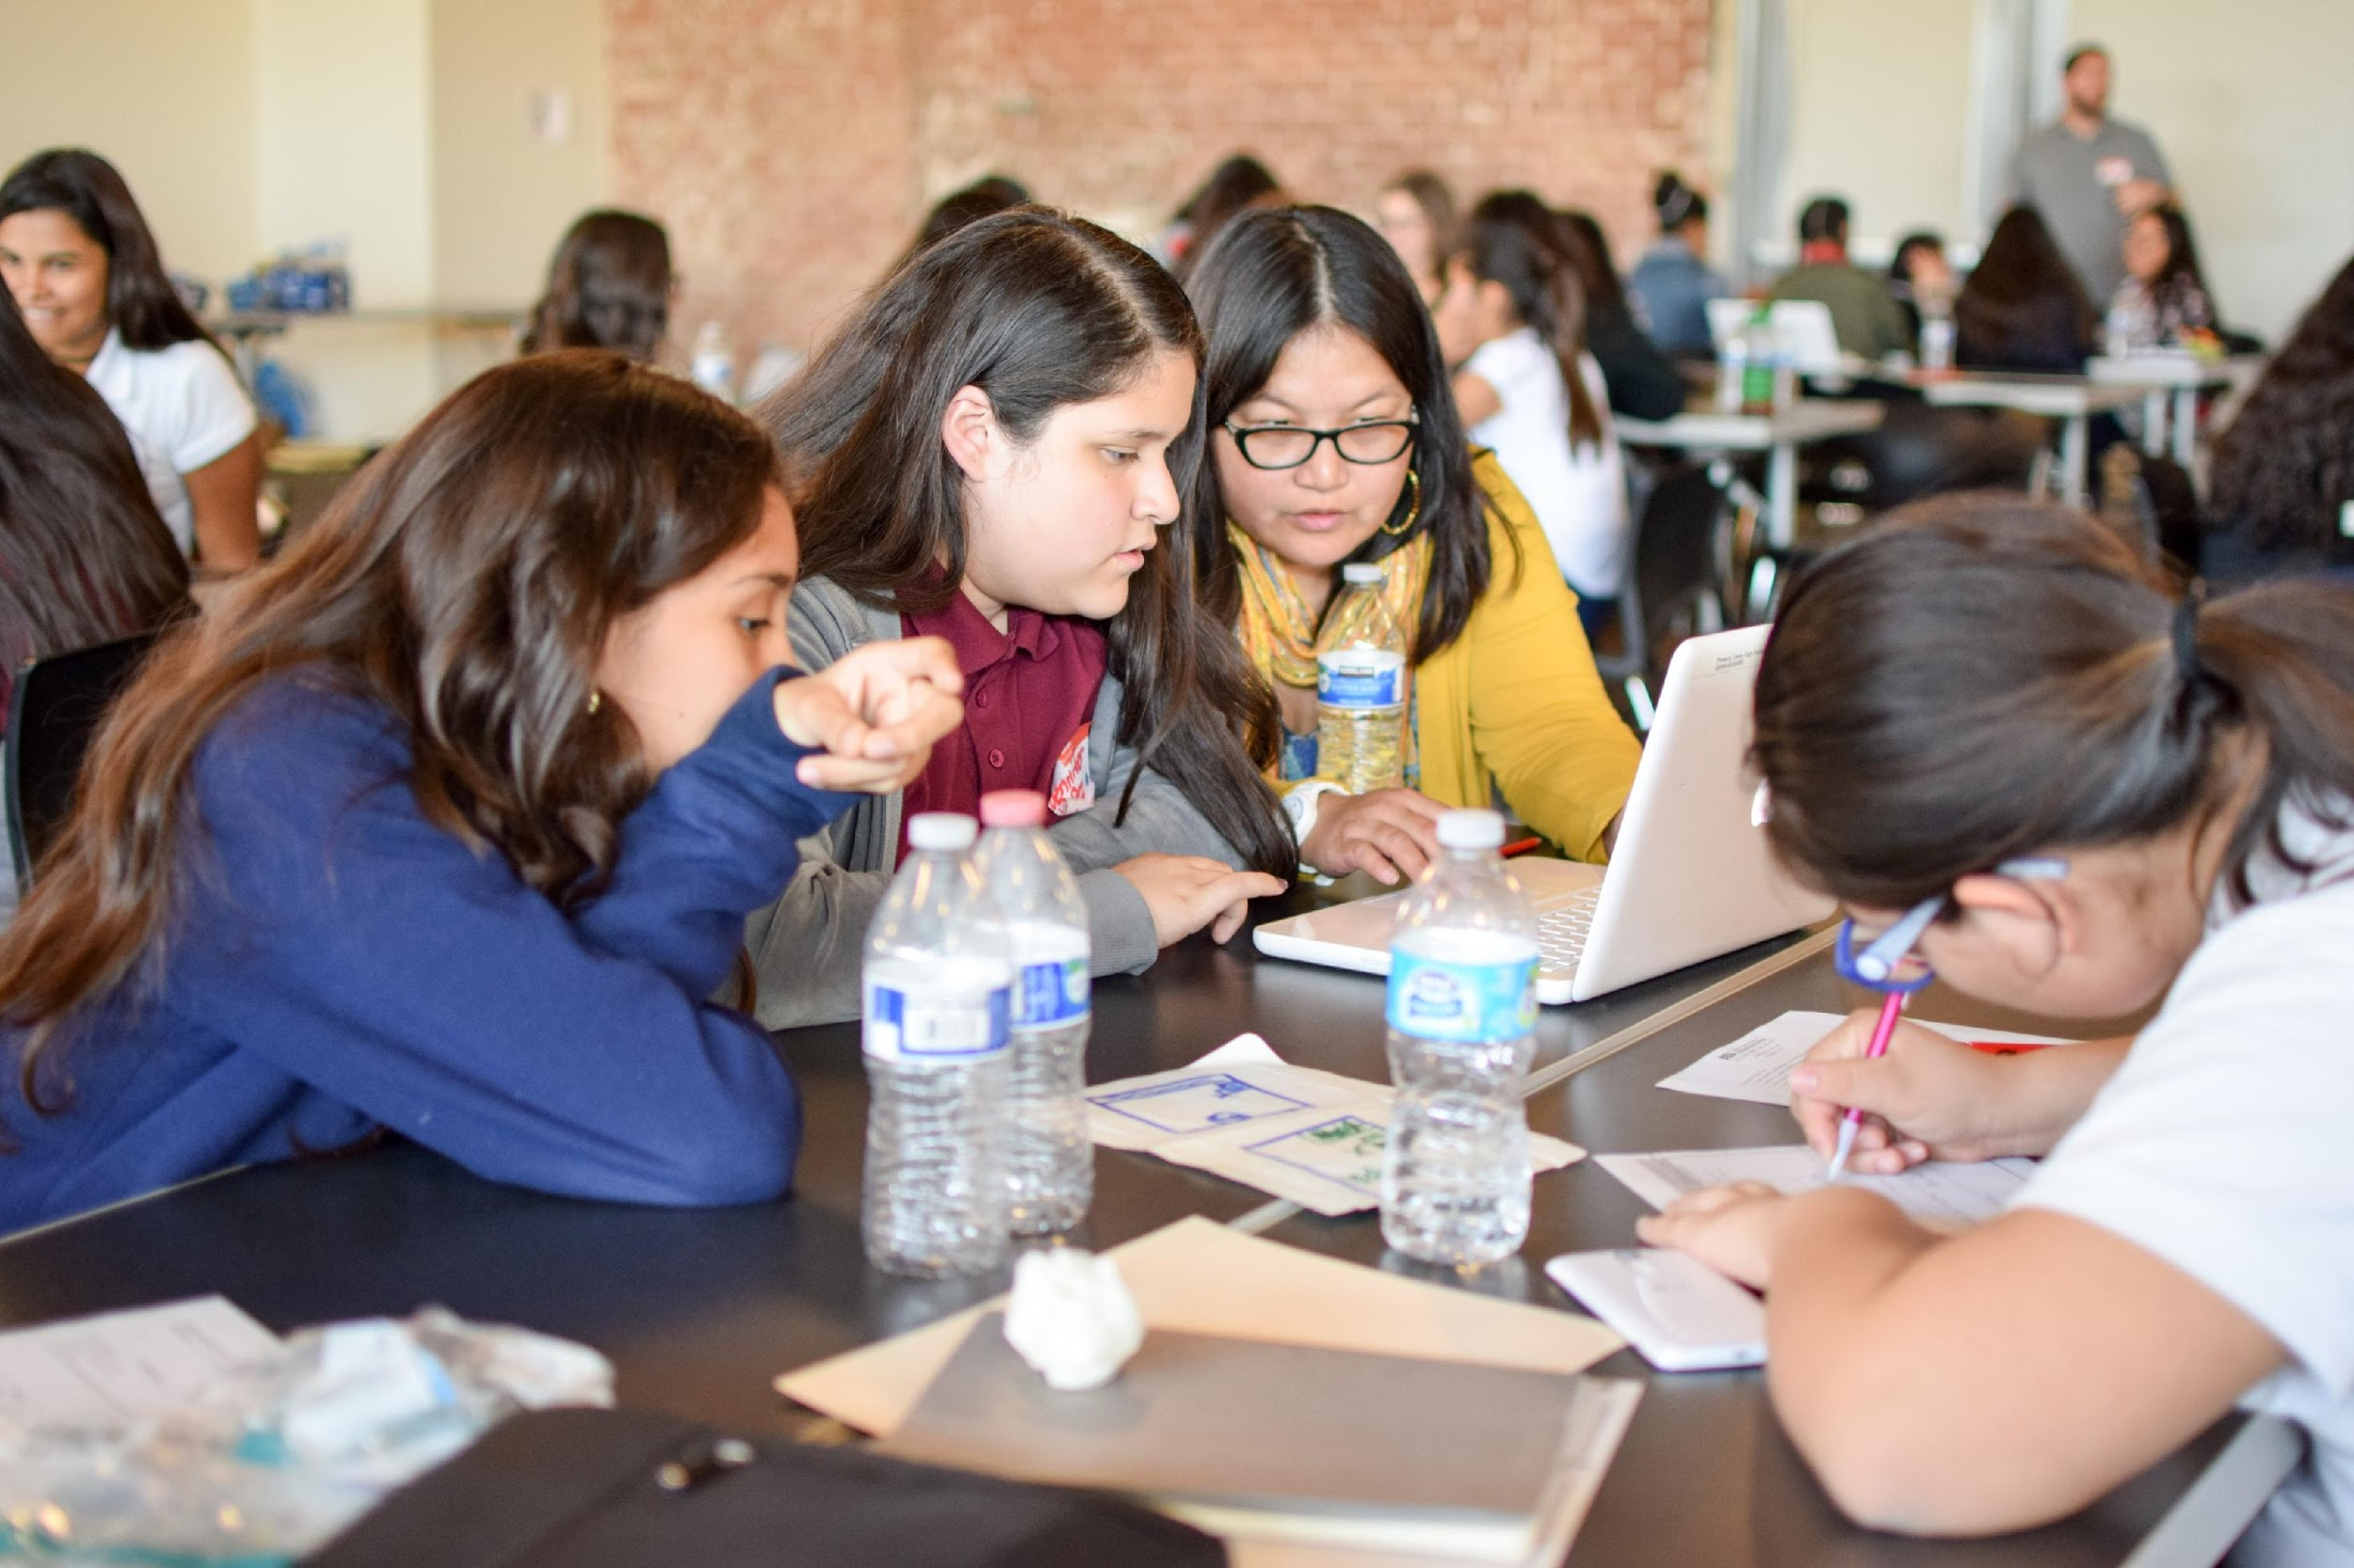
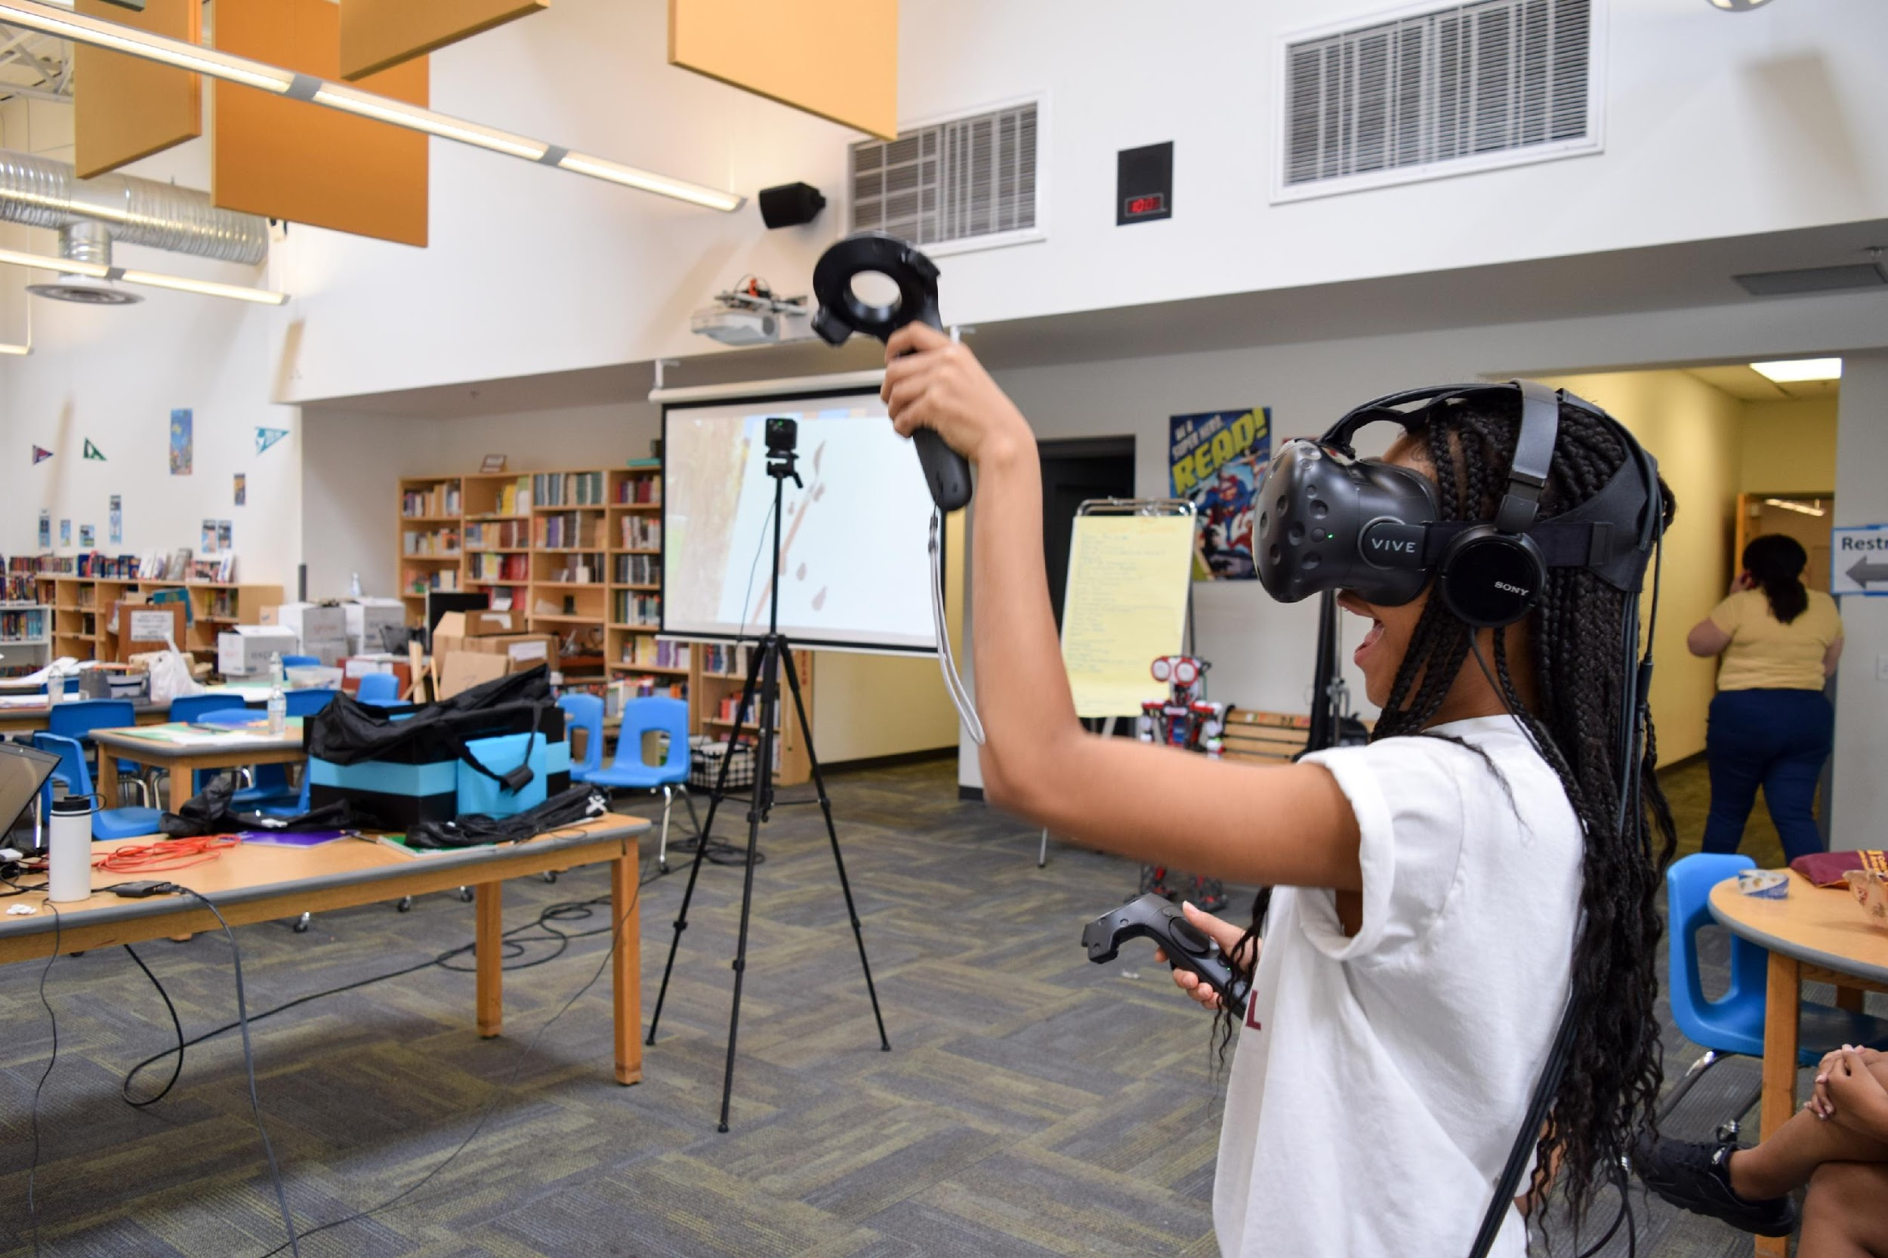
CGEST@ASU

Slide 20
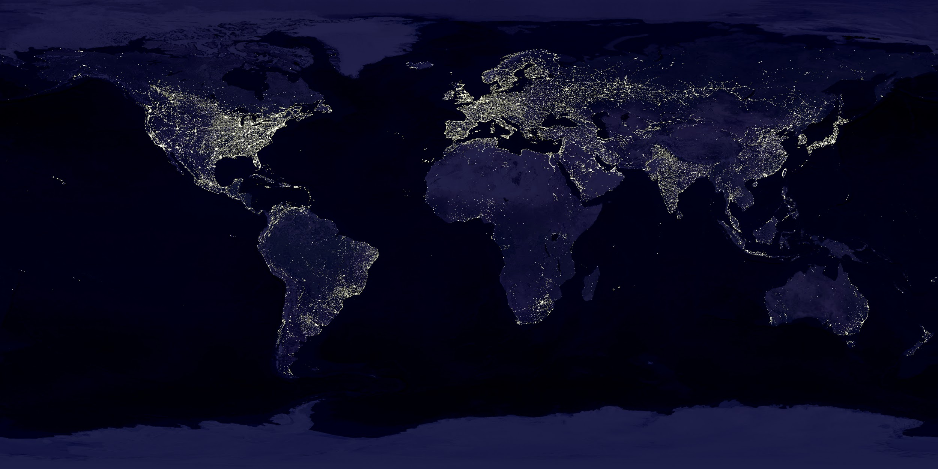
Places been
Places going
Where is CompuGirls?

Slide 21
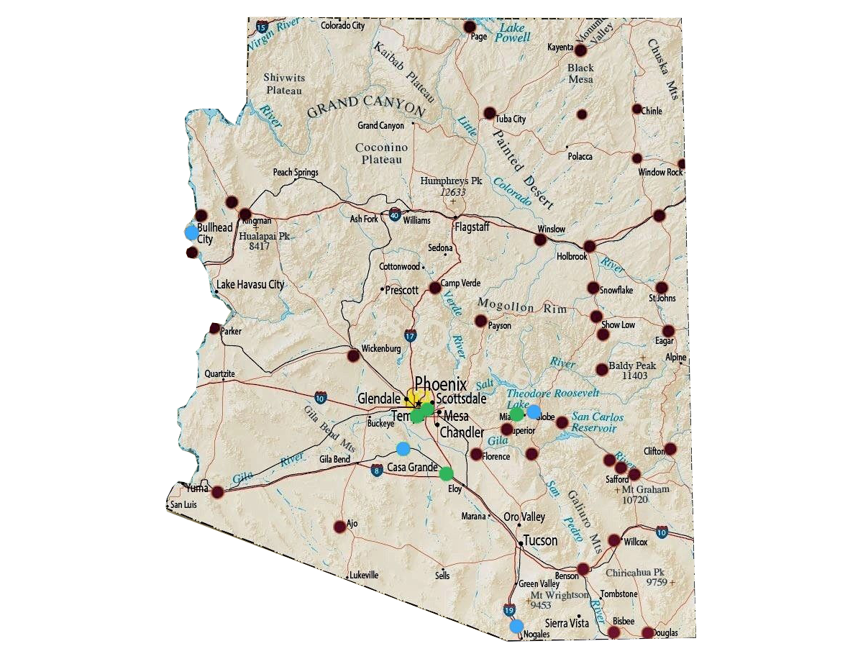
Past Sites
Future Sites
Active Partner
Committed for 2019/20
In Discussion for 2019/20
Where is CompuGirls/CompuPower?
Notes:
KIM – PLEASE PRESS PRESENT TO SEE THIS SLIDE IN FULL, IT HAS A BASIC ANIMATION FUNCTION TO ALLOW FOR ALL REQUESTED CONTENT.
Let’s have this slide begin with answers (in graphic form)to GSUSA questions. For instance, they want to know the Compugirl sites. Providing a map with past and current sites i.e. NJ, Wisconsin, California, Michigan, AZ, Colorado. Mexico City Past (but check with Kalani). Future - North Carolina and Texas, Same slide, have a global map illustrating future sites—Ireland, Armenia, Saudi Arabia. Also, illustrate on same two maps CompuPower sites (ask Matt) and future CompuPower sites. Distinguish between compupower and compugirls perhaps by color but should be a big map of the world!
o How does ASU fund CompuGirls? Since they do not, include an image of facilities and other indirect items (check with kalani in terms of resources e.g. phones) access to k-12 schools.
o What is the cost per girl per location? Kalani can give you a range. For instance, the library cost of compugirls is different than the robotics budget; different than the per student aisl. I think providing examples based on course. For instance, cost of Course 1 (digital storytelling); Aisl with gs souther AZ=?

Slide 22
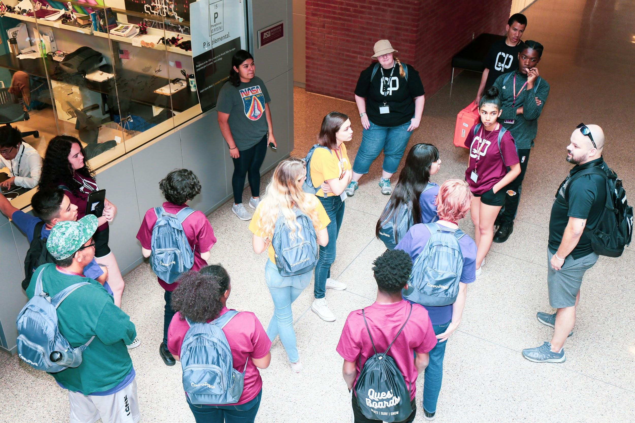
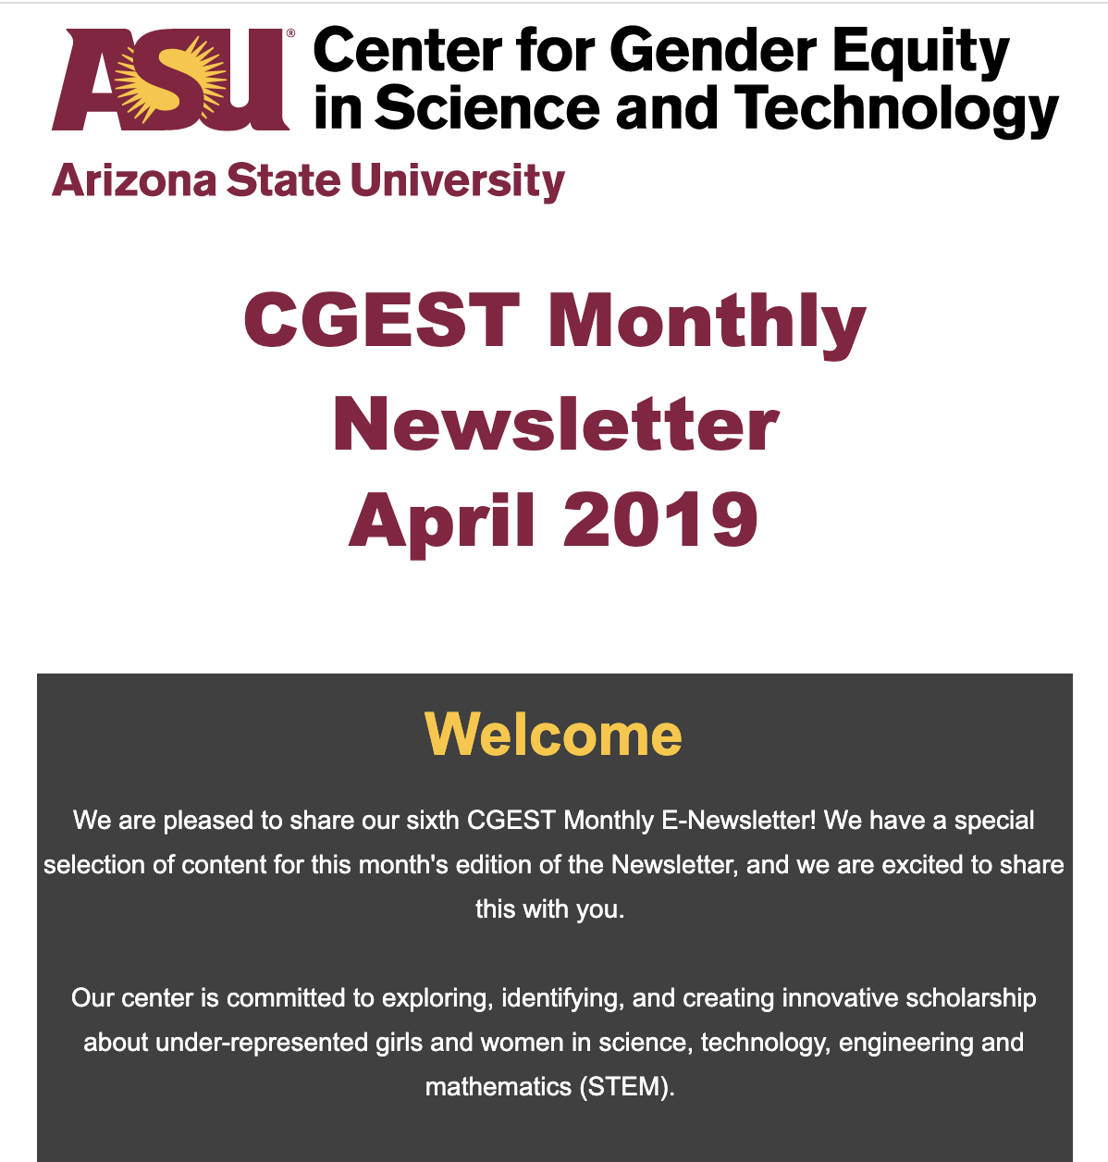
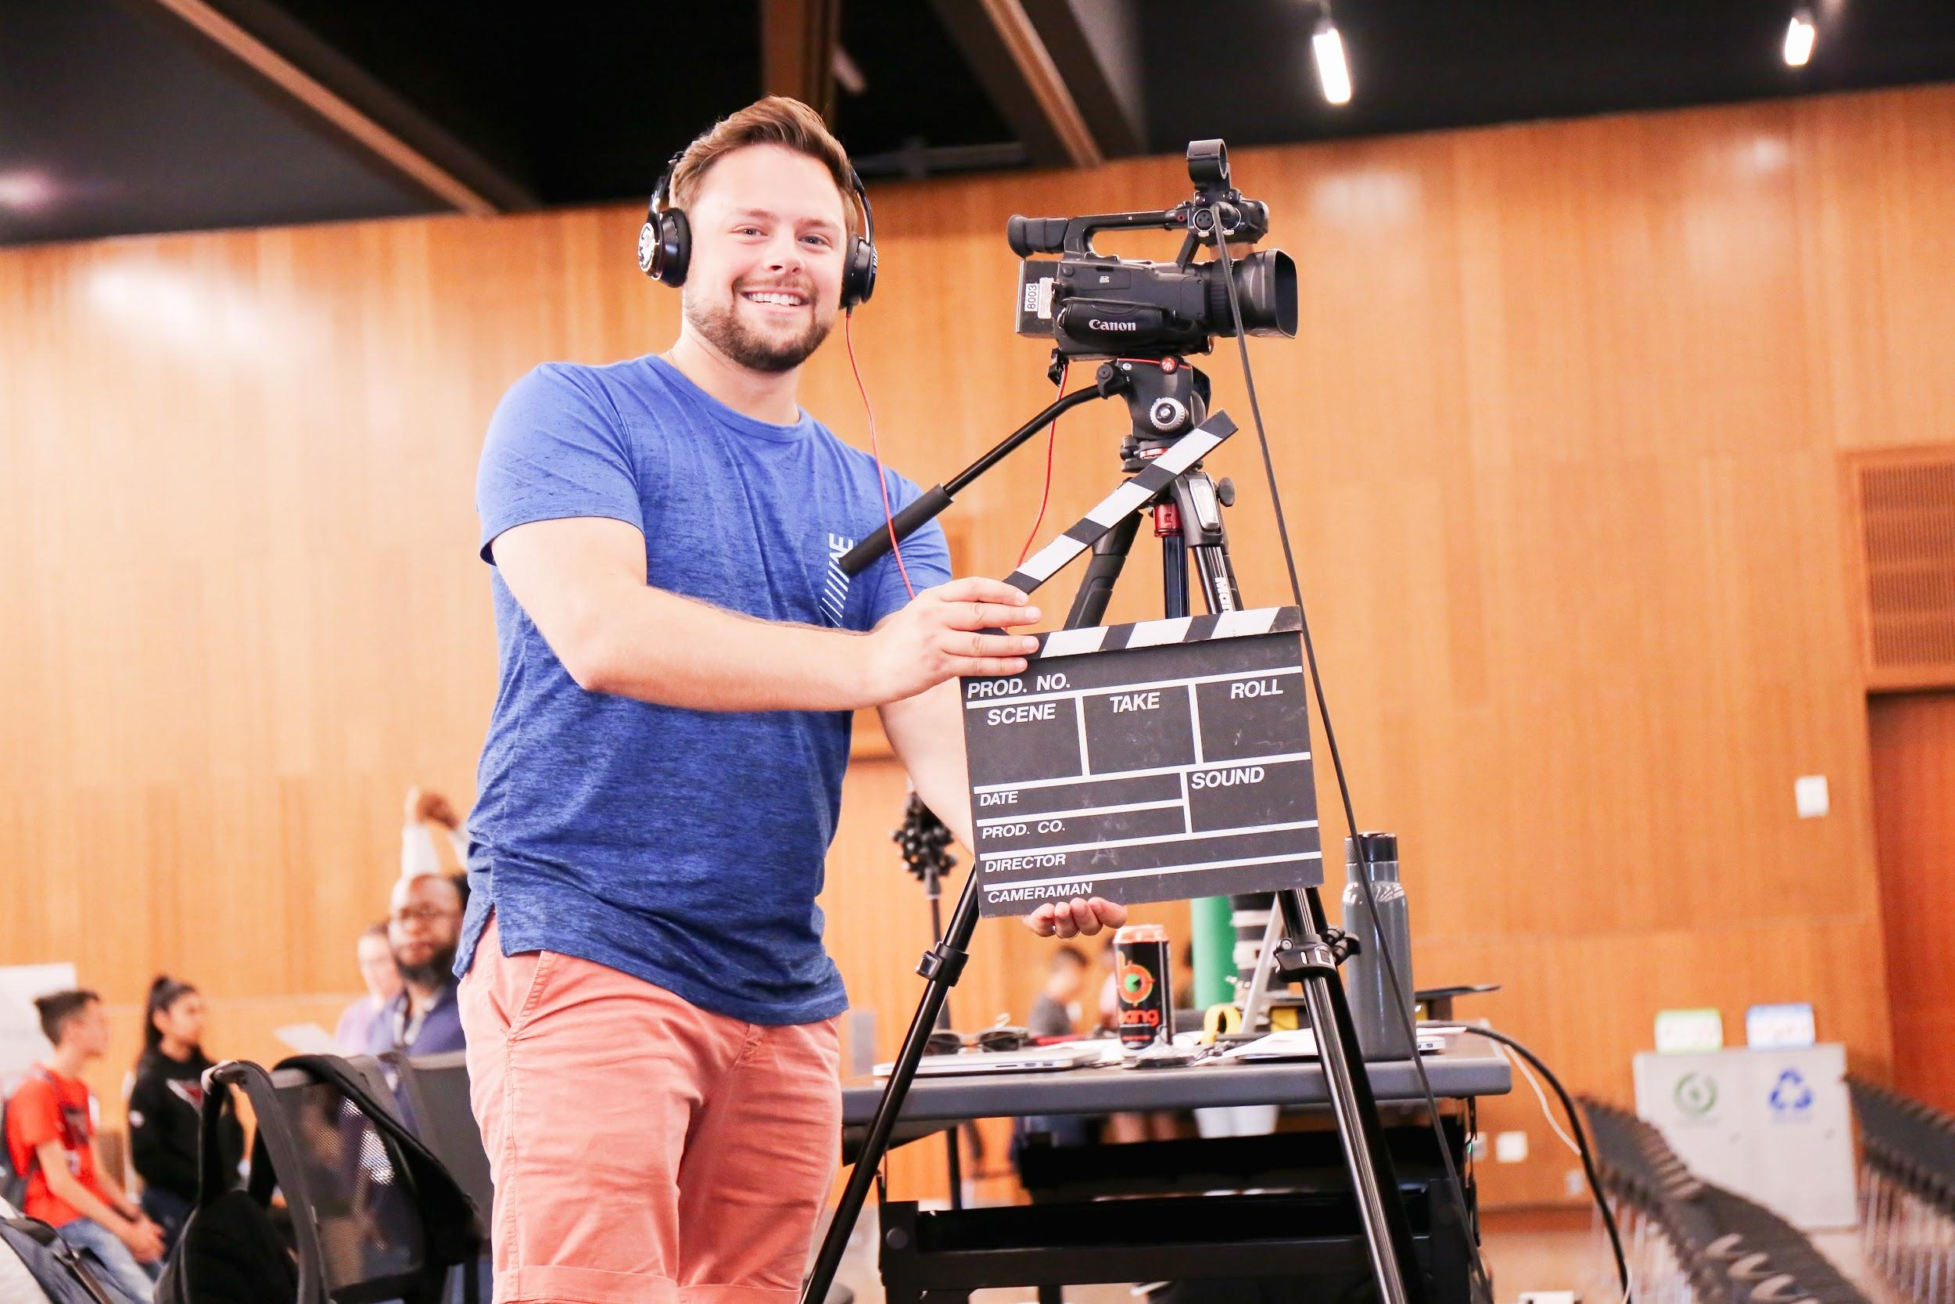
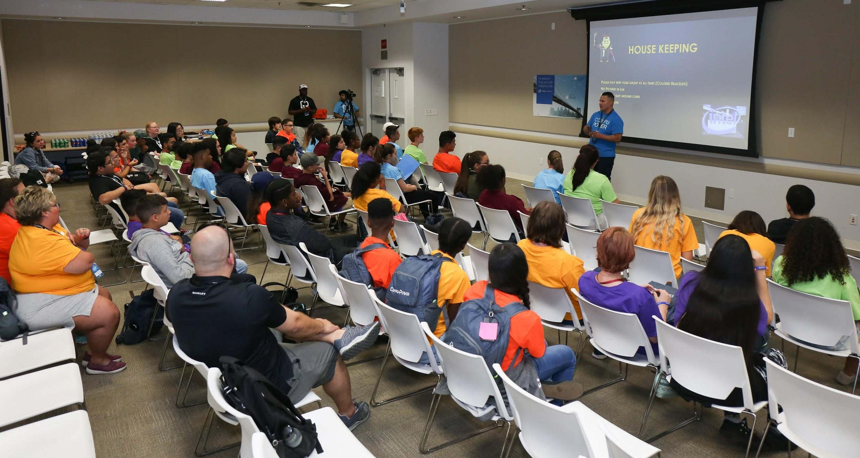
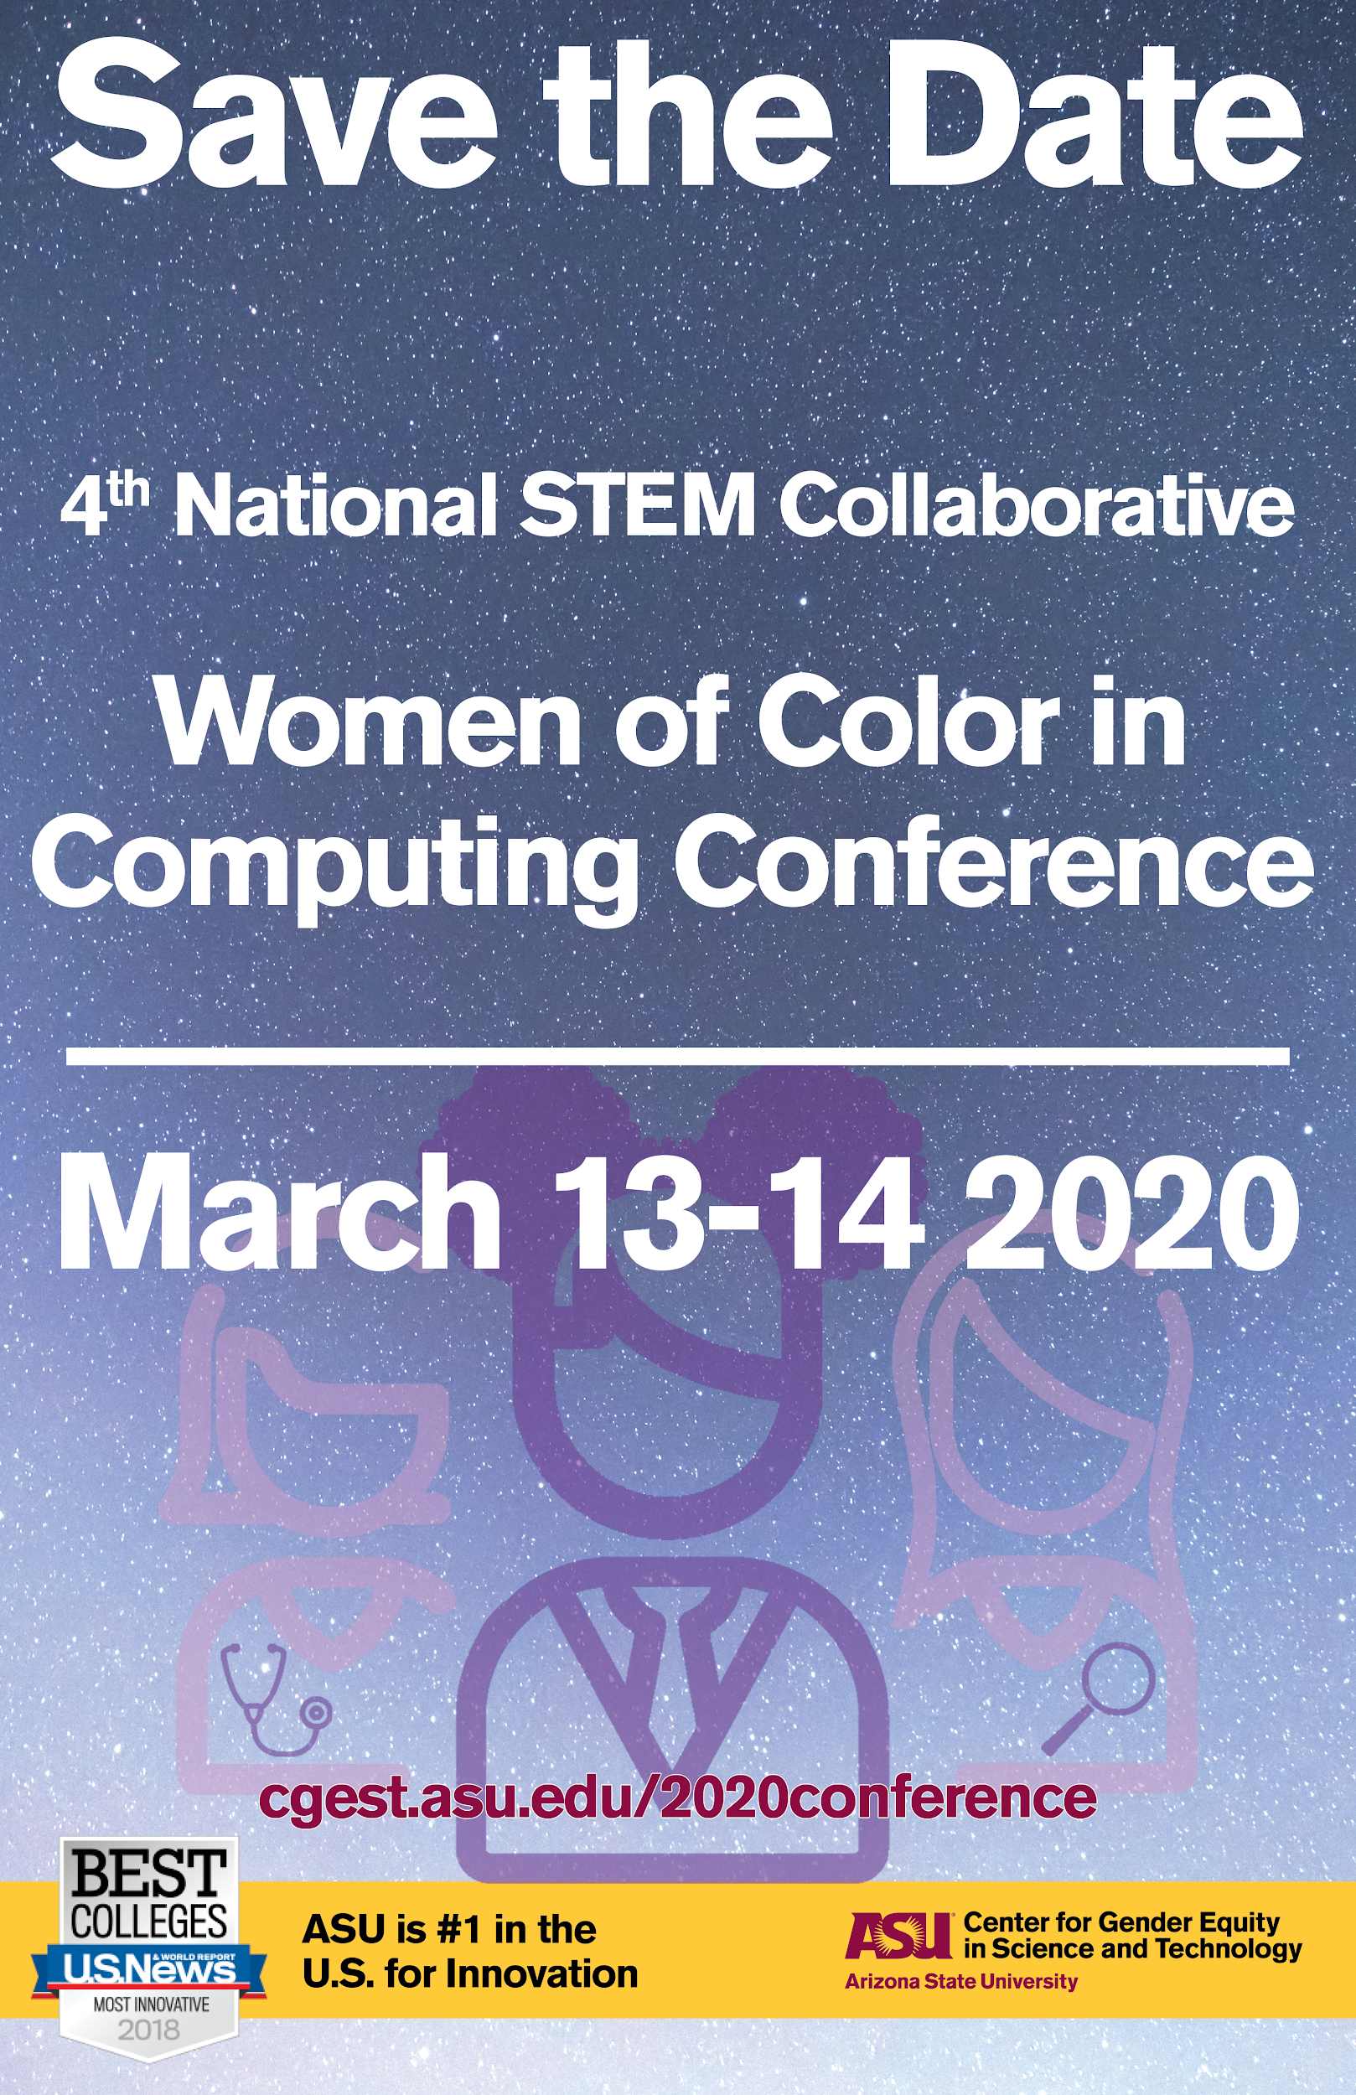
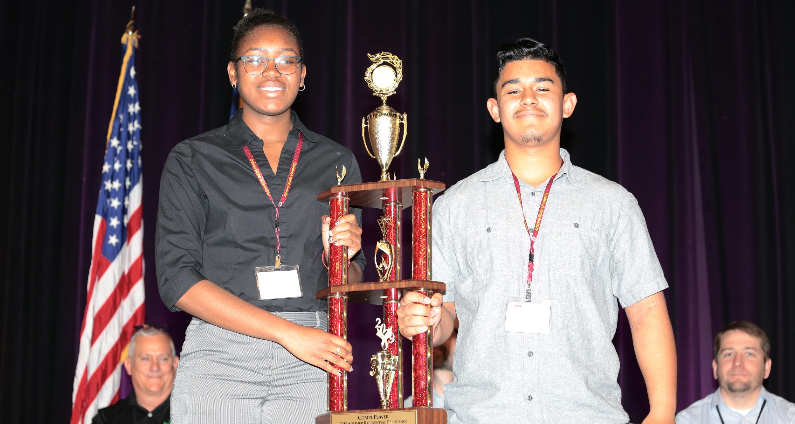
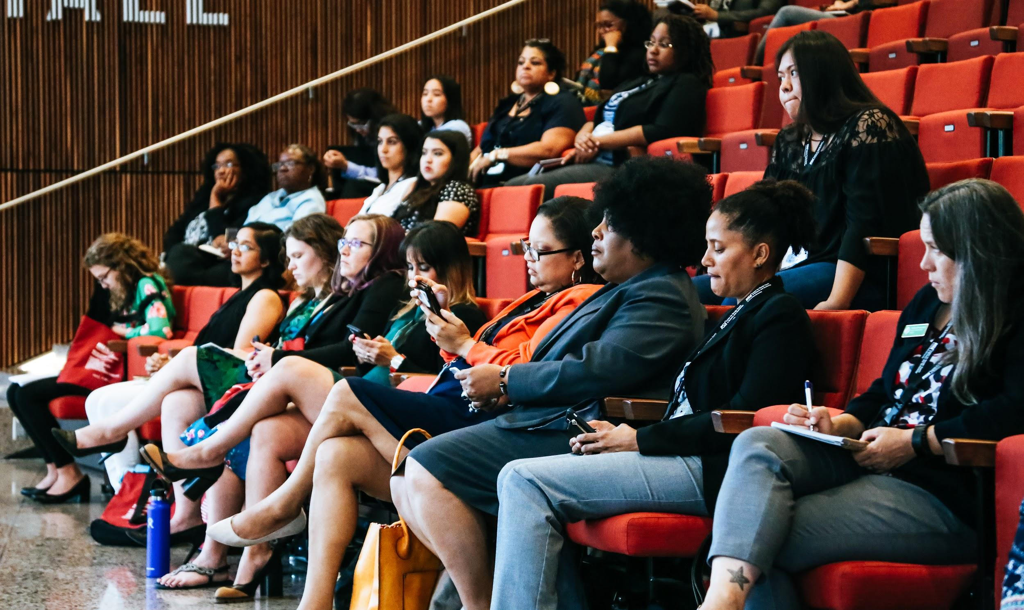
What WE do here at CGEST
CGEST@ASU

Slide 23
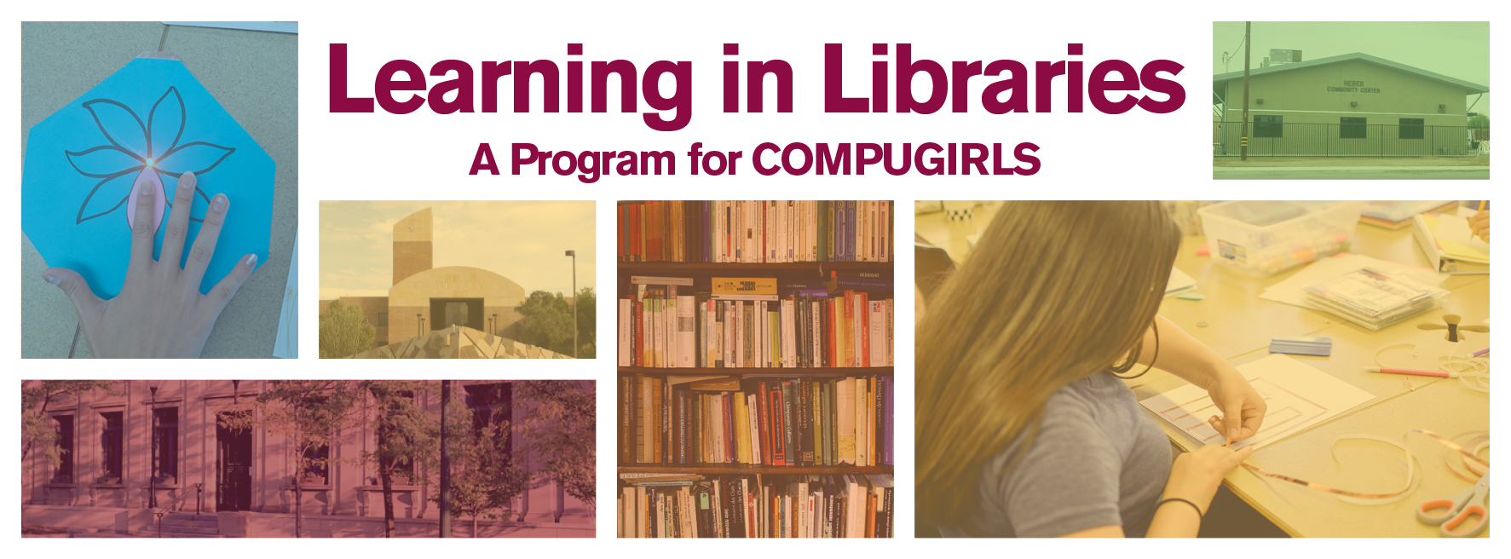
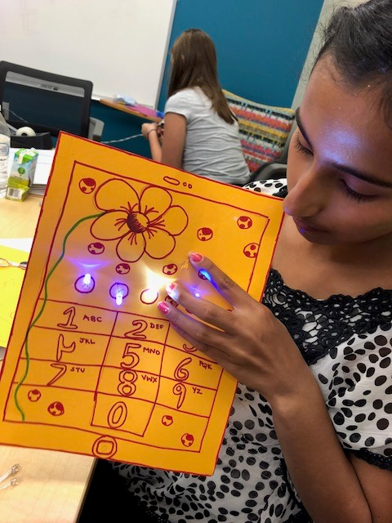
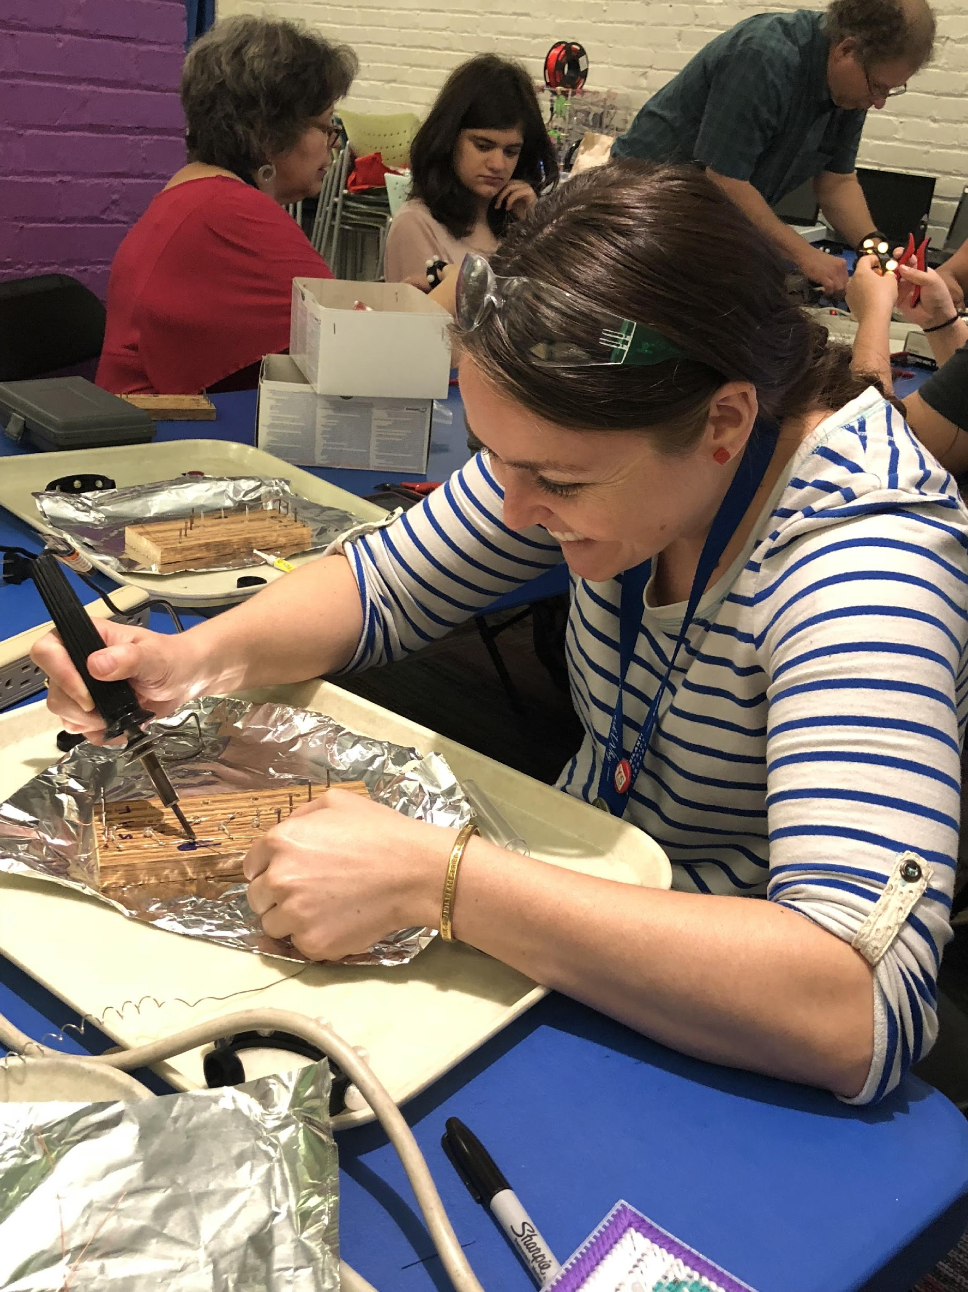
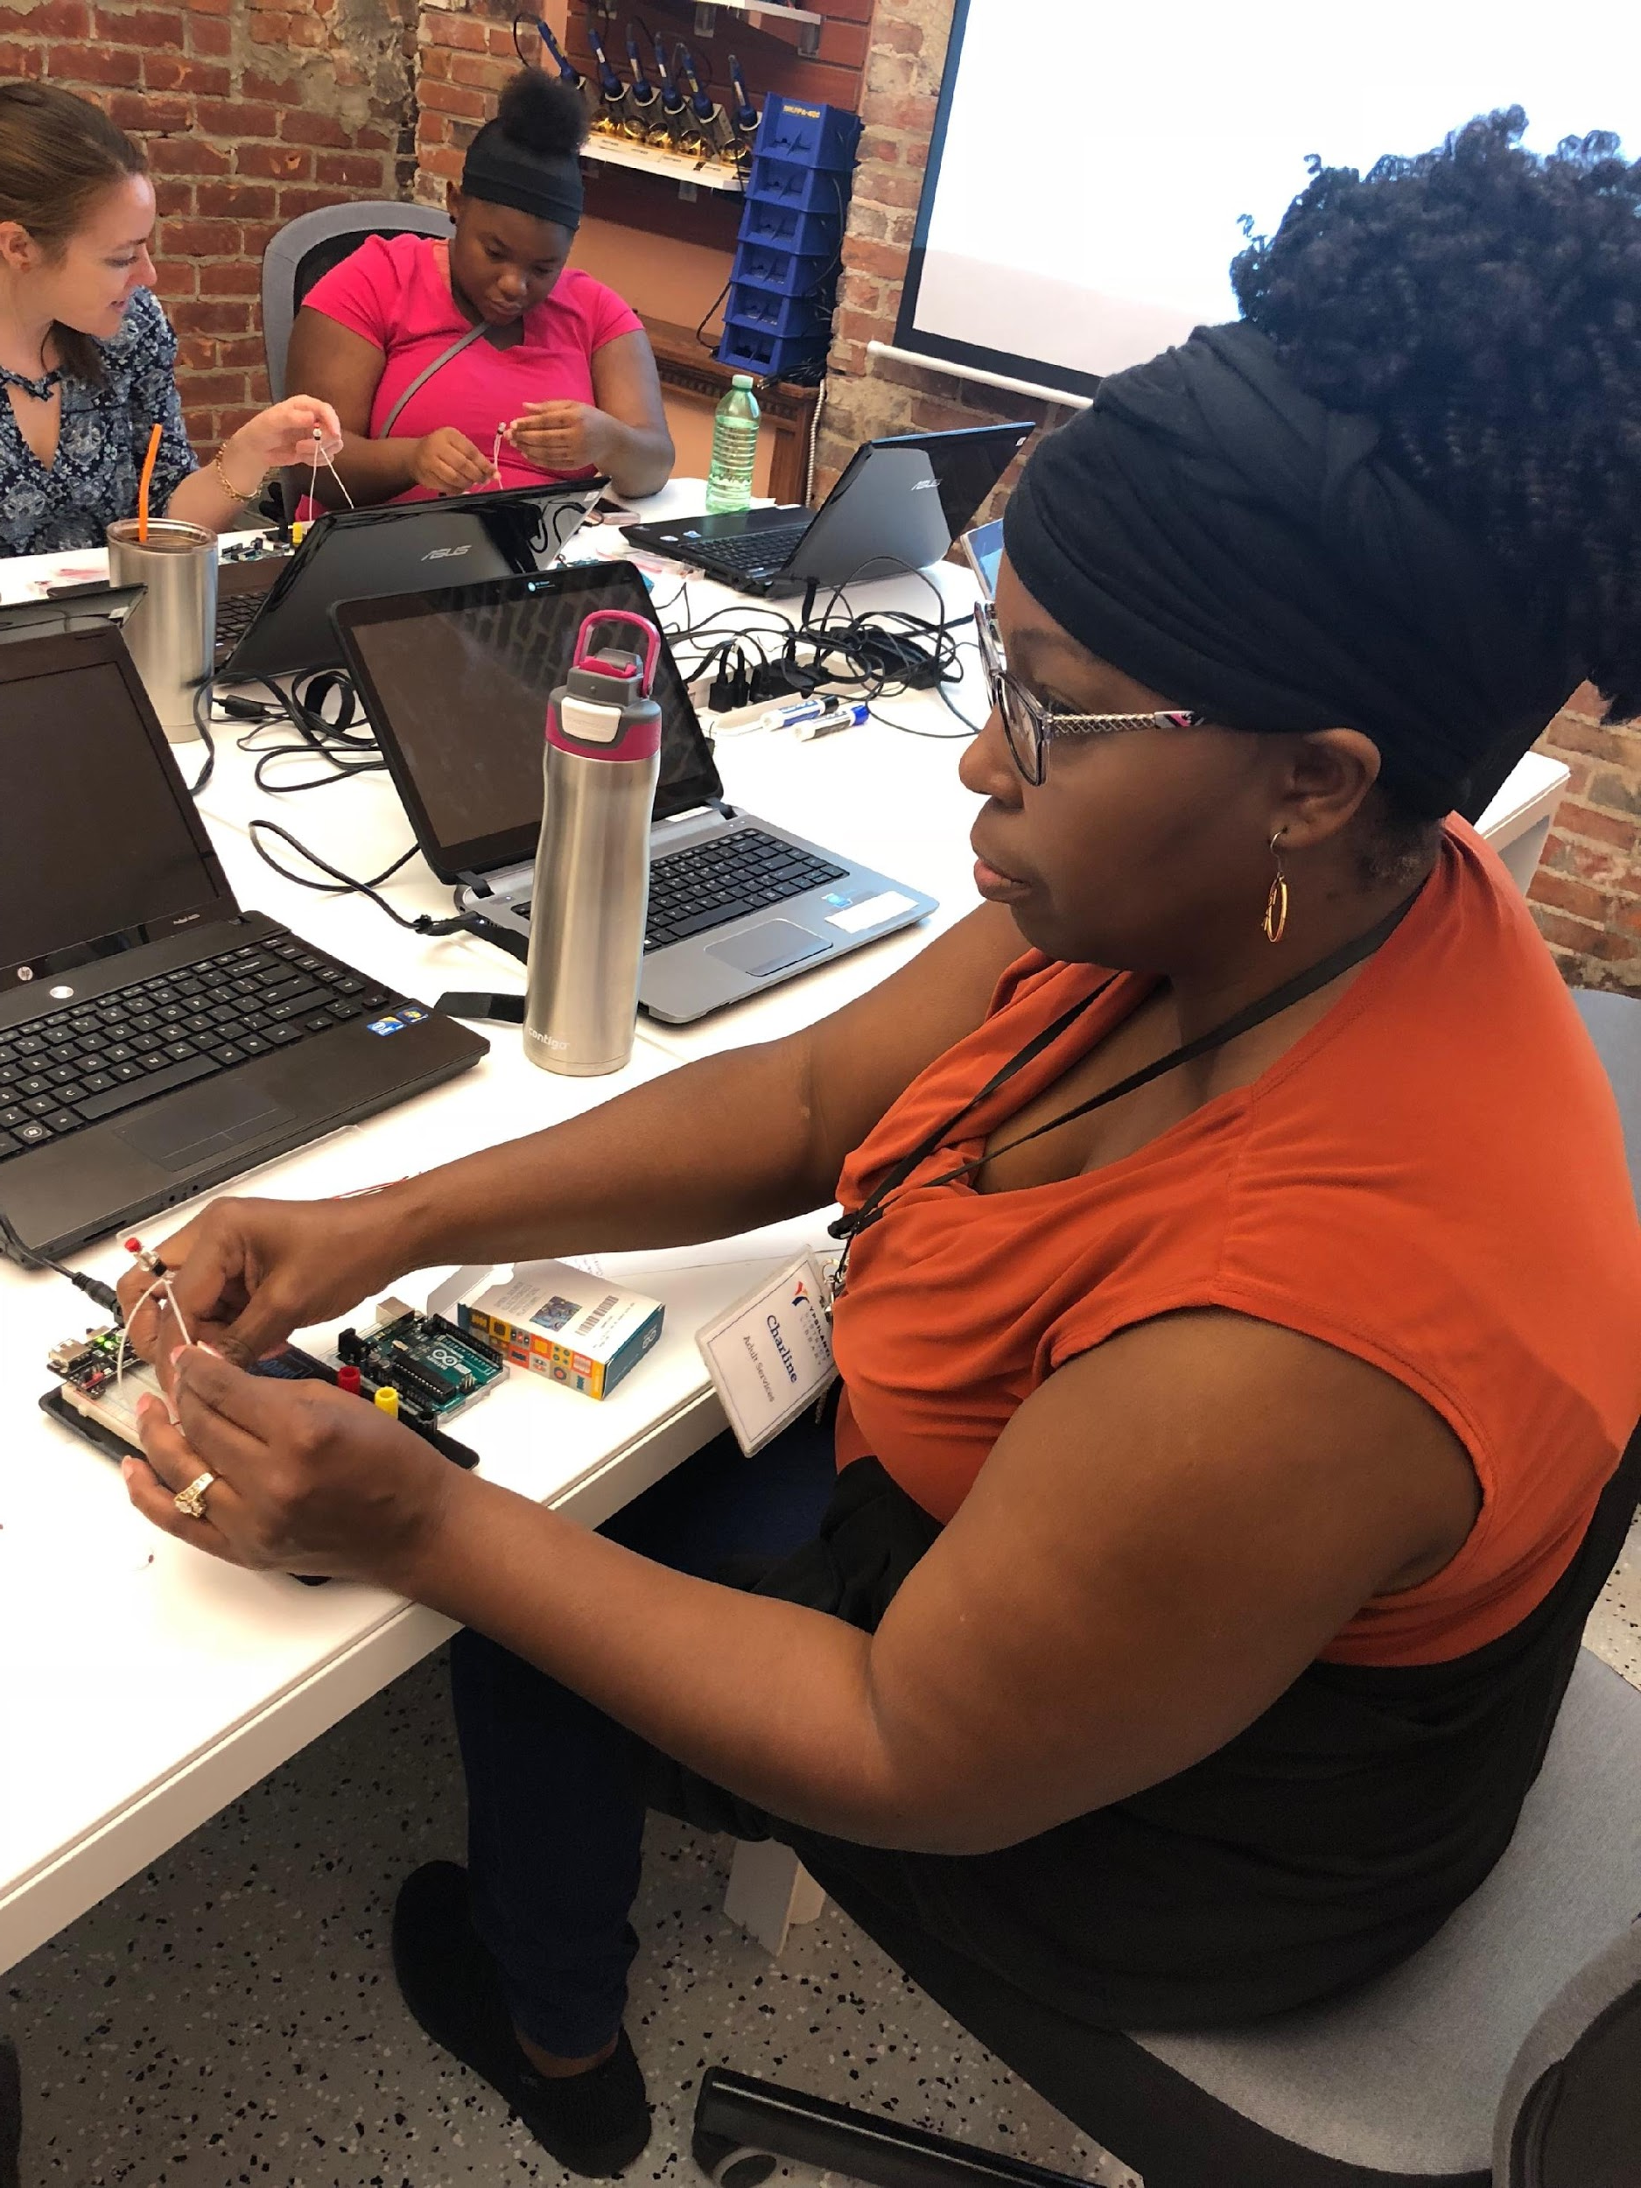
CGEST@ASU
Notes:
Good morning Dr. Kavanagh, my name is Sheldon Joseph and I serve as the Project Manager for CGEST. I manage the implementation of several grants as well as developing implementation standards for continuous long term efficiency in our operations. I’ll be talking a bit about our projects involving IMLS.
COMPUGirls: Learning in Libraries
With the success of the CompuGirls Program, Dr. Scott pursued and realized an opportunity to create a unique iteration of COMPUGIRLS, funded by IMLS, to bring the COMPUGirls program into Libraries in Arizona, Michigan and California.
The project is guided by two overarching goals:
1) to build institutional capacity within libraries by ensuring that librarians possess the expertise needed to serve as computer science educators who can effectively deliver a culturally responsive and low‐resource model for teaching computational thinking in libraries; and
2) to evaluate the feasibility of the model for scalability and sustainability with the help of an external evaluator who will conduct formative and summative assessments.
So far we’ve had over 30 girls participate in the pilot year spread between 3 library systems and we are actively recruiting two more between Arizona, Michigan and California.
dSpace Repository
dSpace repository is a free open source platform used by thousands of organizations worldwide.
The repository we are building will help us capture, preserve and share digital content across multiple communities and users within our network.
We will initially populate the repository with IMLS data and assets that can be searched by users with varied levels of access and deploy late this summer.
Once fully stabilized, we will begin adding in assets from CompuPower and other grant projects.
The goal is to have the wealth of culturally responsive STEM related data in the world that is easily accessible by the communities that need the resources the most.
Lightly touch on Implementation Standards
One of the areas of that i’m working in is to add long term efficiency in the implementation of grants and projects. Currently documenting the existing processes that are driving current implementations to completion (SRE, IMLS, etc.)
Assessing the tasks necessary across all efforts, developing a minimum standards playbook for CGEST, to include the common tasks and documented processes for unique requirements based on the grant/project.
And now Krissy will share details on CompuPower

Slide 24
Advanced Informal STEM Learning (AISL)
CGEST@ASU
Culturally Responsive Social Programmable Robots
Notes:
Krissy - Oliver to Add Robot Photos (Edited 2017) GirlScouts Logo asvncinfg informal STEM learning
Incorporate https://www.anki.com/en-us/cozmo graphically
We are here today to have a collective conversation about opportunities for investing in women of color.
There have been several efforts emerging, but time to capitalize on that momentum and use our resources and capital to drive that work forward

Slide 25
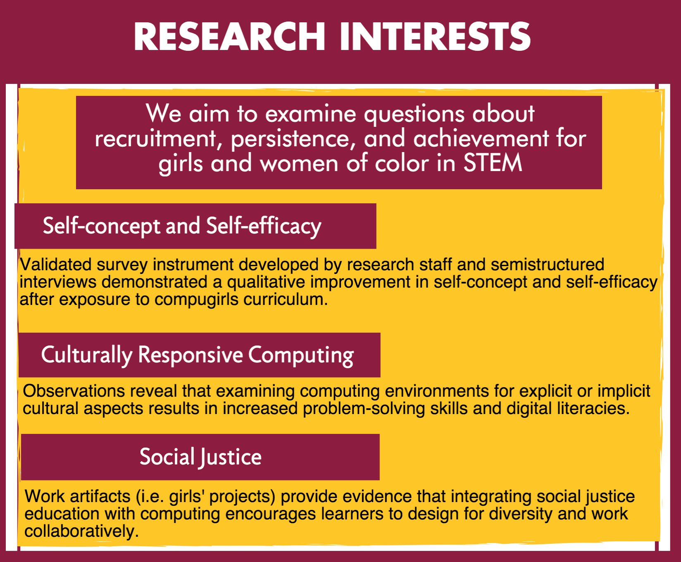

Slide 26
Partners & Sponsors
Notes:
E+I), National Academies of Science), University of Pitt), CM uni), Mayo Clinic), DriveTime), school of life sciences, (ALL ADDED)

Slide 27
CGEST@ASU
THANK YOU!
Notes:
TAKEN FROM ‘Material for GSV’ Doc
Contributing to Greater Economic Inequality (OR Improving Economic Mobility)
Wage gaps by gender, most impacting Black and Latinx women
Wealth gaps between Black and White families
Tech salaries
Opportunities to gain wealth

