Slide 1
Leveraging IT for Domestic, Sexual, and Dating Violence Education and Outreach
ASU Clothesline Project
Dr. Alesha Durfee
Alesha.Durfee@asu.edu

Slide 2
What do we mean by “domestic violence” and “sexual violence”?
Emotional & verbal abuse
Threats
Stalking
Technological abuse
Physical abuse
Coercion and Manipulation
Sexual coercion/abuse
Stem from a need for
POWER and CONTROL

Slide 3
Prevalence of IPV in the United States
More than 12 million men and women in the U.S. experience some form of IPV each year
33% of U.S. women will be abused by an intimate partner during their lifetime
29% of U.S. men will be abused by an intimate partner during their lifetime
Most women experience multiple forms of IPV, while most men experience only physical violence

Slide 4
Prevalence of IPV on college campuses
21% of college students report having experienced dating violence by a current partner.
32% experienced dating violence by a previous partner.
Over 13% of college women report they have been stalked. Of these, 42% were stalked by a boyfriend or ex-boyfriend.

Slide 5
Today’s talk
What do we mean by domestic, sexual, and dating violence?
What should I do when someone discloses?
What’s the ASU Clothesline Project?
How can I leverage my IT skills for outreach, education, and intervention efforts?

Slide 6
Healthy Relationships
They’re important!
What makes a healthy relationship?
SPEAK UP!
Respect your partner
Compromise
Be supportive
Respect each other’s privacy

Slide 7
What to do if a friend is abused:
LISTEN
Issues of power/control – respect autonomy
What are your friend’s priorities?
Believe and validate
Respect privacy – keep confidential
REACH OUT FOR HELP!

Slide 8
Make a statement:
I’m glad you told me.
I believe you.
I’m sorry you had to go through that.
It’s not your fault.
No one deserves to be abused.
You are not alone.
I want you to be safe.
I want to help. Let’s work together to find resources for you.

Slide 9
The Clothesline Project
The Clothesline Project is a visual display of shirts
with graphic messages and illustrations
designed by survivors of and individuals impacted by domestic, sexual, and dating violence.

Slide 10
The Clothesline Project
The purpose of the project is to:
increase awareness,
destabilize stereotypes about “victims”,
celebrate a person’s strength to survive, and
to provide another avenue to courageously break the silence that often surrounds these experiences.

Slide 11
ASU Clothesline Project

Slide 12
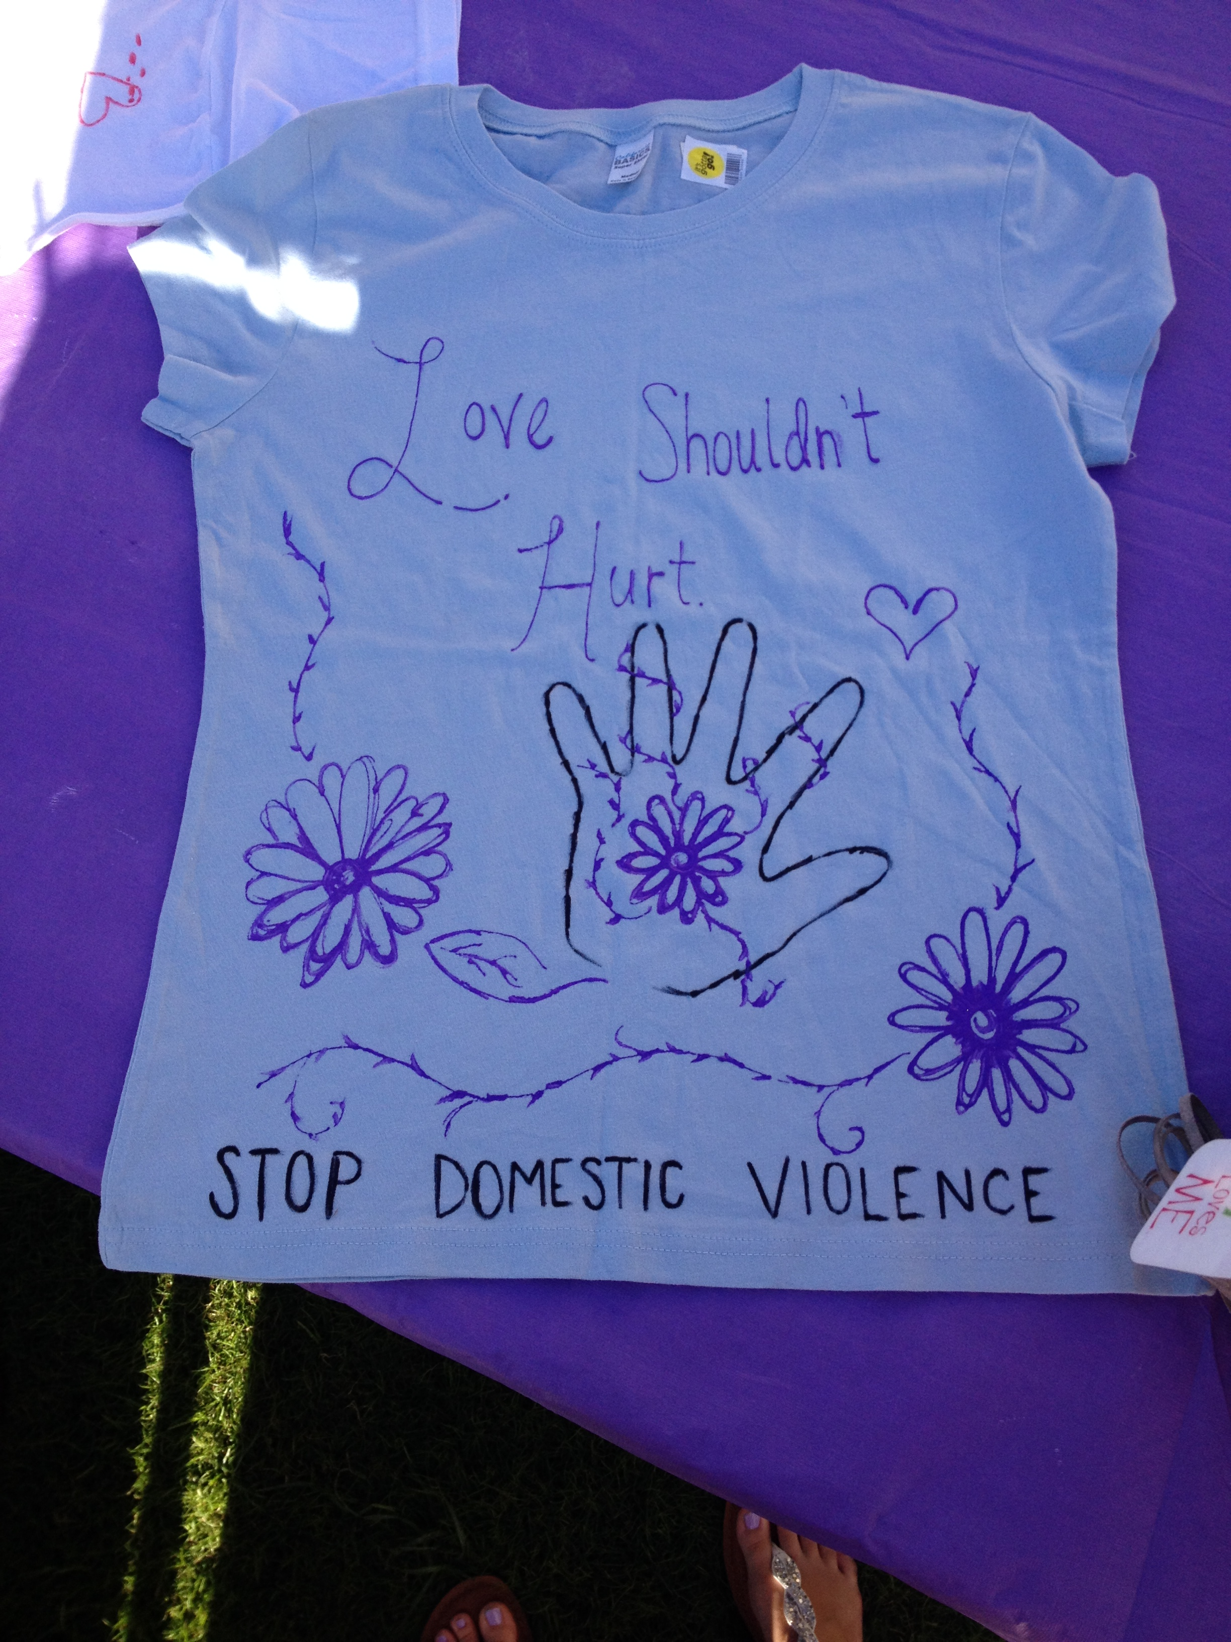

Slide 13
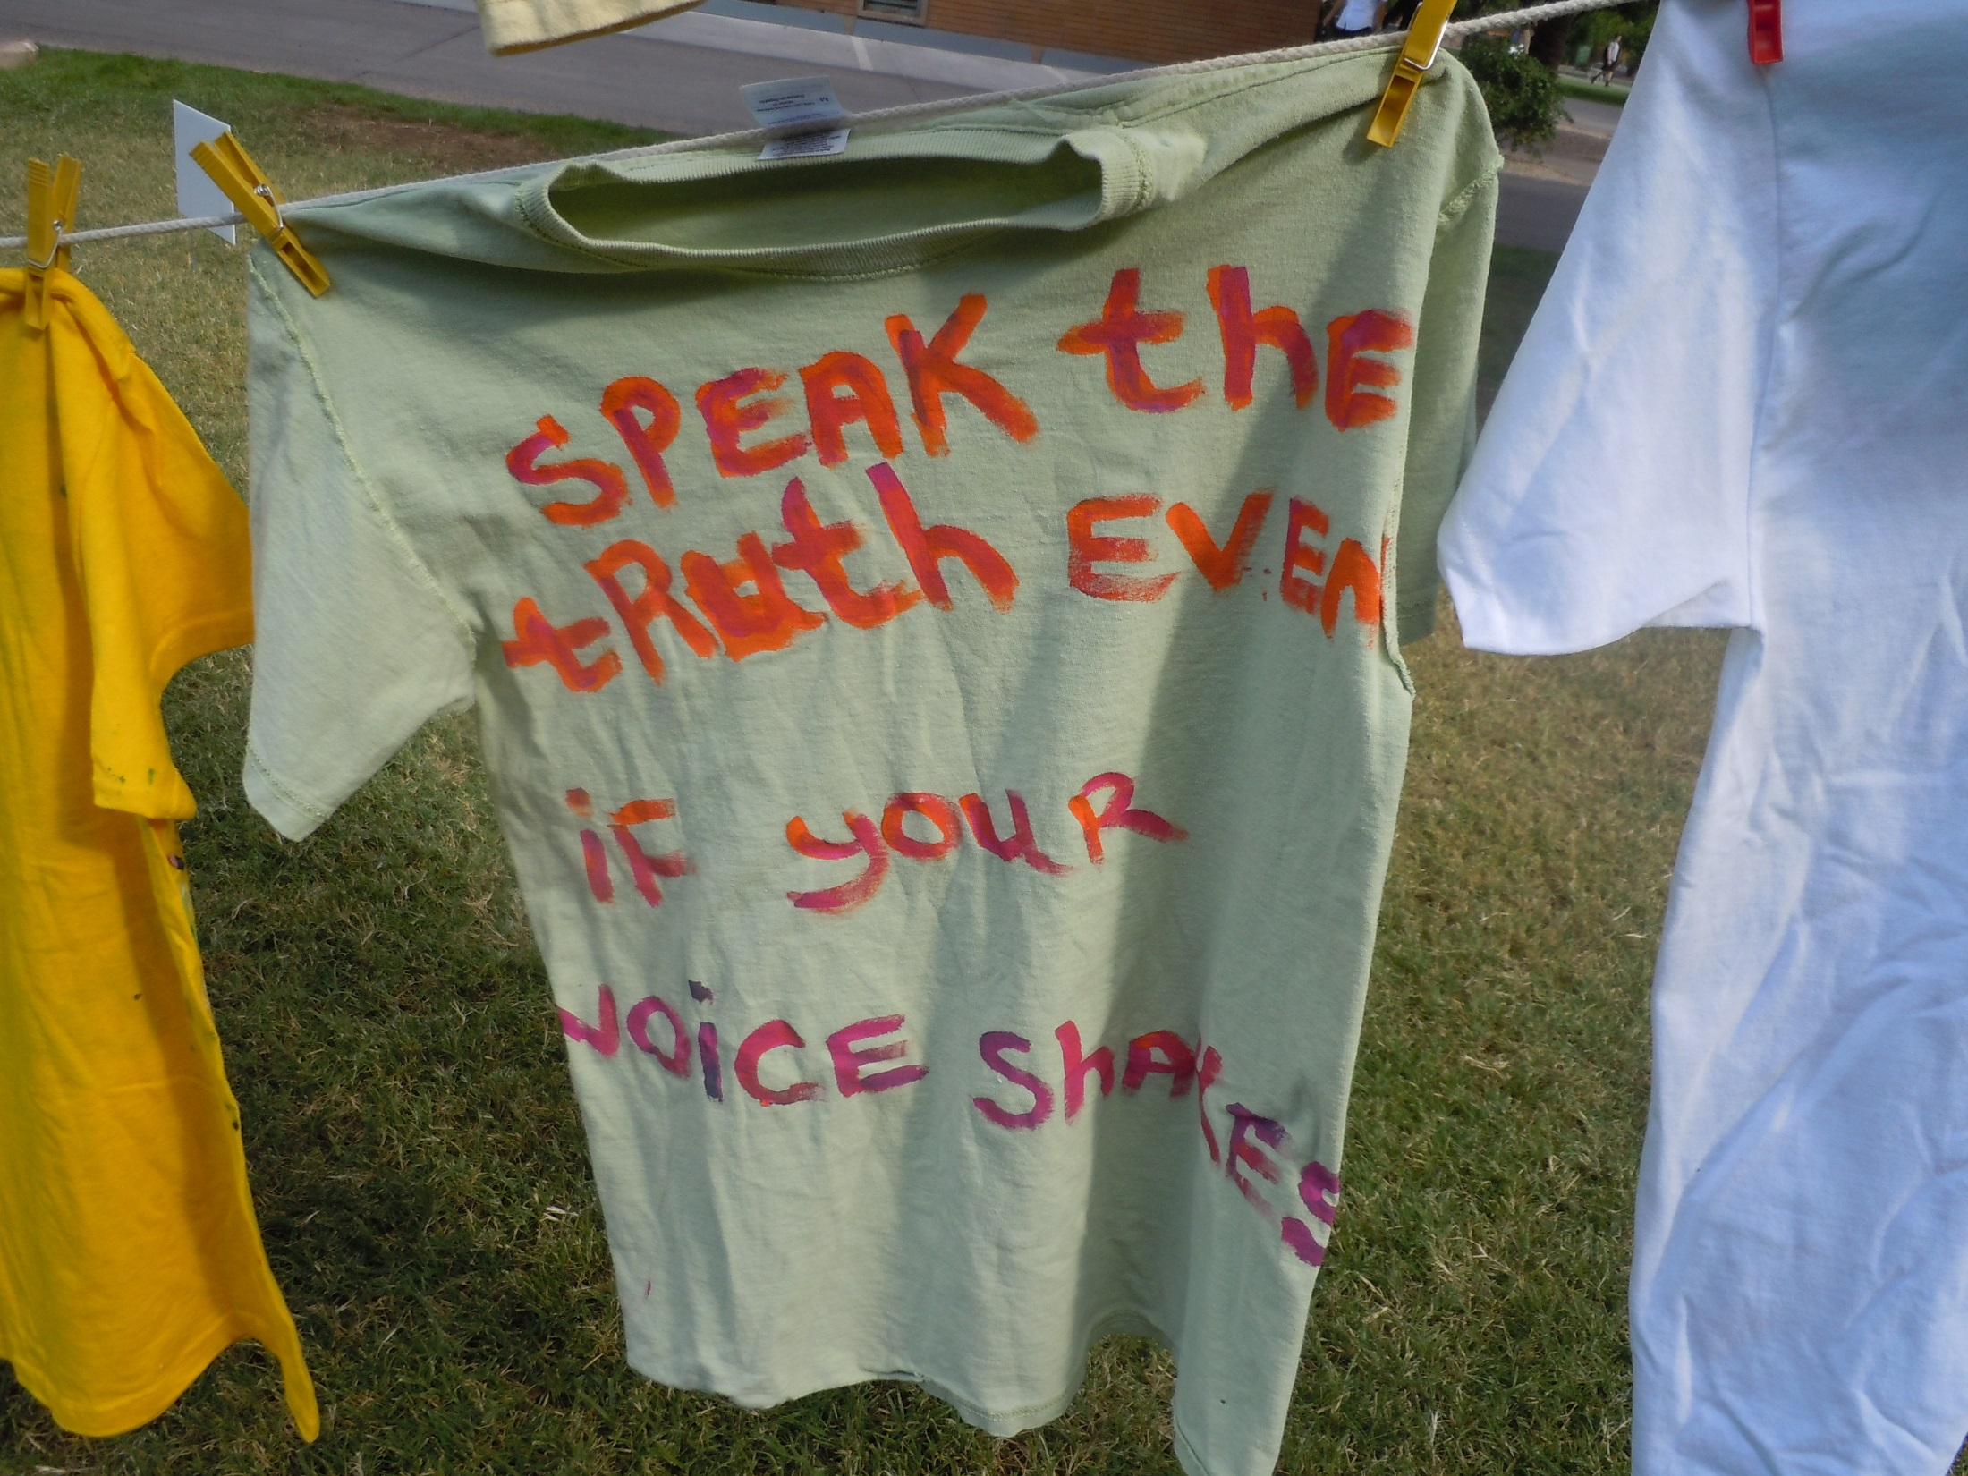

Slide 14
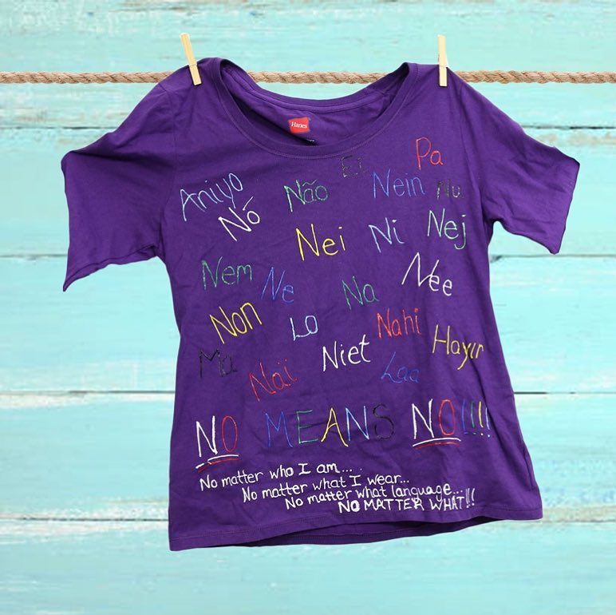

Slide 15
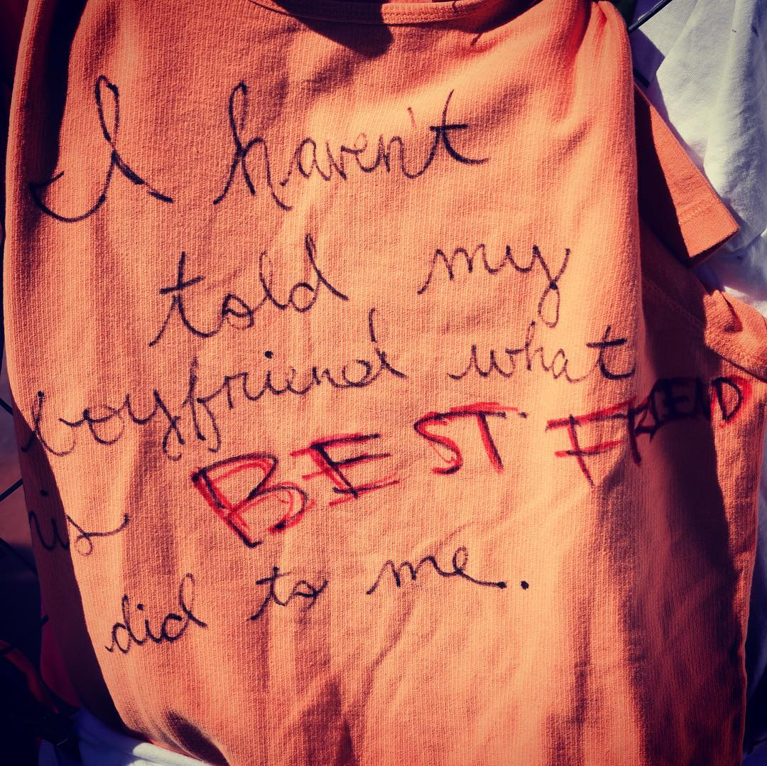

Slide 16
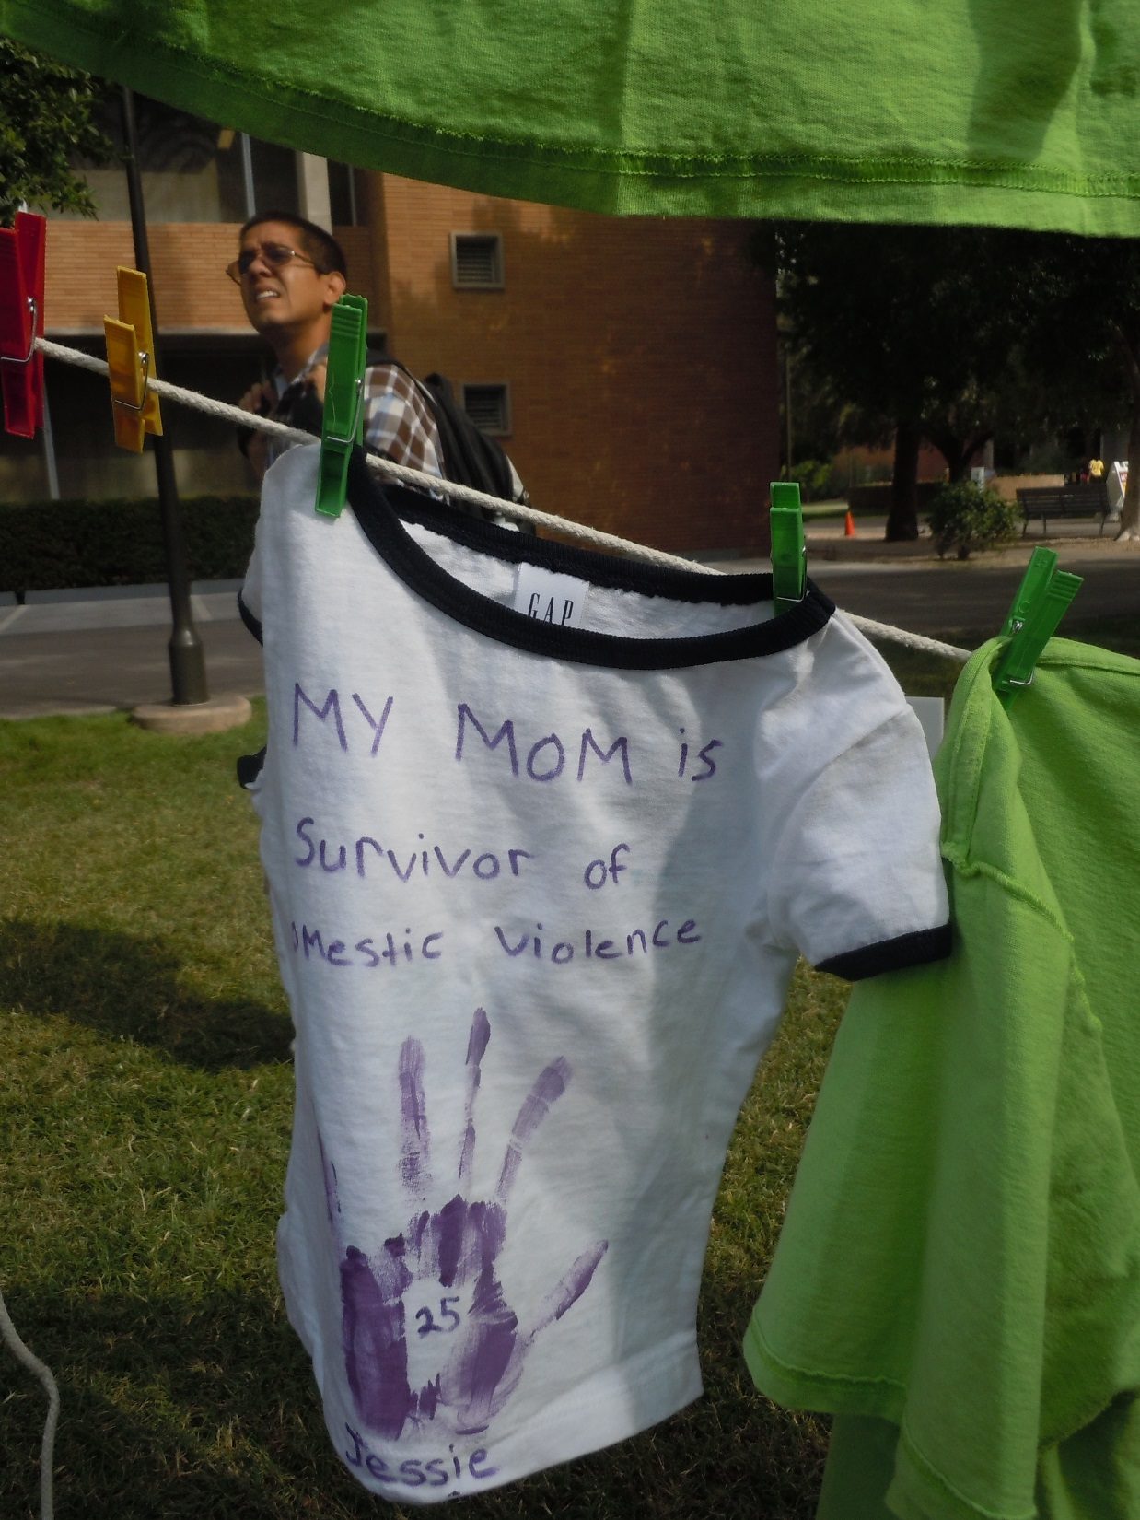
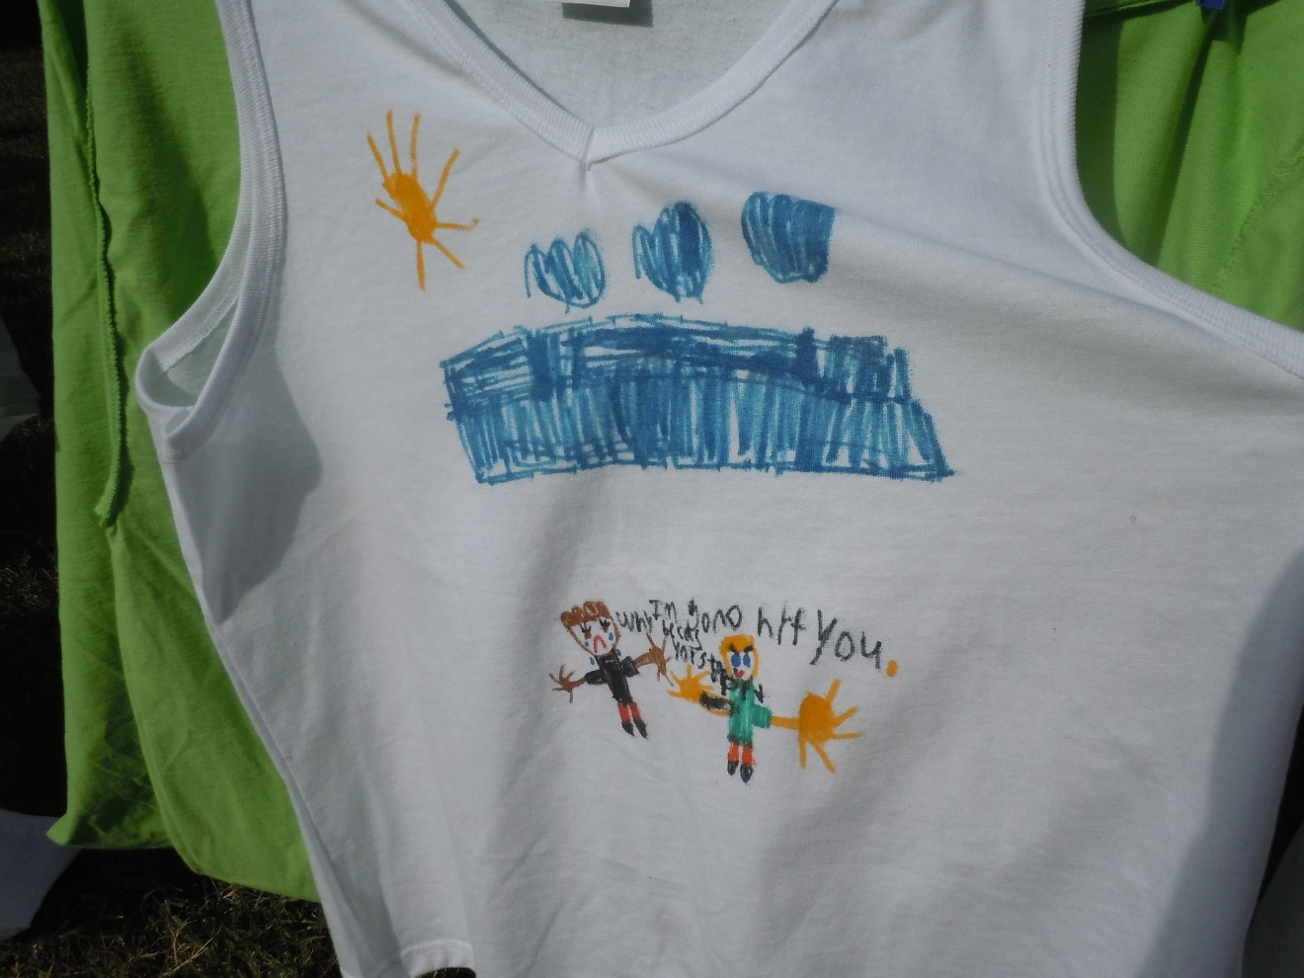

Slide 17
Online Outreach
Presence on Facebook, Instagram, ASU
Effort to digitize CLP, modify in-person event
Spearheaded by Aidan Cooney (JSI MS student)—Coverdell internship
Supported by Sexual Violence Prevention

Slide 18
ASU Clothesline Project

Slide 19
Digitization Process

Slide 22
Benefits
Access to wider audience, including online students and community
Give people tools to host own CLP event, connect with ASU event
Provide advocacy and information 24/7, year-round
Link to online information, resources, apps

Slide 23
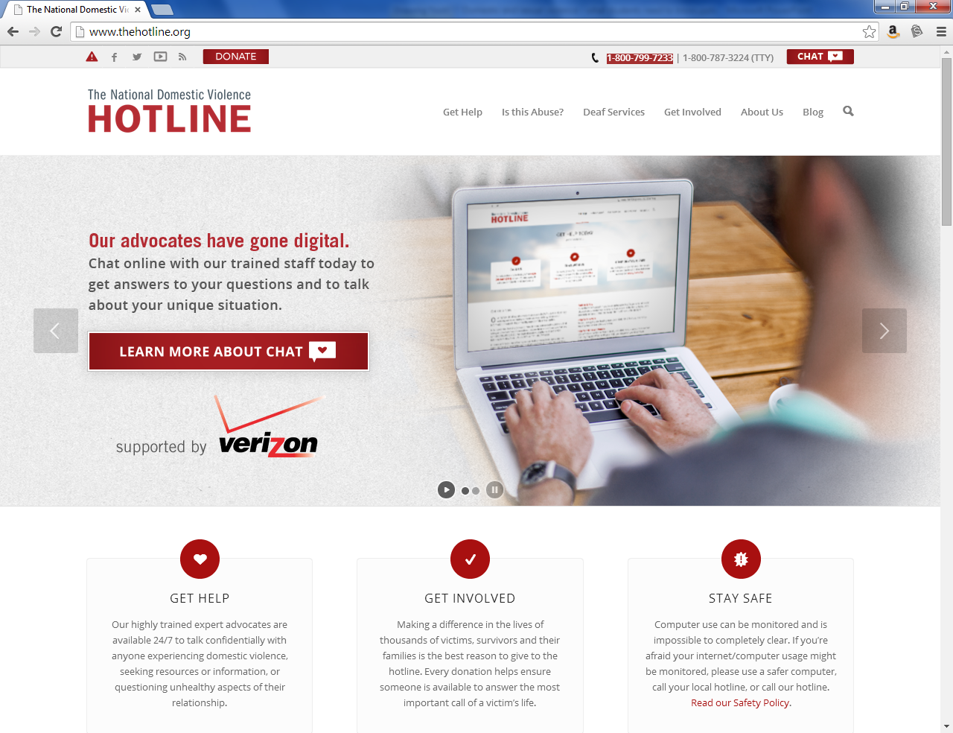
Note that they have a chat feature – you don’t have to call, you can chat online

Slide 24
Other Apps you can use
https://www.myplanapp.org/home
http://www.circleof6app.com/
http://www.loveisrespect.org/

Slide 25
Resources
National Teen Dating Violence Helpline www.loveisrespect.org
National Domestic Violence Hotline
(800) 799-7233
http://www.thehotline.org/
RAINN (Rape, Abuse, & Incest National Network)
http://www.rainn.org/
GLBTQ Domestic Violence Project http://www.glbtqdvp.org/
National Sexual Assault Hotline
(800) 656-HOPE

Slide 26
Challenges
Providing real-time specialized resources
Limitations of geographic resources versus online event
Conveying sheer scope, magnitude of event
Monitoring of submissions, activity

Slide 27
Questions about how to get involved?
Dr. Alesha Durfee
Arizona State University
Alesha.Durfee@asu.edu
https://sst.clas.asu.edu/clothesline-project
https://www.facebook.com/asuclotheslineproject

