Slide 1
The Universal Learner
Photo by Dimitri Veritsiotis/Getty Images

Slide 2
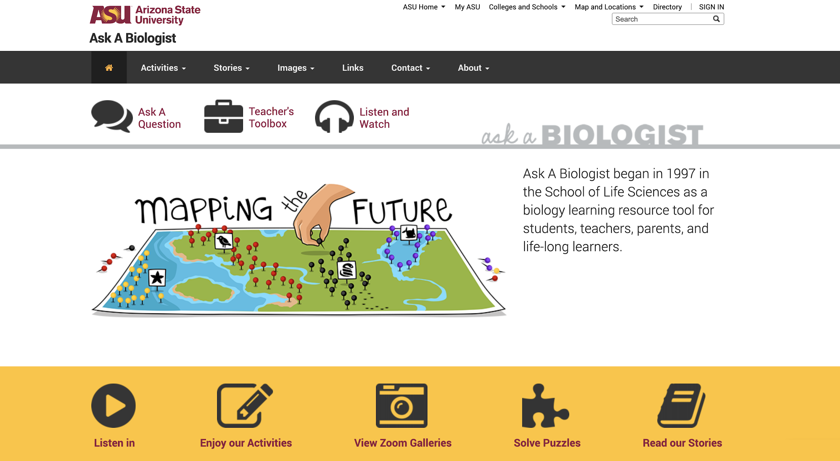

Slide 3
How and how many use Ask A Biologist?
over
15.1
7,000
million
Number of Visits/Year
Classrooms used
the site during the year ⁽¹⁾
41
85
thousand
Virtual Trips
thousand
Average Daily Visits⁽²⁾
Defined as 5+ visits from a specific location and time.
Measured from raw server logs and includes access to (PDF, MP3, SWF, MP4, PNG, GIF, JPG) that are not tracked by Google.
Notes:
Defined as 5+ visits from a specific location and time.
Measured from raw server logs and includes access to (PDF, MP3, SWF, MP4, PNG, GIF, JPG) that are not tracked by Google.

Slide 4
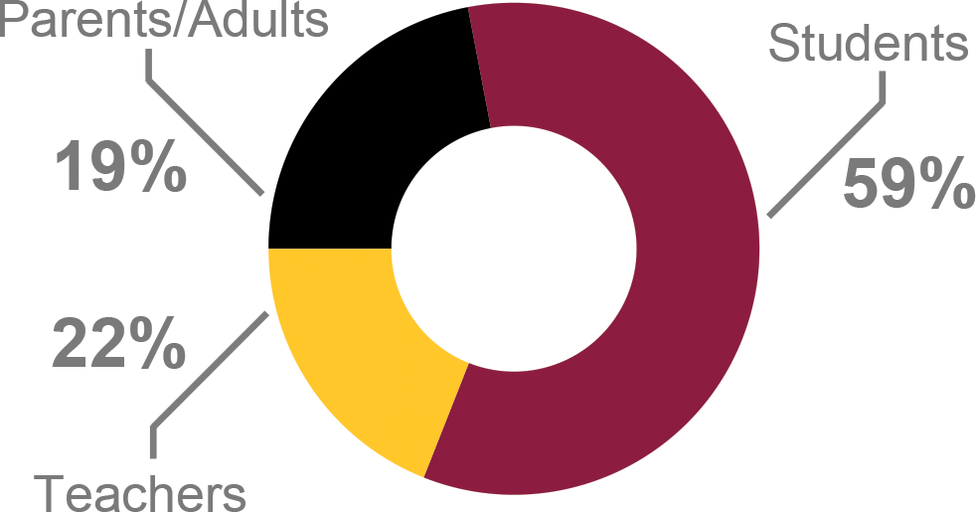
Who Uses Ask A Biologist?
International
visits
48%
194
Countries
Out of 195

Slide 5
How and how many use Ask A Biologist?
36
4.8
million
Page Views
million
Downloads ⁽²⁾
31%
640
Viewed the site on a
Mobile Device
thousand
Game Plays

Slide 10
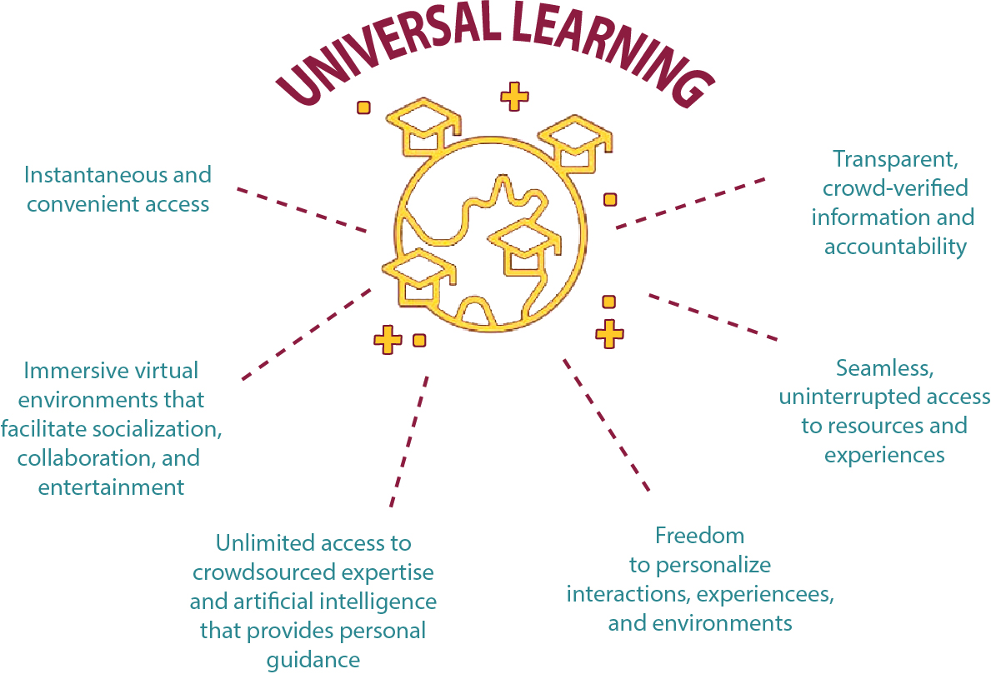

Slide 13
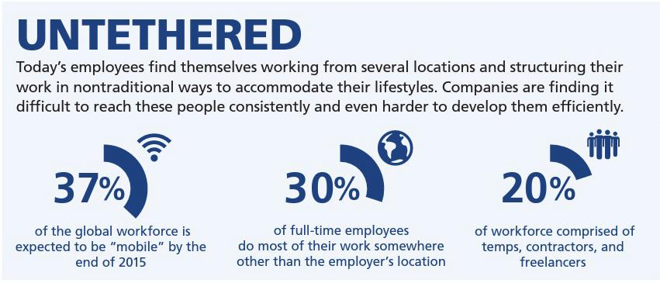
THE
MODERN
LEARNER

Slide 14
THE
MODERN
LEARNER

Slide 15
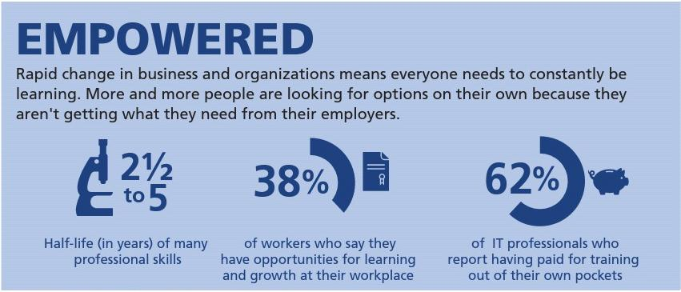
THE
MODERN
LEARNER

Slide 16
THE
MODERN
LEARNER

Slide 17
THE
MODERN
LEARNER

Slide 19
K
E
Y
THE
MODERN
LEARNER

Slide 20
KEEP
EDUCATING
YOURSELF
THE
MODERN
LEARNER

