Slide 1


Arizona State University
Network Access Control
Cisco ISE – Present and Future
Overview Presentation

Slide 2
Cisco ISE – The Basics
Hye Tech Network & Security Solutions, llc
Role with the university
Purpose of today’s presentation
What is NAC? Why do we call it ISE?
How does it work?

Slide 3
Cisco ISE – What is it?
What exactly is ISE?
What can it do?
What is it doing for ASU today?
What is it NOT doing?

Slide 4
Cisco ISE – What is Next
Wired Authentication
Non Dorm switch ports will be configured to use .1X
Pilot sites are being scheduled
Goal is two fold
  Identify the users on the network
  Give them the access they need

Slide 5
Cisco ISE – How it Works
Acronyms and Names You Will Hear…
Wireless Access Point - WAP
Wireless LAN Controller – WLC
Cisco Prime - Prime
Cisco ISE – ISE or NAC
Windows Active Directory – AD
Access Switches
VLAN’s and VRF’s
Endpoints – Users and their devices

Slide 6
Cisco ISE – How it Works cont’d
Authentication – Credentials vs other
  What are the options?
  What else is used?
Access – Successful connectivity
  What happens now?
  Why is the EDNA role important for a user?
ISE and Network Segmentation
  How does it all tie together?

Slide 7
Cisco ISE – Current Architecture
Data Centers – IO and ISTB1
6 UCS Hosts
2 Admin nodes
2 Monitor nodes
4 Policy Nodes

Slide 8
Cisco ISE – Future Architecture
Data Centers – ISTB1 and West
6 UCS Hosts
2 Admin nodes
2 Monitor nodes
12 Policy Nodes
4 F5 Load Balancers

Slide 9
Cisco Future ISE Topology

Slide 10
Cisco ISE Architecture
Highly Available & Scalable Design
Each virtual appliance is capable of supporting 20,000 end users
Initial deployment with 4 nodes
All nodes in a single cluster
Load Balancer to achieve even more resiliency and scale

Slide 11
Troubleshooting Tools
Tools and logging
Splunk
Cisco ISE
Cisco WLC
Access Switch
EDNA and AD

Slide 12
Tools – SPLUNK
University owned Syslog system
Easily searchable by user ID or MAC
Most systems log to Splunk
  ISE
  WLC
  Prime
  Access switches

Slide 13
Other Factors
Issues that impact the user experience
Active Directory Groups
EDNA Role
Device Support of .1X
Ability of device to dynamically change IP’s
Login and Password

Slide 14
Troubleshooting
Confirm the basics
What kind of device is it?
  Hardware and OS?
  Get the MAC
  What is their IP address?
How are they trying to get on?
  MAB or credentials?
    What credentials?
Who are they?
  Student or staff?
  Do they have rights?
When did they last attempt to connect and authenticate?
What was the experience?
  Details MATTER!

Slide 15
Troubleshooting cont’d
Why do we need the data points?
  The failure to connect may be the expected behavior
  Black Listed
  Role may not allow authentication
Follow the data gathered
Verify the experience if you can
No such thing as too much info
Questions…

Slide 16
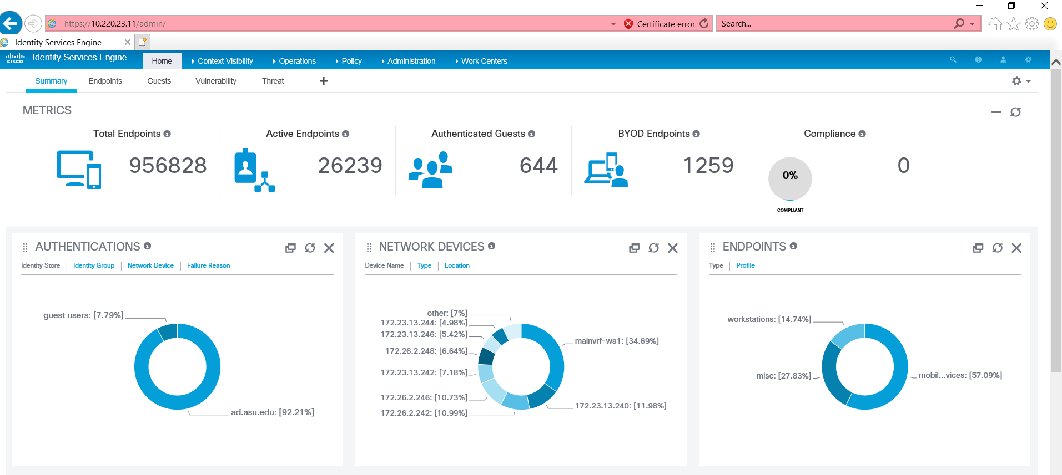
Troubleshooting Tools
Cisco ISE Dashboard

Slide 17
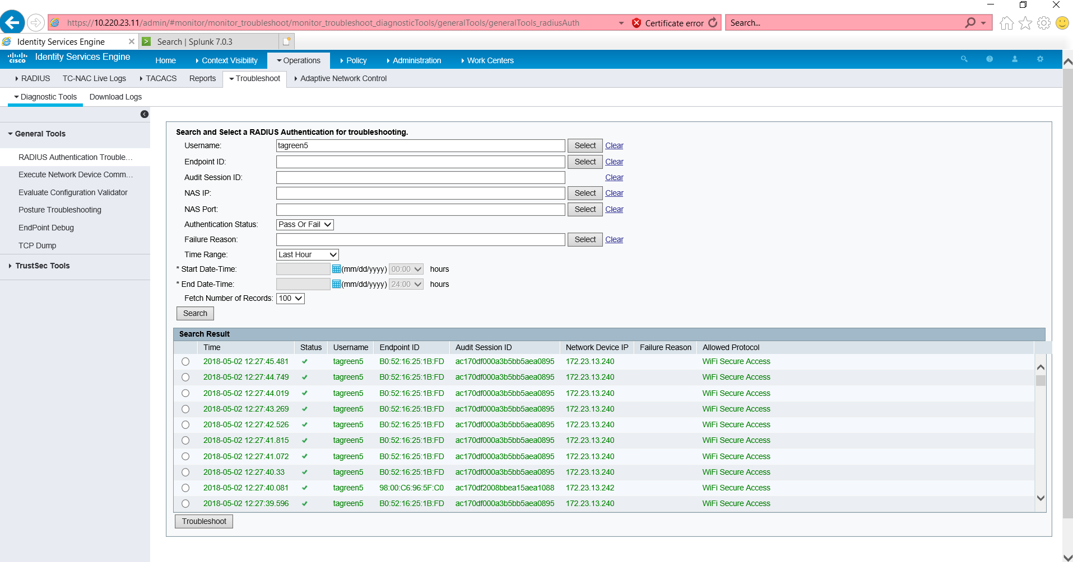
Troubleshooting Tools
Cisco ISE Radius Troubleshooting Log

Slide 18
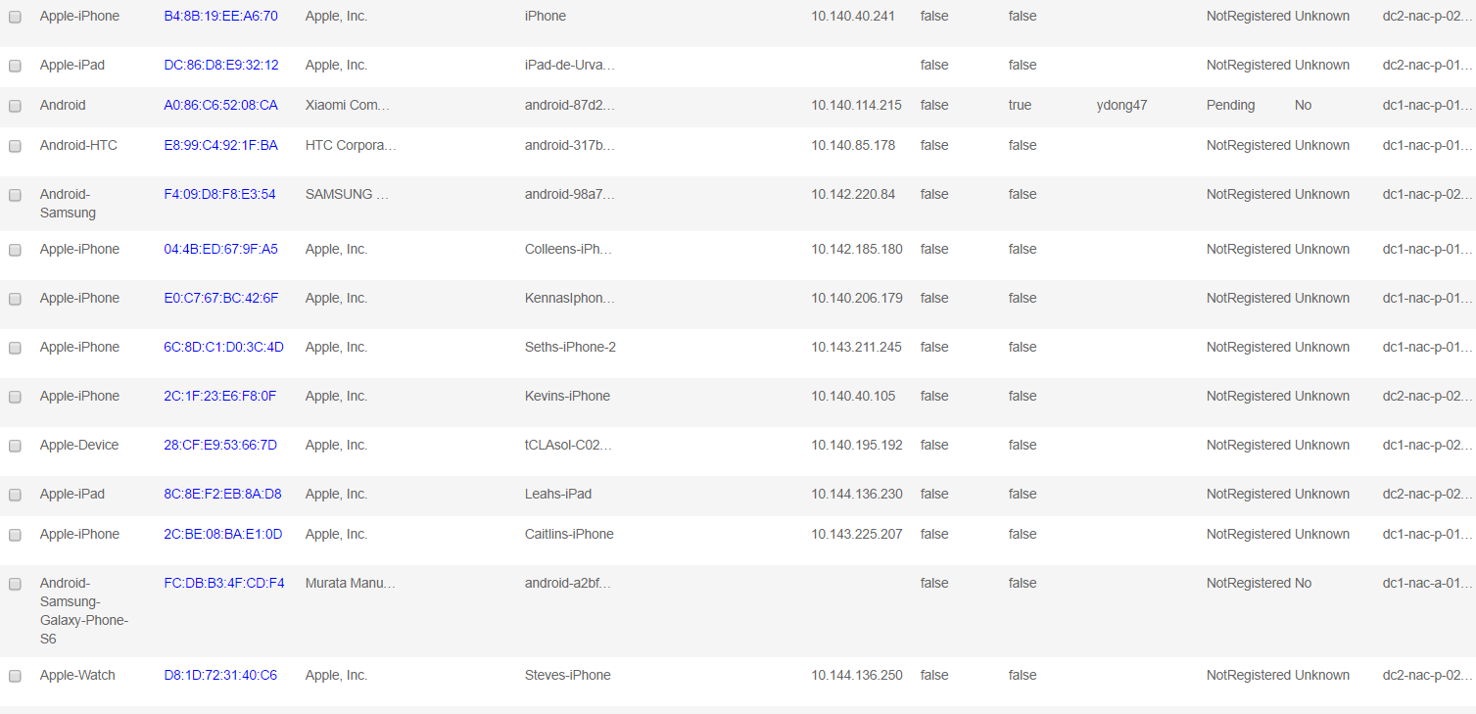
Troubleshooting Tools
Cisco ISE Identity Management

Slide 19
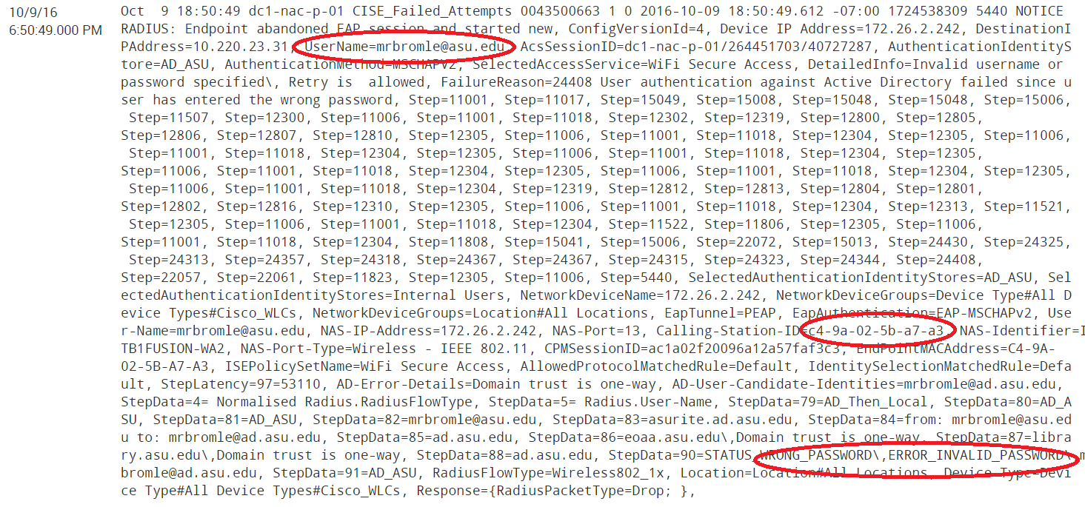
Troubleshooting Tools
Splunk Output on Query

Slide 20
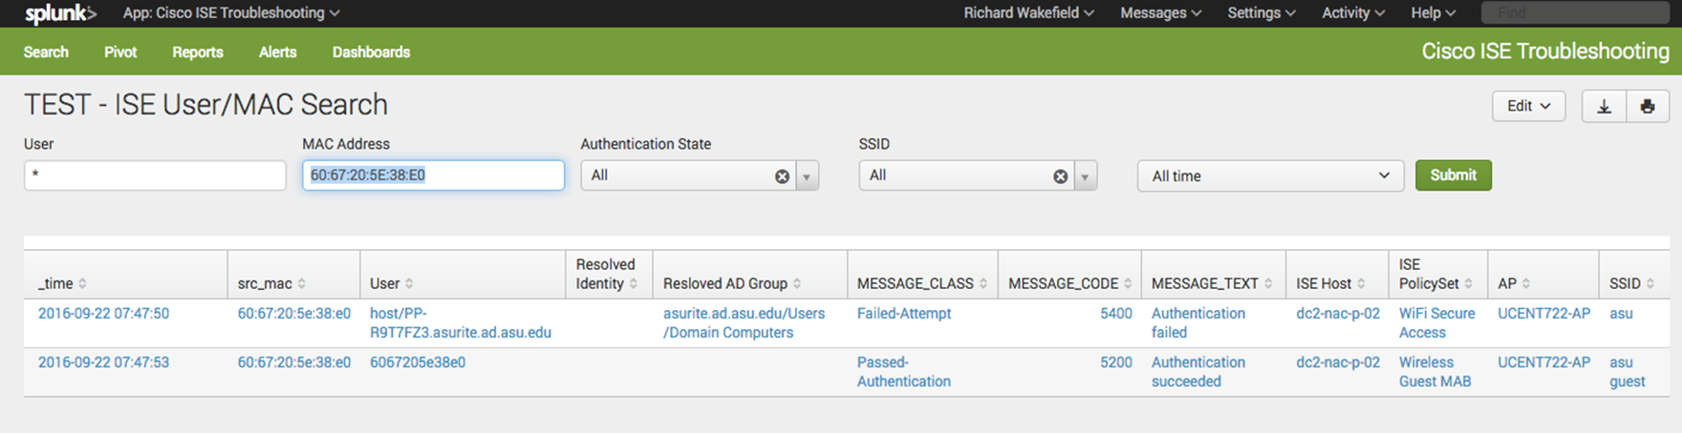
Troubleshooting Tools
Splunk Service Desk Dashboard

Slide 21
Troubleshooting Tools
Requesting Splunk Access via Service Now
Submit Service Now “Enterprise Infrastructure and Services/SPLUNK Access” catalog item with your user ID
Select “SPLUNK Access” and “SPLUNK Tier1 Support” access needed.

Slide 22
Questions?

