Slide 1
Click to begin image slideshow

Slide 2
EdPlus/Education for Humanity
ASU Empower Conference 2019
Nicholas Sabato
Director, Country Programs
Education for Humanity

Slide 3
Arizona State University Charter
“ASU is a comprehensive public research university, measured not by whom it excludes, but by whom it includes and how they succeed; advancing research and discovery of public value; and assuming fundamental responsibility for the economic, social, cultural and overall health of the communities it serves.”

Slide 4
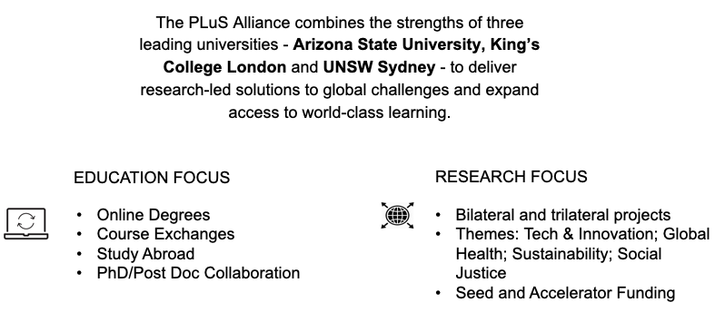
EdPlus Global Initiatives: PLuS Alliance
Notes:
Leverage Our Place
ASU embraces its culture, socioeconomic and physical setting.
Enable Student Success
ASU is committed to the success of each unique student.
Transform Society
ASU catalyzes social change by being connected to social needs.
Fuse Intellectual Disciplines
ASU creates knowledge by transcending academic disciplines.
Value Entrepreneurship
ASU uses its knowledge and encourages innovation.
Be Socially Embedded
ASU connects with communities through mutually beneficial partnerships.
Conduct Use-Inspired Research
ASU research has purpose and impact.
Engage Globally
ASU engages with people and issues locally, nationally and internationally.

Slide 5
EdPlus Global Initiatives- Al Ghurair Foundation for Education: Open Learning Scholars Program
Scholarship program that covers the total cost of university tuition and other mandatory university fees for eligible master’s degree
In line with AGFE's mission to create opportunities to activate the untapped potential of Arab youth, by providing underserved, high-achieving students with the scholarships, support and skills training that they need to thrive.
Has allowed us to discover and address the obstacles online international students may face while pursuing a formal degree online
Notes:
Google suites does not operate in Sudan
Accessing textbooks from anywhere in the world
Different naming conventions obscuring centralized systems
Lectures taking up too much bandwidth for the infrastructure

Slide 6
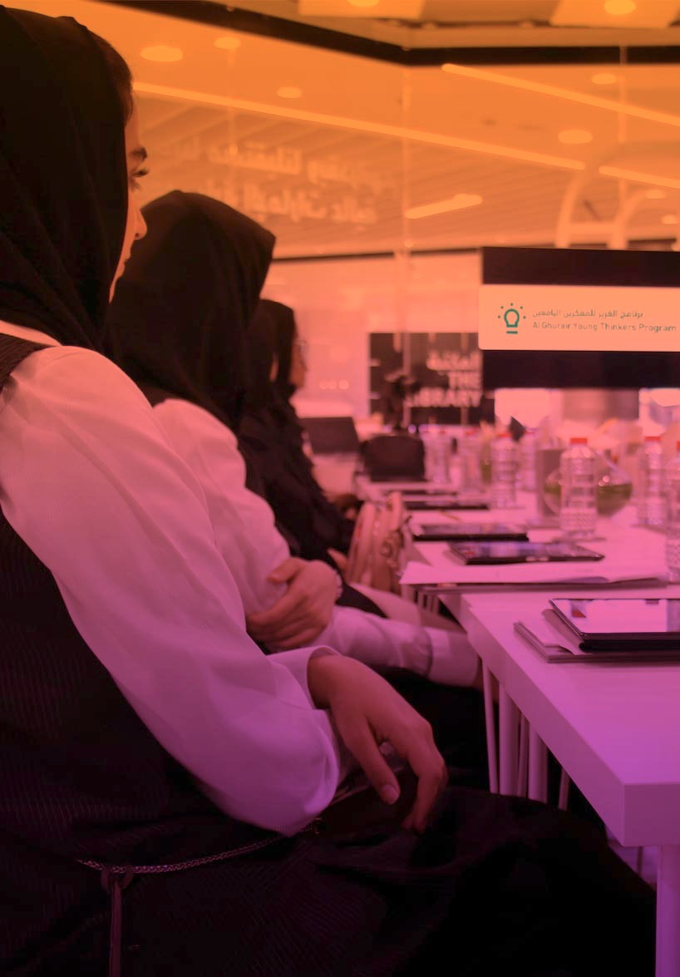
EdPlus Global Initiatives: Al Ghurair Foundation for Education Young Thinkers Program
Dual-language (English/Arabic) stand-alone platform:
Interactive, image-based me3 Career Exploration Tool adapted for the UAE
Customized Open edX LMS: 20+ College and Career Readiness Courses
Customized Rocket-Chat Tool:
ASU-trained, bilingual Success Advisors
Resource Channels with curated information about Universities, Careers and Announcements

Slide 7
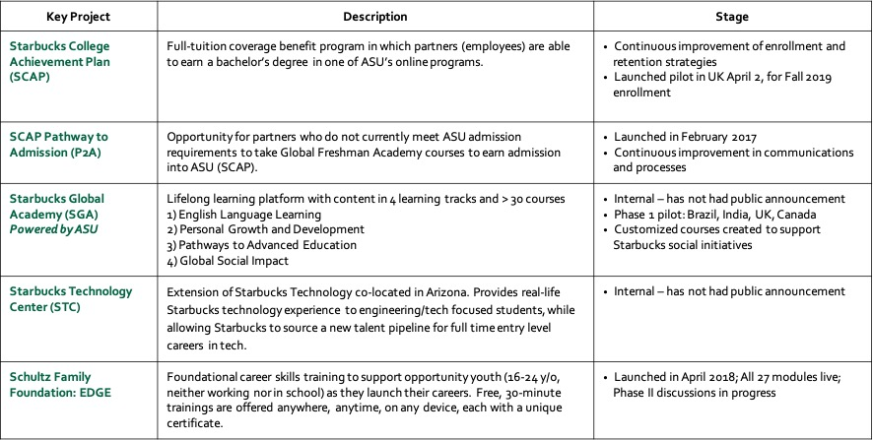
EdPlus Global Initiatives: Starbucks Partnership

Slide 8
EdPlus Global Initiatives: Baobab Mastercard Foundation Scholars Program
Social learning platform for:
*Collaboration *Learning *Mentorship
*Finding jobs, internships, scholarships & more
Technology consists of:
Custom Rails application with React/Redux front-end designed for Africa’s low-bandwidth infrastructure
Dedicated Open edX instance with 30+ self-paced short courses
Integration with customized version of open-source chat tool Rocket.Chat
iOS and Android mobile apps (React Native components & embedded web view)

Slide 9
Education for Humanity.
1%
refugees attending university
68.5 million
people displaced worldwide
44,500
average number of people displaced daily
Source: The UN Refugee Agency
Notes:
ASU has been recognized as the most innovative university in the US for the past 4 years in part due to our track record of social impact at scale. We are deeply committed to leveraging our open scale learning tools and expertise to contribute to alleviating this complex crisis.

Slide 10
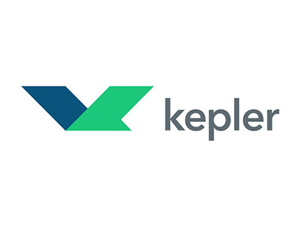
Education for Humanity.
Arizona State University (ASU) is working in collaboration with local organizations to provide postsecondary preparation through tech-enabled solutions that support refugee learners and local communities affected by displacement.
Notes:
President Crow prioritized the use of half of your generous donation to launch Education for Humanity as a way to discover what is possible in the arena of delivering high-quality educational resources to learners impacted by displacement around the world.
Our offerings and strategy have evolved organically through making hypotheses and testing those through conversations, focus groups, surveys, and other user-centric data collection methods. We began this process by taking an inventory of ASU’s digital assets, and presented the possibilities to local NGOs in areas where we decided to focus our efforts. We tried to strike a healthy balance of what was needed (local labor market), what was wanted (by the learners), and what we had (at ASU). And though there are many other factors to consider, this was a good guide for us as we set out to talk with refugees themselves, universities, and potential NGO partners.

Slide 11
Challenges to educating refugees
Industry Level
Refugees
Lack access to education opportunities and ability to earn credentials
NGOs
Focused on aid logistics, need to build capacity to meet educational needs
Universities
Lack funding and capacity to develop refugee pipelines

Slide 12
Challenges to educating refugees
Program Level.
Limited internet access, unreliable power
Time difference
Low attendance, high dropout
Gender norms

Slide 13
Developing responsive interventions.
Challenge | Digital Intervention
Lack of digital and information literacy | How to Be a Successful Online Learner
Language barriers | Learn English Now!
Lack of access to stable electricity and internet | 95/5 Model Powered by SolarSPELL
Lack of access to transcripts and official documentation | 1+3 Undergraduate Degree Pathway
Workplace readiness | Contextualized Certificates
Notes:
In response to that information, and the challenges outlined here, we are staging 4 interventions.
1) Many of our students have never taken an online class, and in some countries where we work, online learning is not well-understood.
a. To address this first challenge, we developed a four-module series that helps learners develop valuable time management and study skills, as well as familiarizes them with how to navigate a learning management system and helps them evaluate the validity of the sources they read online. This is our Be a Successful Online Learner series, or BSOL.
2) English level can be a barrier to attending an English-speaking university, or even most online universities.
a. Our Learn English Now! Courses are delivered mostly online, but feature in-person sessions at least twice a week.
3) The computer centers that we use, whether at our partner sites in camps or in community centers, can have slow or no internet connectivity with unpredictable power outages. There is also the challenge of limited use hours at the centers, and our undergraduate level courses can take up to 135 hours to complete.
a. To combat this challenge, we have experimented with a solar-powered educational learning library developed by Dr. Hosman here to build an agribusiness course that can be delivered 95% offline and utilize an internet connection 5% of the time. This has the ability to drastically reduce some of those barriers.

Slide 14
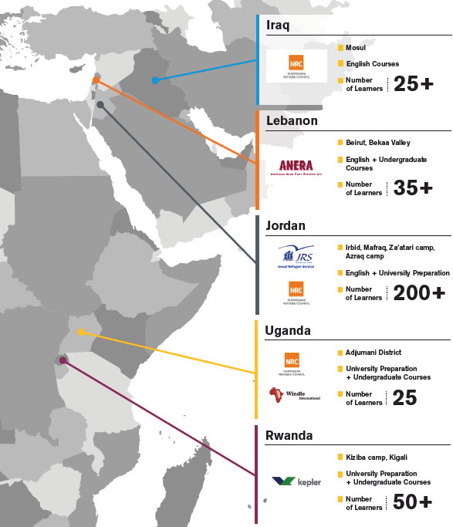
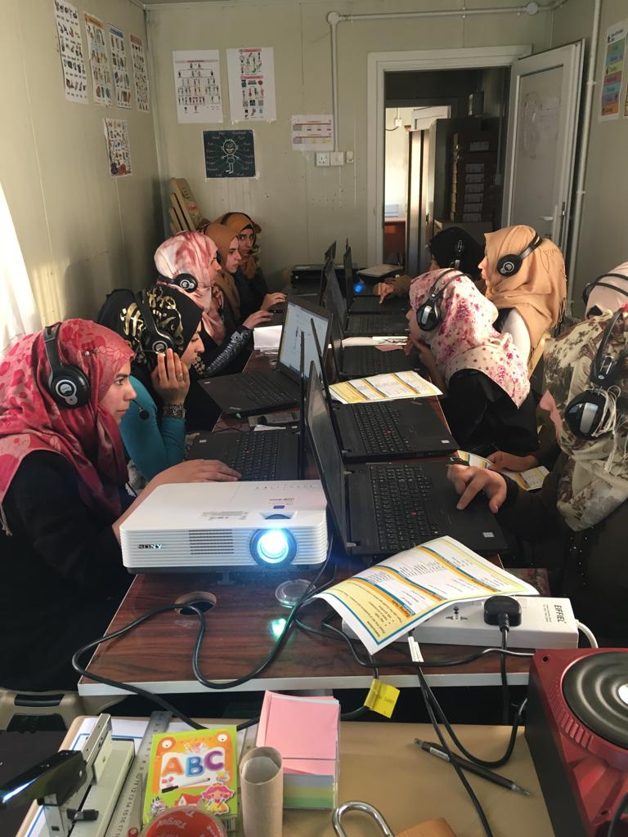
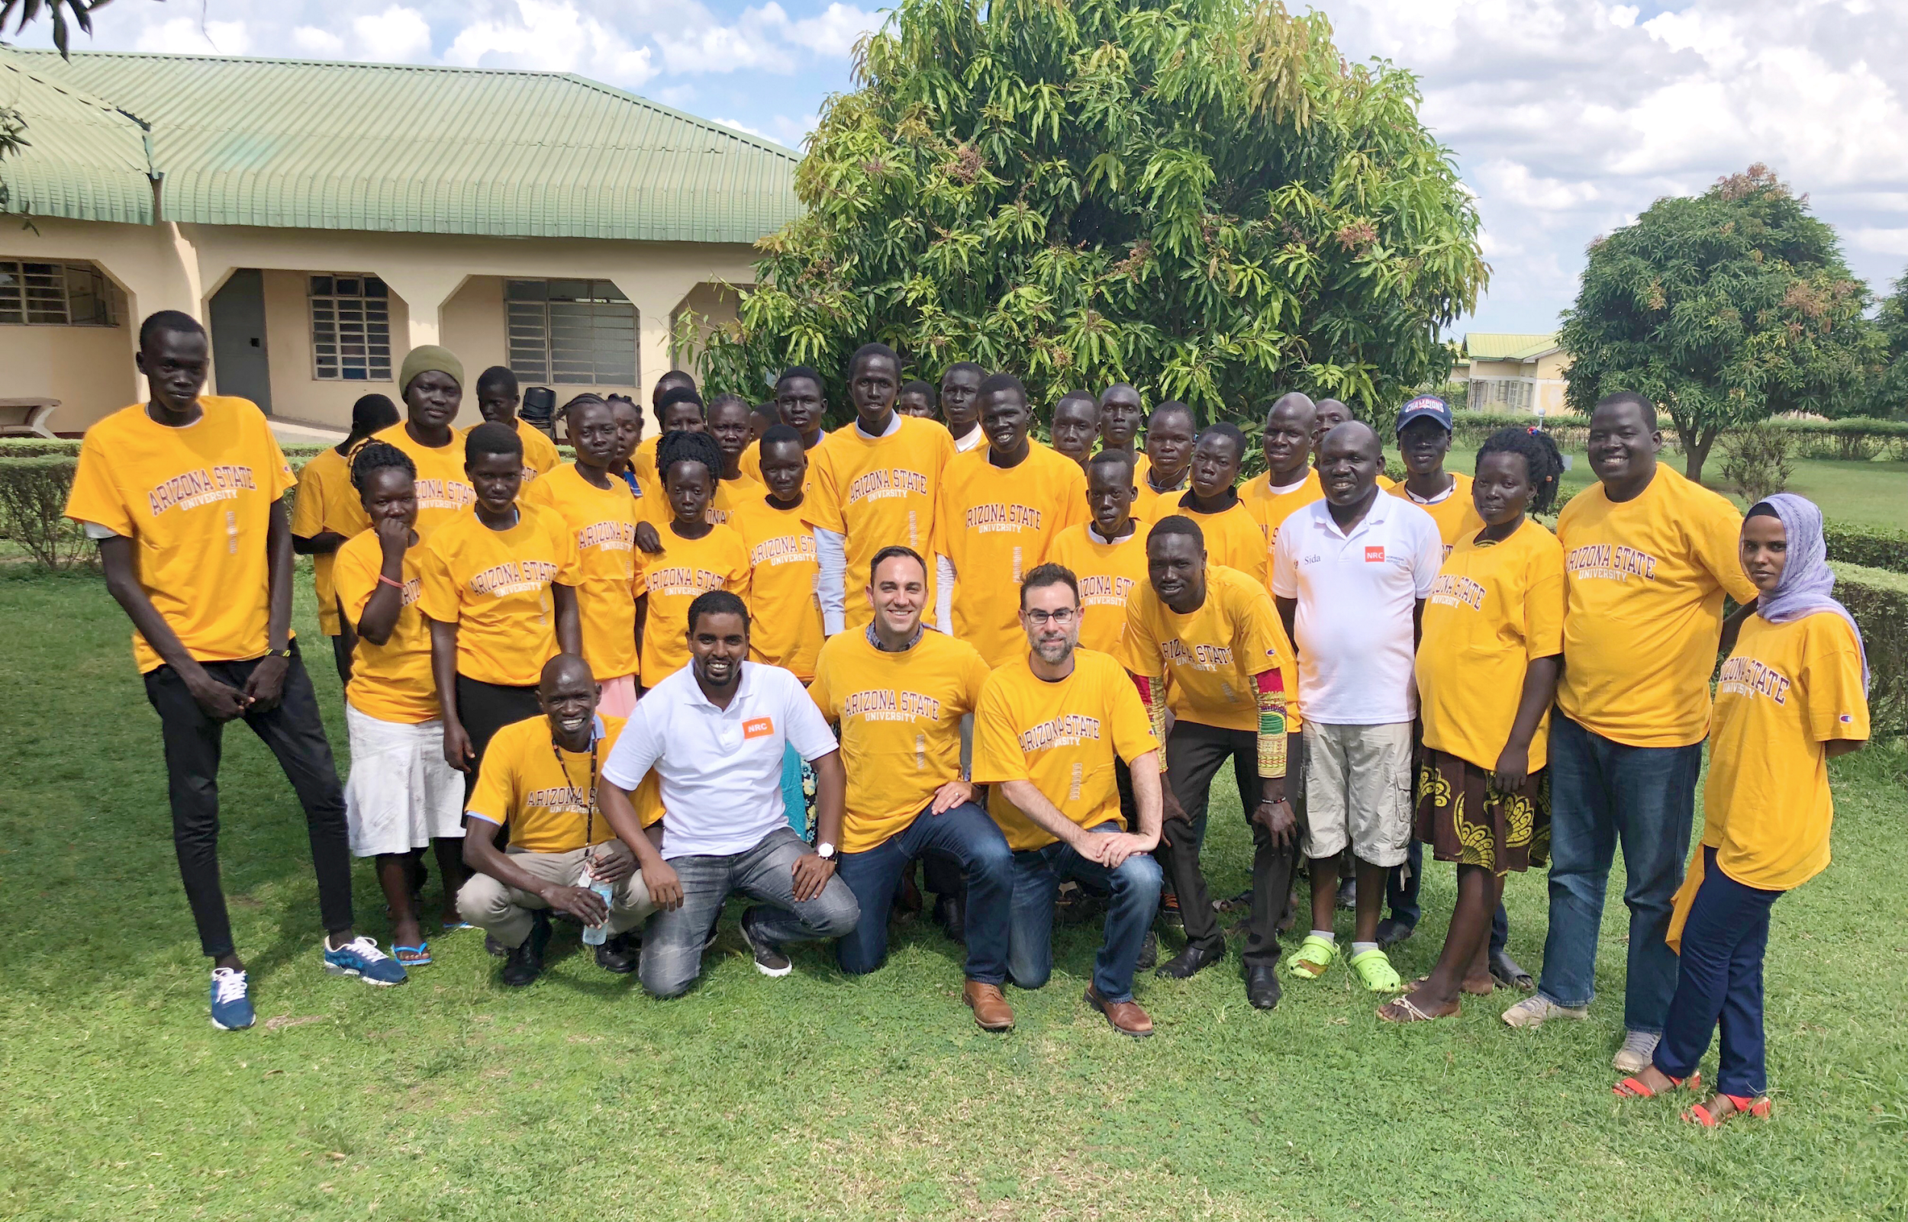
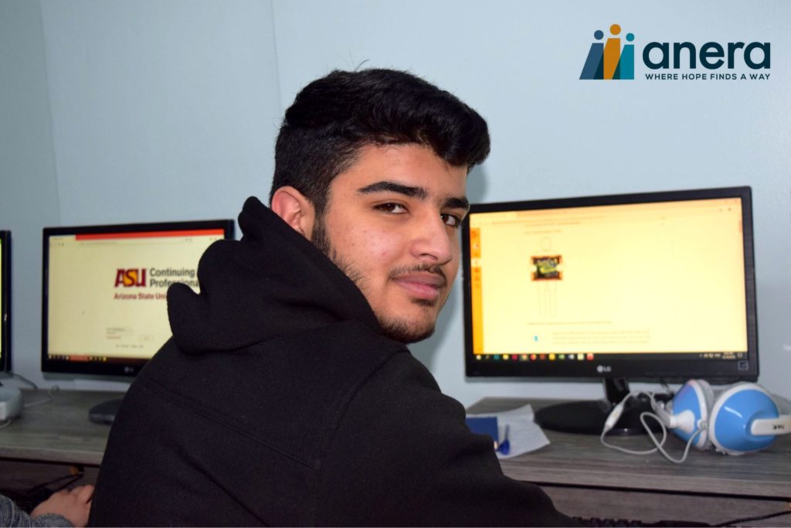
Current Programs
Notes:
Nearly 700 learners have engaged in our programs since 2017

Slide 15
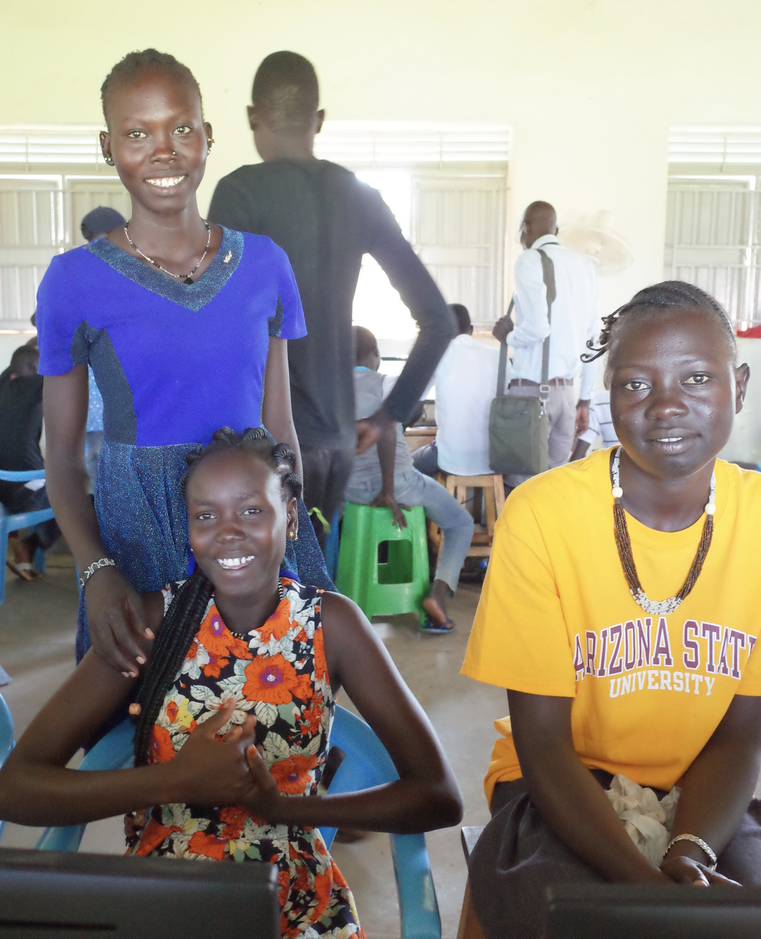
Current Programs
Learn English Now!
University Preparation
Undergraduate Courses
“I decided to enroll in ASU because it gives me an opportunity to go further with my studies. It has bridges the gap that had closed for me. After completing a university degree in banking or finance, I hope to work with NGOs providing education and financial support to refugees around the world”
-Akon, 20, South Sudanese Student
Adjumani, Uganda
Notes:
Scalable tertiary educational offerings

Slide 16
Pilot programs
Agribusiness certificate course delivered via SolarSPELL
Entrepreneurship
Online Masters of Applied Leadership and Management
“One student in my class learned skills that enabled her to sell her handmade art to tourists who came to Jordan”
-Ahmed, Course Facilitator
Irbid, Jordan
Notes:
Testing proven global programs with local partners on a small scale

Slide 17
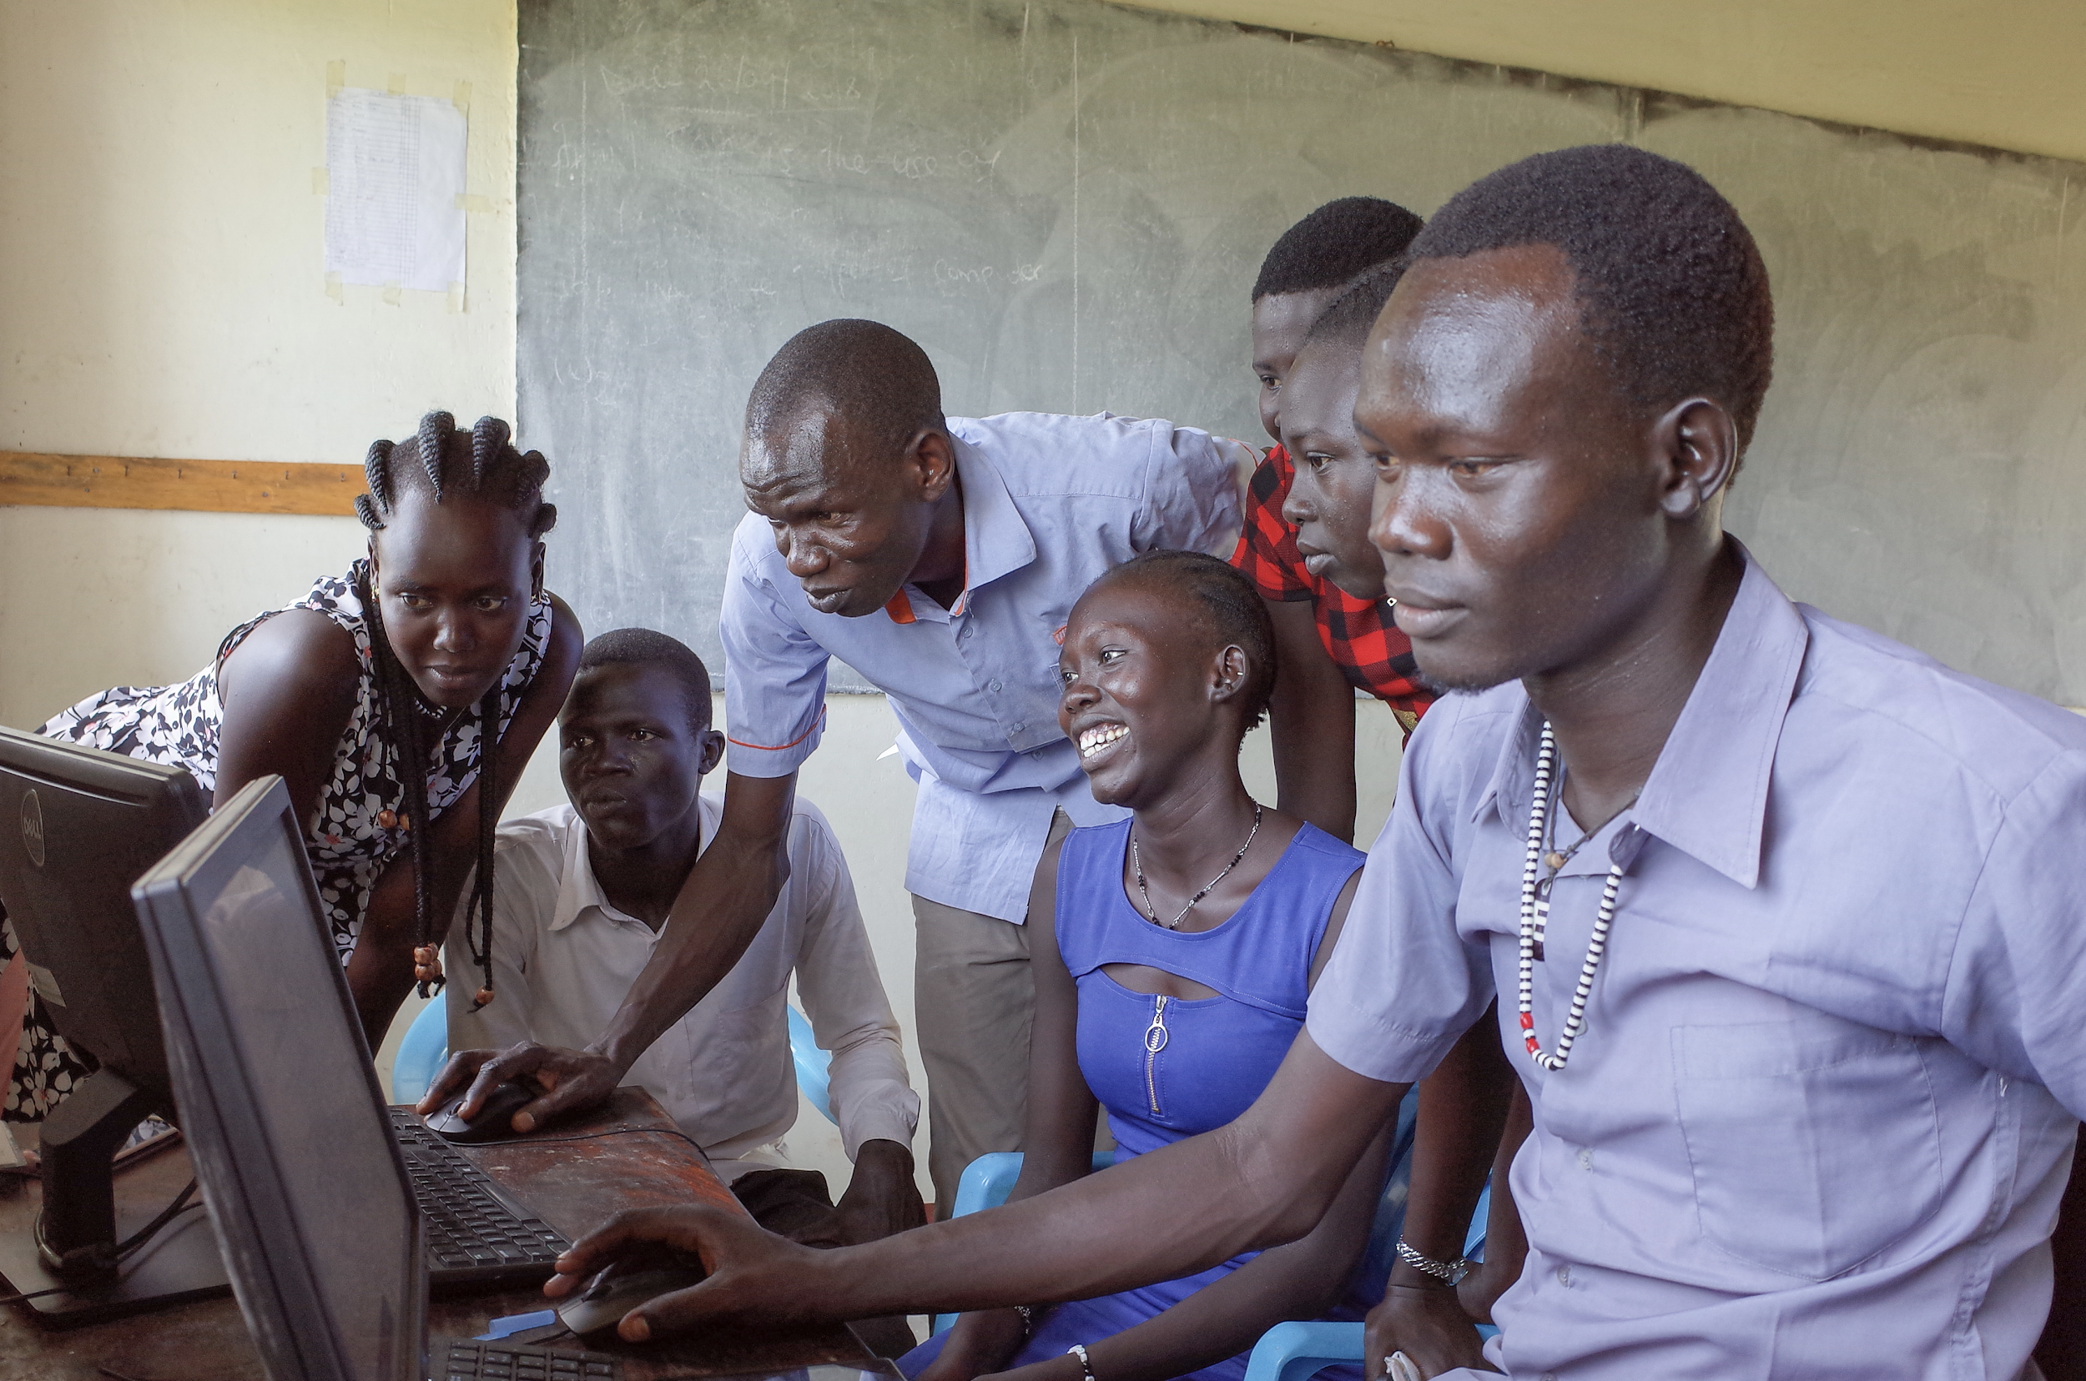
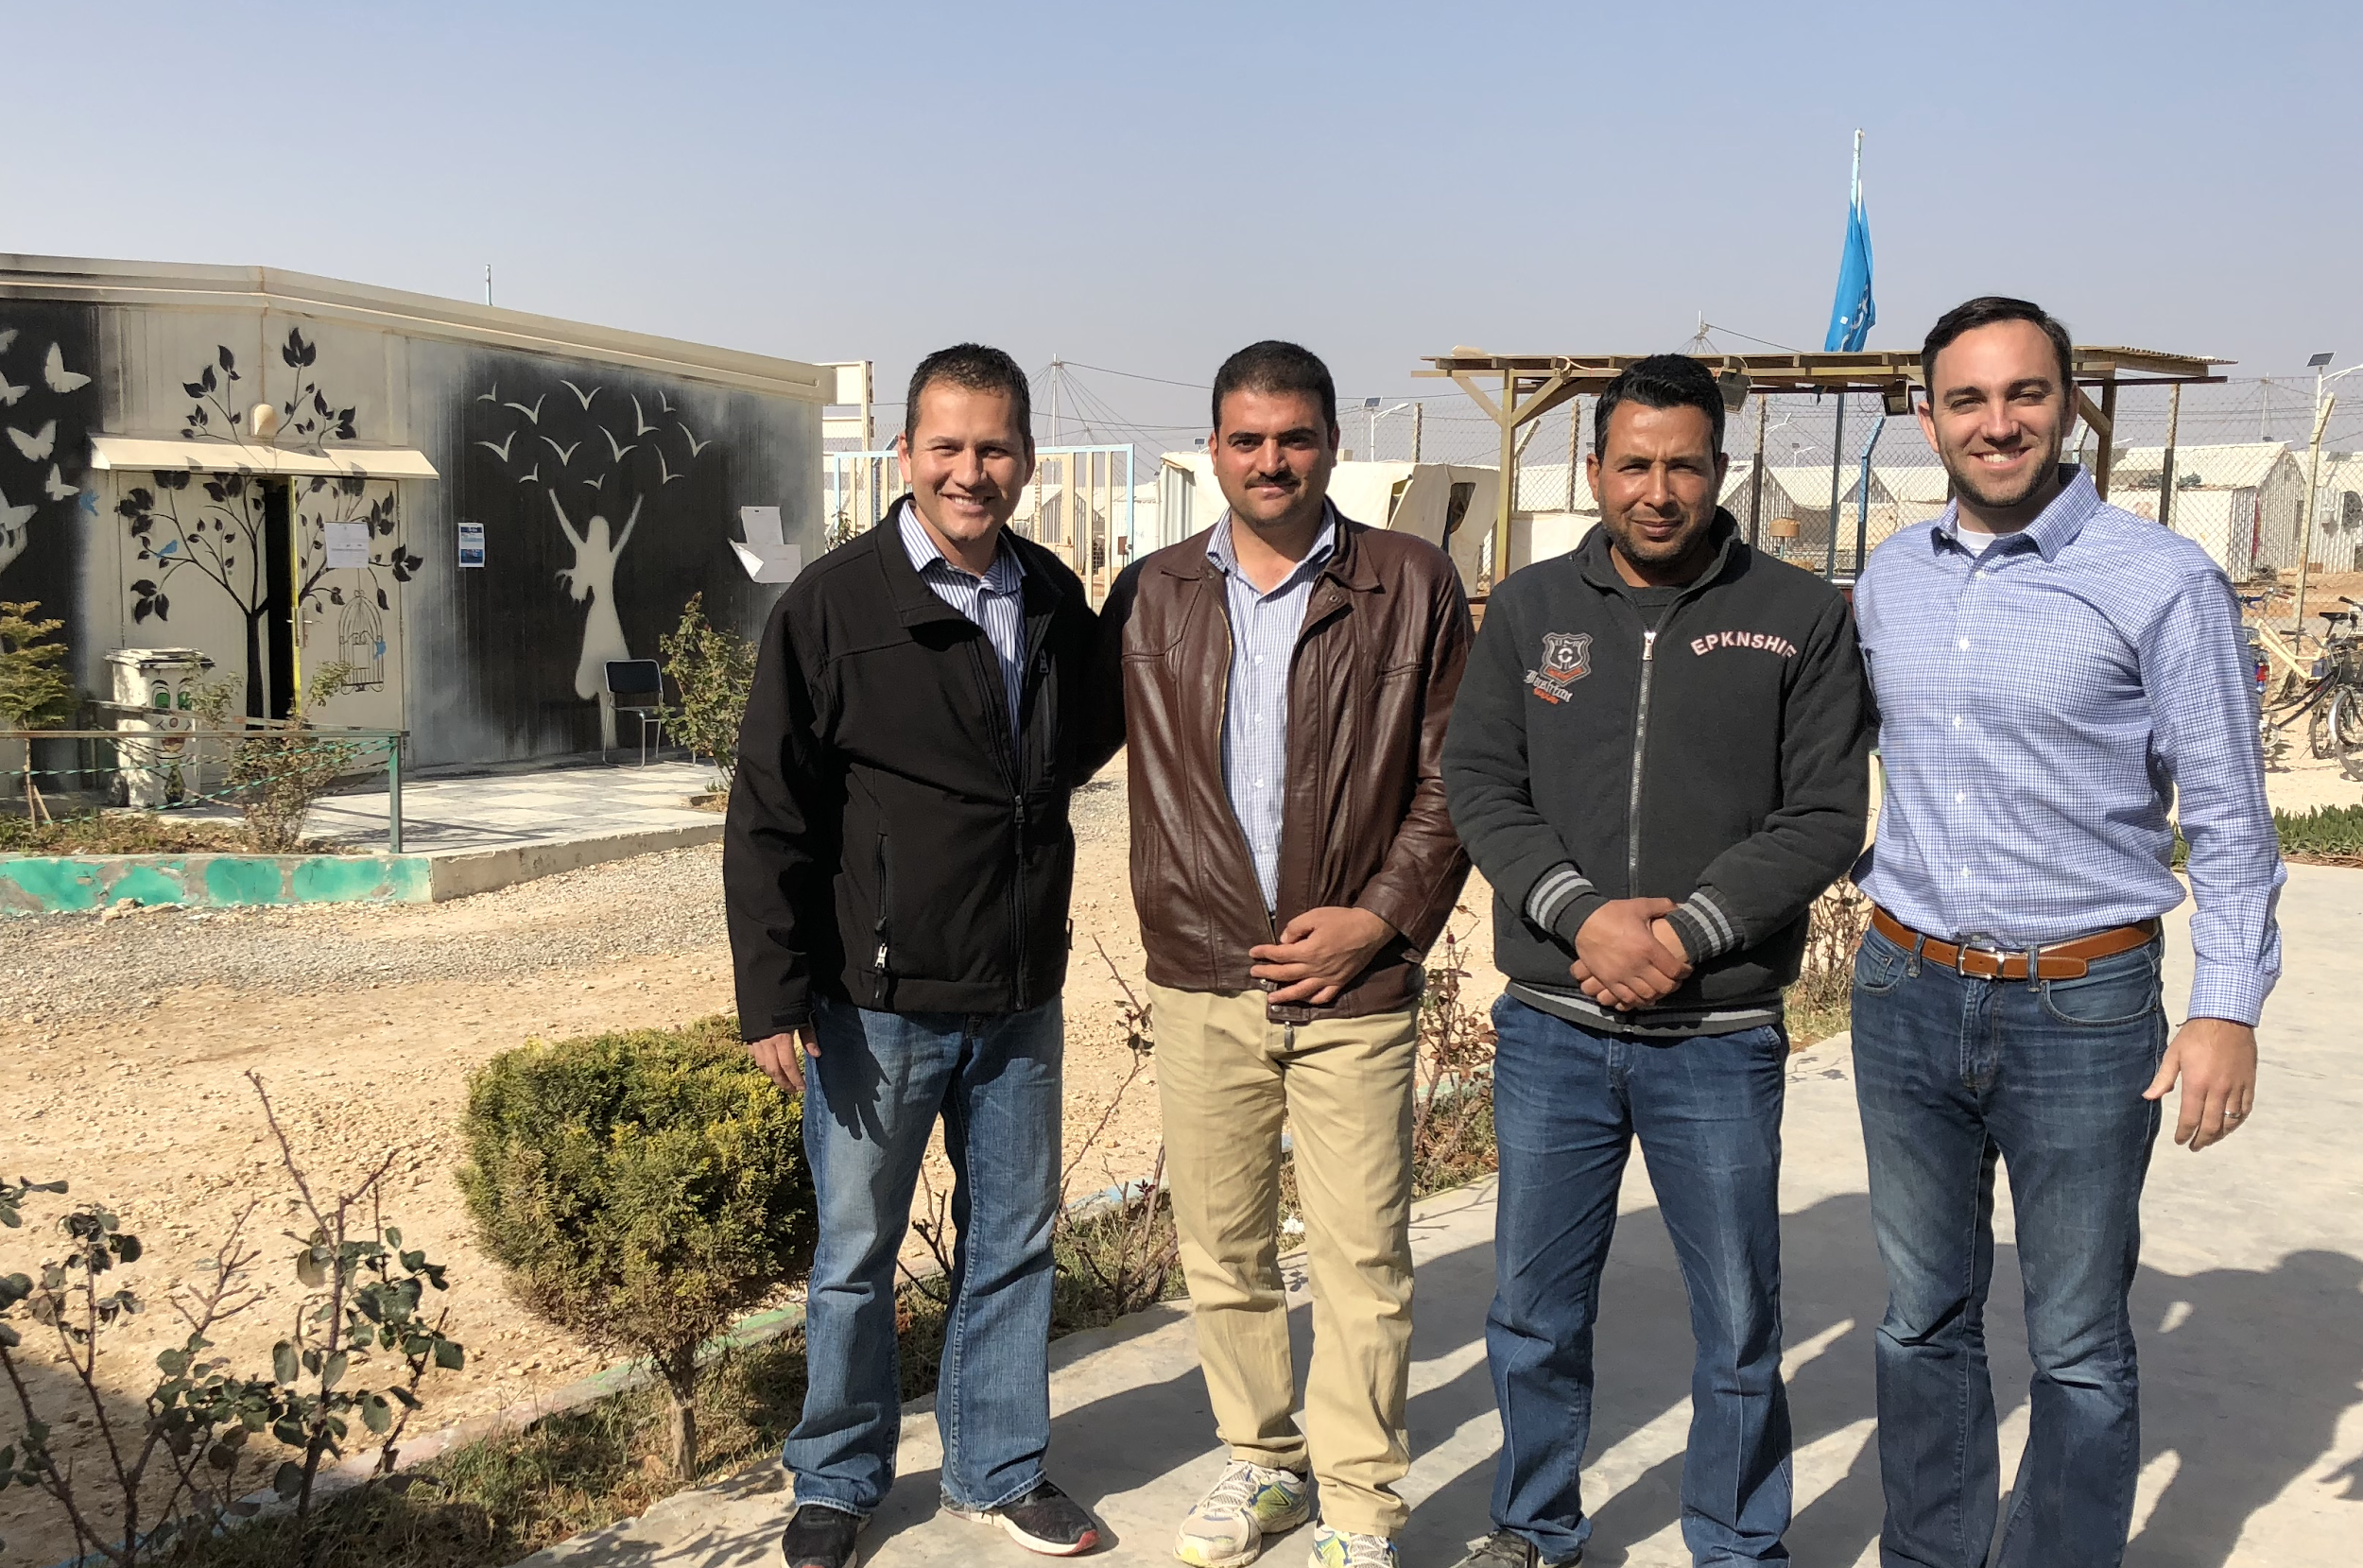
Future Programs
Facilitating the matriculation of learners into degree programs in the countries where they reside
Teacher training for educators working in crisis contexts
Continuing education options for NGO staff
Notes:
Extending reach thru expanded course options in more languages and addressing humanitarian ecosystem at all levels

Slide 18
Looking Forward
Accelerate awareness of the effectiveness of digital and blended learning
Advocate for the importance of higher education for refugees as a component of human resource development for both the host and origin communities
Address the humanitarian ecosystem at all levels
Extend our reach through expanded course options in more languages
Notes:
1) Not only are we offering online programs, but we have found ourselves introducing the idea of online learning to universities that have an old-fashioned notion of what university education is or can be
2) The majority of funding in the refugee education space goes to primary and secondary education
3) Several humanitarian aid workers who support refugees have also expressed to us that they are interested in understanding how to do this work better- they have asked about Master’s degrees and we think this is a great way to really address the humanitarian ecosystem at all levels
4) We are exploring how we might translate course materials into Arabic and French, as this will expand the populations we can serve

Slide 19
Education for Humanity at Arizona State University
@ASUed4humanity
nsabato@asu.edu

