Slide 1
Virtual Simulations in the Biological Sciences
Empower 2019

Slide 2
How do we teach lab science online to a geographically distributed student population?
Notes:
Points to mention
Scale
Access

Slide 3
Why virtual simulations in the sciences
Simulations allow learners to test their hypotheses of the effects of input variables on the intended outcomes (De Jong, 1991; Tobias & Fletcher, 2010)
Simulations can provide cost-effective practice of procedures using virtual apparatus that in real life could be cost prohibitive (Lalley et al, 2010).
VR affords investigation of distant locations, exploration of hidden phenomena, and manipulation of otherwise immutable structures (Lee & Wong, 2014).
Notes:
Plenty of research to back this up, but here are a selected few. Talk about immersion and presence, the feeling of being there, and its impact on the learning experience.

Slide 4
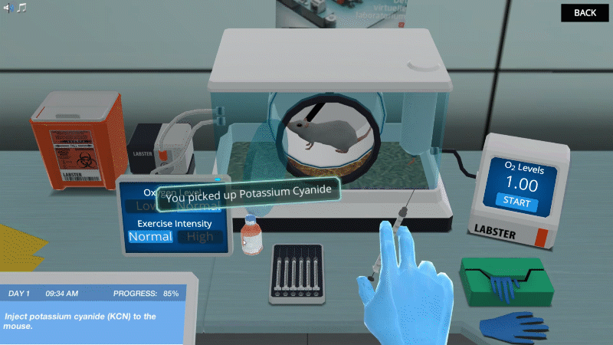
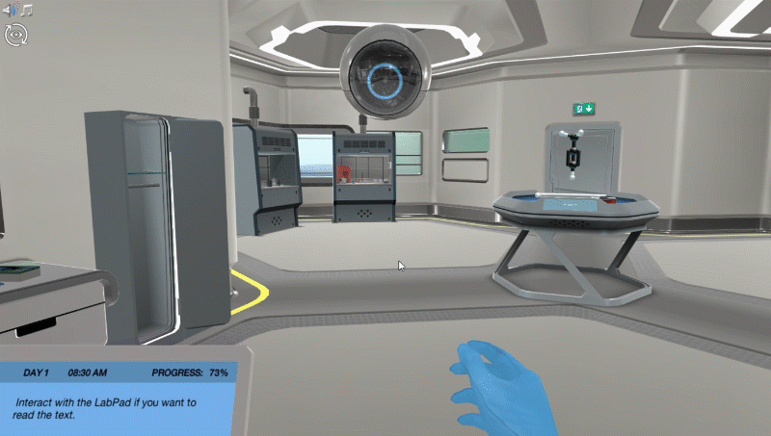
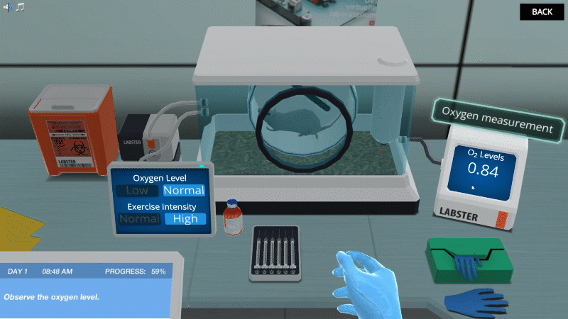
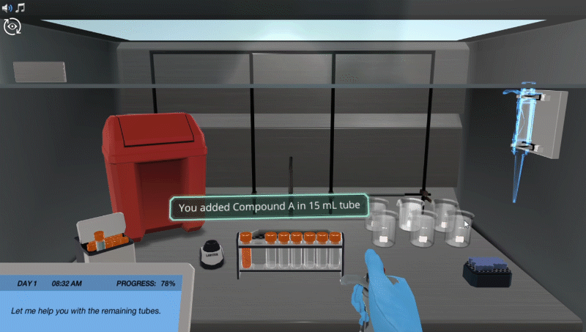
Work with animal models
Difficult today in real laboratories
Give students unlimited lab access
Too expensive for schools in real labs

Slide 5
The Partnership
License
Develop
Develop and market
Supply headsets
Notes:
Talk about headset distribution

Slide 6
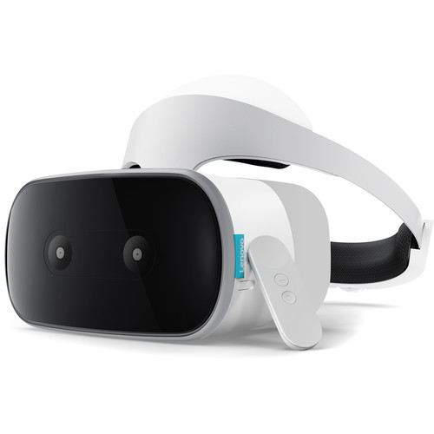
Notes:
Lenovo Mirage Solo VR Headset
1st standalone Daydream headset

Slide 7
Pilot and future plans
World’s first fully only biology degree powered by virtual simulations launched officially in Fall 2017.
VR pilot in BIO 181 General Biology with 30 students in Fall A 2018
BIO 394 Animal Physiology (Fall B 2018)
BIO 451 Cell Physiology (Spring B 2019)
BIO 321 Ecology (Summer A 2019)
Currently 700+ students enrolled in the degree.

Slide 8
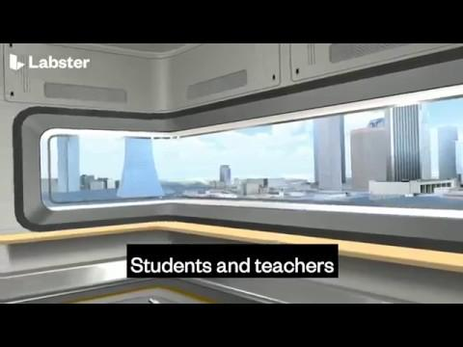

Slide 10
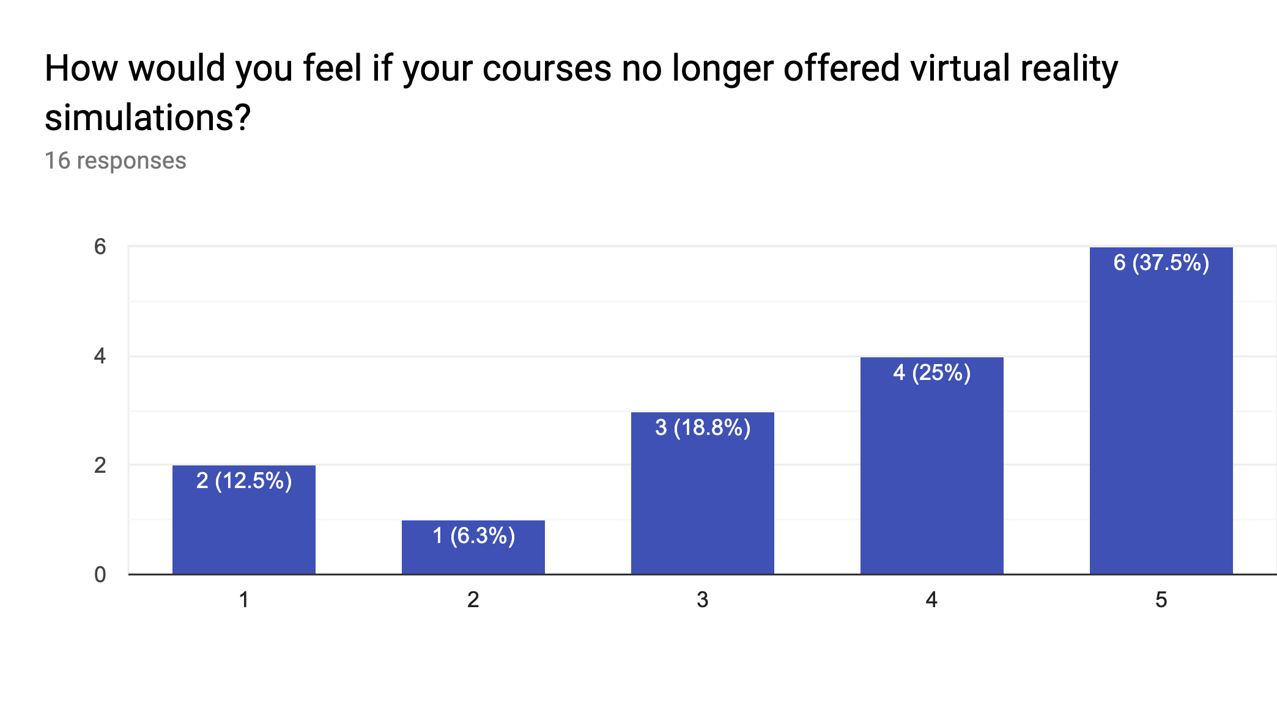

Slide 11
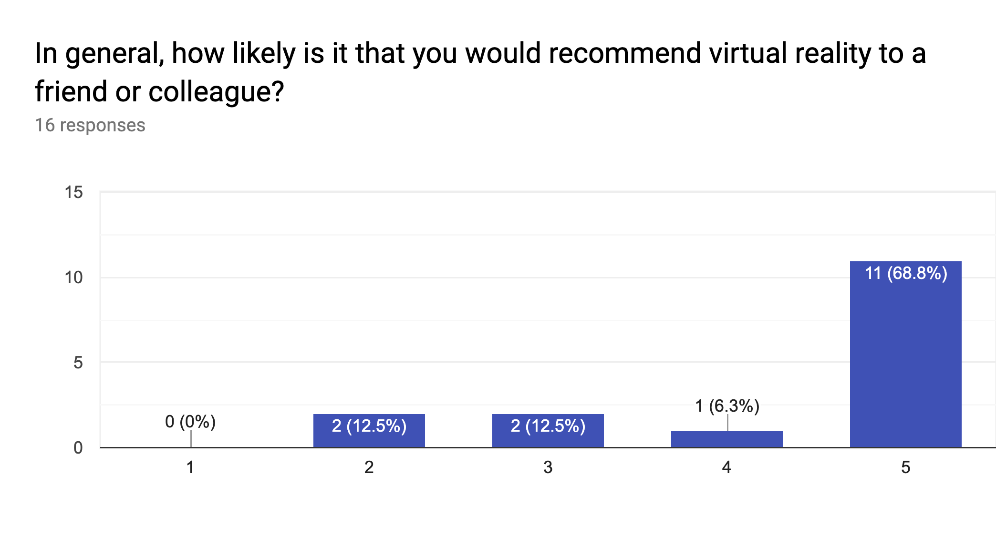

Slide 12
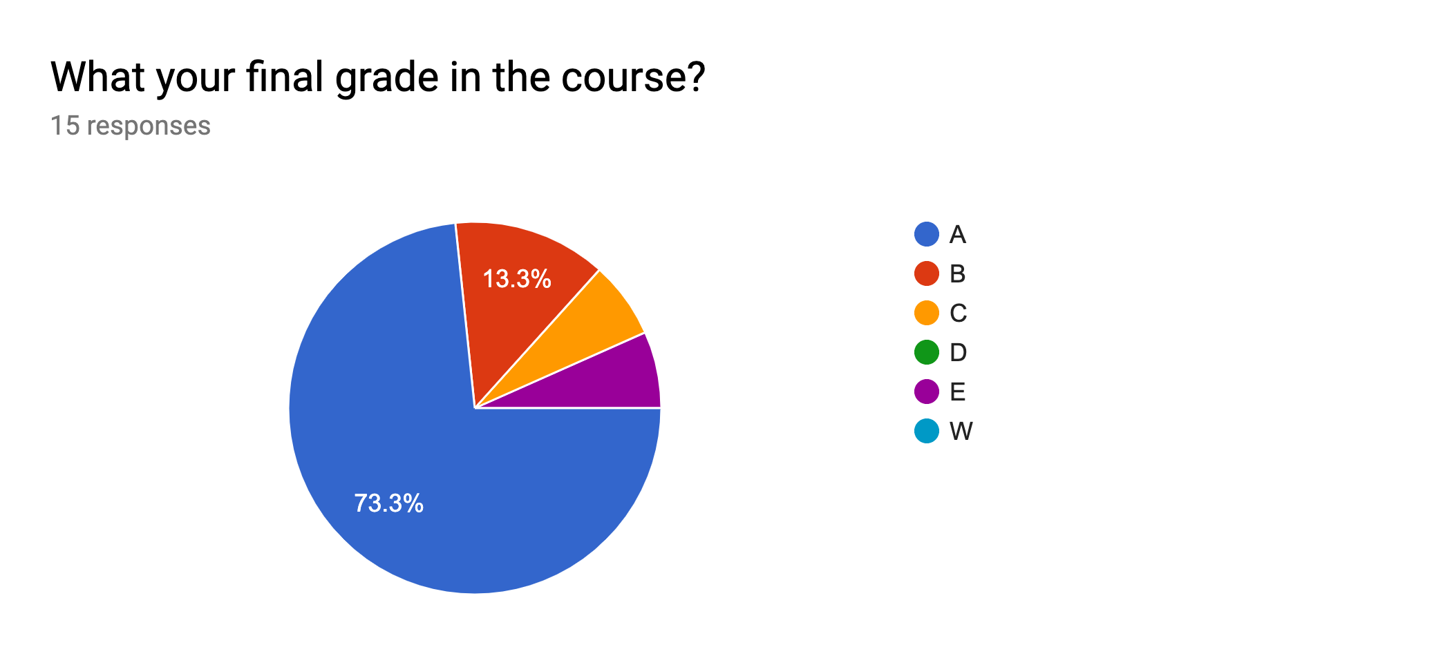

Slide 13
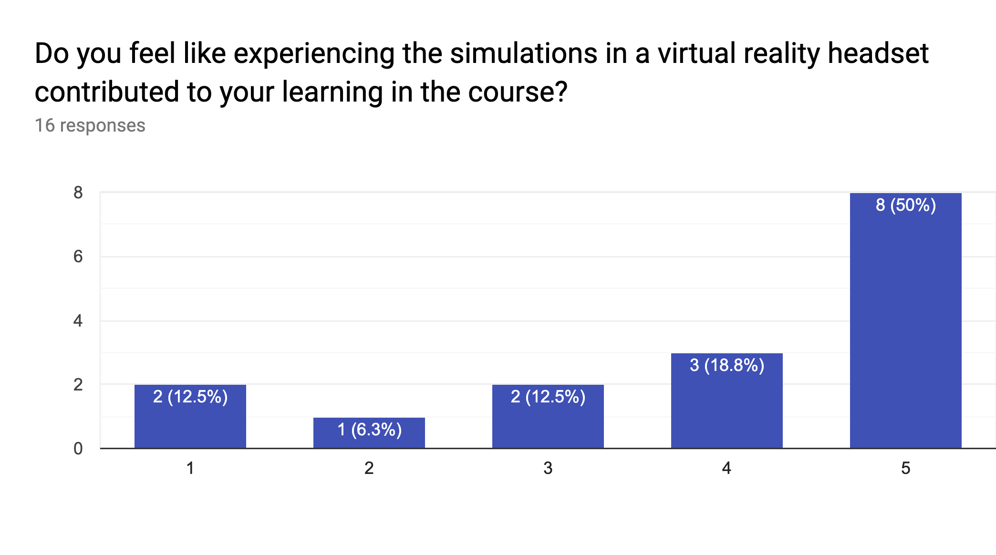

Slide 14
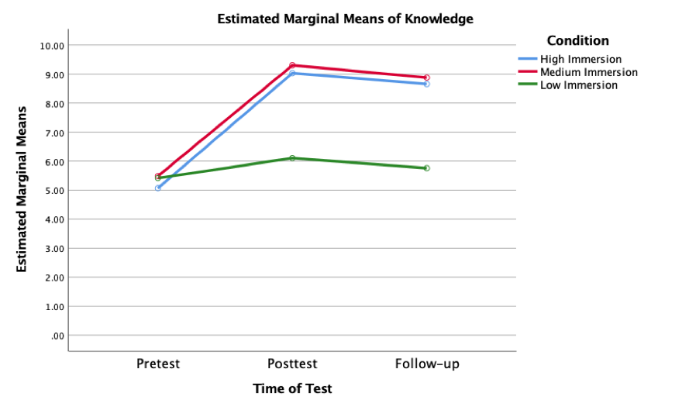

Slide 15
Positive student feedback
What I liked most was feeling like I was in an actual lab. During the cellular respiration lab, it took you inside the mitochondrial matrix, and let you see the electron transport chain and you felt like you were actually there!
I felt more involved with the lab then when I did it on the computer. I was able to concentrate on the material without distraction.
The VR headset made the labs more engaging and realistic. It is also very fun to use. The labs were far from completely realistic but it was useful for real-world lab situations. I feel that it was a lot more engaging than compared to the other labs which were completed on a computer.

Slide 16
Not positive student feedback
That it was only available for 2 labs instead of them all.
I didn't hate it, but I do wish there were more labs available for this Bio 181 course.
The technology was definitely new to me. It was hard to use and navigate at first; however, it got easier with time.
The connection was lost easily. Once this happened, an error message would occur and there was no way to restart the lab from where I left off. Instead, I had to log out and begin the process. It became too time consuming, at which point I stopped using the headset and solely used the desktop website.

Slide 17
What we learned
VR is not for everyone
Students who experience it love it
Solve a problem
Design for the user

Slide 19
Virtual Simulations enable learners to experience situations that are otherwise inaccessible. They can travel in time and space, experiment and explore complex environments that are physically inaccessible and sometimes dangerous.
Notes:
Safe environment where students can try, fail, learn and gain confidence.
You feel like you are there.
Students work through real-life experiences.
Experiences that are difficult or impossible to do in a face-to-face course.

