Slide 1
Key Performance Indicators
by Sean Dudley
Empower 2019

Slide 2
token
introductory
quote
“What gets measured, gets managed.”
- or -
"If you can't measure it, you can't manage it."
Peter Drucker

Slide 3
Where to start
Service Level Agreement
What we deliver, who we serve, to what extent we provide
Intake Management
Capture and log every service interaction
Workflow Monitoring
Ensure duration, transitions, outcomes are being tracked
Establish ‘why’
Connect service delivery with the overall mission
Train and educate
Quality and process is guaranteed by everyone

Slide 4
What’s next
Set goals with your key stakeholders
Gather quantitative and qualitative data
Develop Key Performance Indicators
Routinely re-evaluate cost vs benefit

Slide 5
What are they?
A few common reasons to deploy KPIs
Support continuous improvement
Promote individual and organizational agility
Provide transparency to stakeholders
Identify ways to enhance capacity
Maintain financial awareness
Add resources, assign merit and promotions
Monitor adherence to best practices
Detect changes in workload type and volume

Slide 6
Common pitfalls
Degree of effort capture does not allow for meetings, micro-requests, food, restroom
Failure to collect appropriate data
Customers or staff are overly interrogated
Service agreement lacks a ‘best effort’ component
Metrics report state of affairs
Management response is mandating instead of coaching

Slide 7
Common pitfalls
Overly prescribed existence
The death of creativity among staff
Improper communication and execution
“We need you to start logging your time”
Failure to integrate the customer as the purpose
“Why are you not getting as much done”
Instills transactional thinking
Encourages cherry-picking

Slide 8
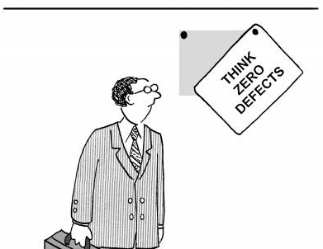
Common pitfalls
Failure to socialize and continuously improve measures
Cost vs benefit is not revisited
Work instructions are compounded instead of streamlined
Forget to baseline
Lack of proper control considerations, such as …
differing proficiency levels
workload disparity
other outcome-impacting heterogeneity

Slide 9
A few practical examples

Slide 10
A quick aside
KPIs are surprisingly uncommon among university-based research administration organizations and are only recently gaining widespread interest
Almost a decade ago we spent two years revising and stabilizing processes by developing work instructions, KPIs, and other mechanisms as preparation for automation to ‘avoid doing bad things more quickly’
KED implemented a comprehensive quality framework to further integrate continuous improvement with our process structures and culture, becoming the first ISO 9001 certified research operations organization in the United States

Slide 11
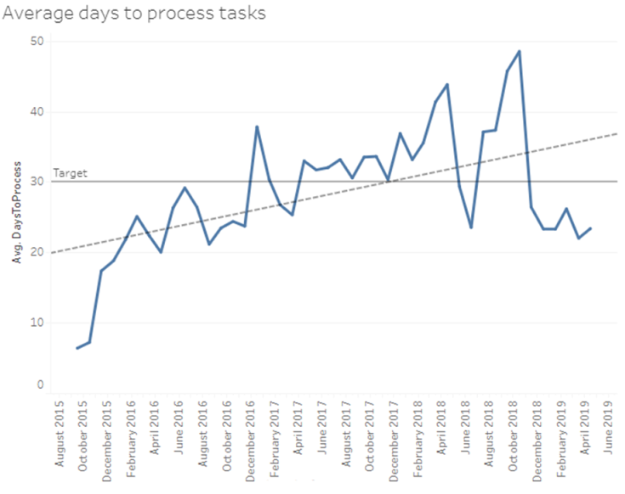
Processing Agreements - Quantitative
What do we see?
Volatility became a significant issue before the average eclipsed our 30-day target
What else could be done?
This activity involves multiple parties: identify duration among each party
Break out by agreement type and any other differentiating factors

Slide 12
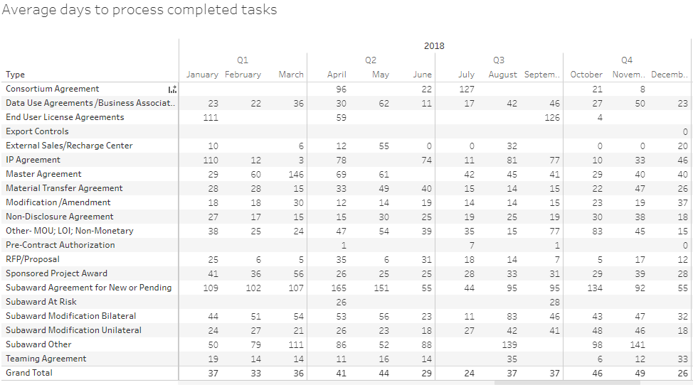
Sample Supporting Insight

Slide 13
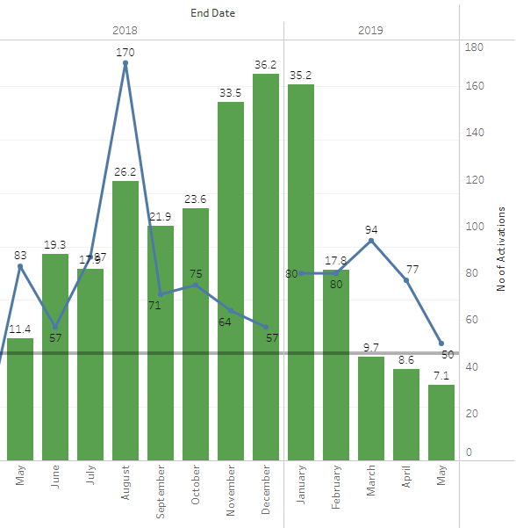
Award Activations - Quantitative
What do we see?
The implementation of new award management and financial systems
How does this help?
Understand the degree of impact to customers to drive outreach
Evaluate the efficacy of new solutions

Slide 14
Research Editing - Qualitative
What do we see?
Non-prescriptive, non-assumptive questioning
How does this help?
Illustrate buy-in for an emerging service
Pair with metrics to isolate what is working and what is not, subjective experience outweighs measurement

Slide 15
Further improvement
Develop and manage work instructions
Team-level assertion or modification checkpoints
Evaluate outliers, examine volatility
Assess outcomes across the same activity type to determine where training is needed
Employ a ‘working managers’ model
Offers continuous evaluation of methods and a qualified escalation path for KPI-impacting ‘rabbit holes’
Empower the customer and the front line

Slide 16
Additional recommendations
Join the Organizational Excellence Community of Practice (OECoP)
Led by Clayton Taylor
Consider deputizing local team members
Explore Six Sigma for Service, ITIL, etc
Learn to use Tableau and leverage analytics.asu.edu
Understand the fundamental structures of quality systems such as ISO 9001

Slide 17
Polling
How many of you have KPIs in place that you use to drive change
How many of you have taken or are interested in process improvement training
How many of you are interested in implementing KPIs for your group

Slide 18
Questions & Audience Experiences

